Slide 1
Comparison of GFS, FV3 and MPAS
NCEP/EMC Global Climate and Weather Modeling Branch
May 23, 2016
1

Slide 2
Forecast-only experiments were run by FV3 and MPAS developers using a subset of operational GFS 00Z-cycle initial conditions from 20150116 through 20160116, with an interval of 5 days. Each forecast was run for 10 days. Output frequency is 6 hourly.
ESRL converted FV3 and MPAS forecasts into NEMSIO format.
NCEP-EMC ran Unified Post Processor to produce grib2 files on T1534 Gaussian grid. WGRIB2 was then used to interpolate the data onto 0.25-deg and 1.0-deg lat-lon grids for verification.
FV3 and MPAS forecasts were verified against operational GFS analyses for computing AC, RMSE and Bias skill scores, against station and rawinsonde observations for grid2obs verification, against CPC gauge observations for computing precipitation ETS and Bias scores, and against CCPA and CPC Gauge observations for making precipitation maps. Verification of hurricane track and intensity forecast is also included.
Results are posted at http://www.emc.ncep.noaa.gov/gmb/wx24fy/nggps/. Password for accessing this site is nggps2016.
2

Slide 3
Outline
Verification against operational GFS analyses
Verification against surface station and rawinsonde observations
Precipitation ETS and Bias scores
Hurricane track and intensity
Forecast maps
Precipitation maps

Slide 4
500-hPa Height Anomaly Correlation
NH, die-off curve
NH, day5
SH, die-off curve
SH, day5
4

Slide 5
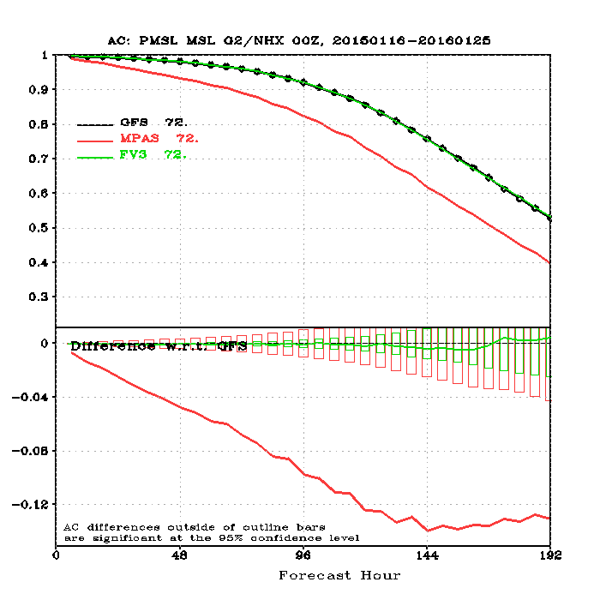
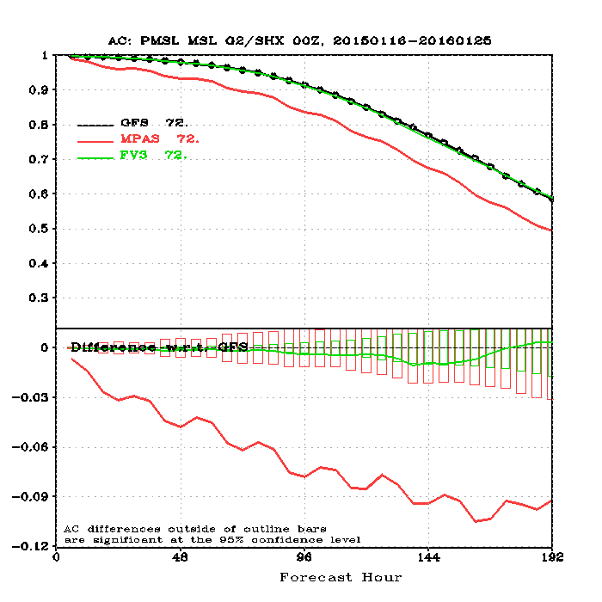
Sea-Level Pressure Anomaly Correlation
NH
NH, day5
SH
SH, day5
5

Slide 6
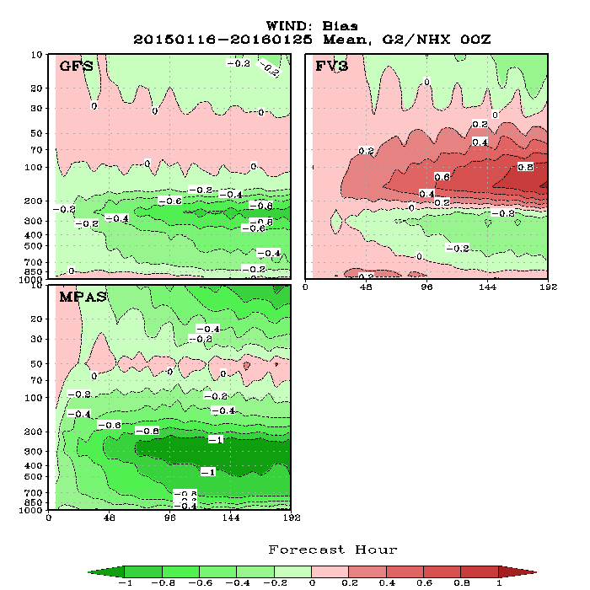
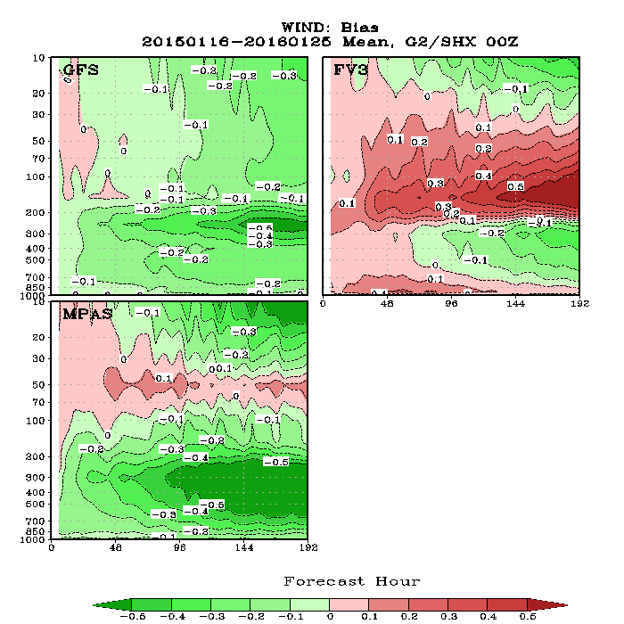
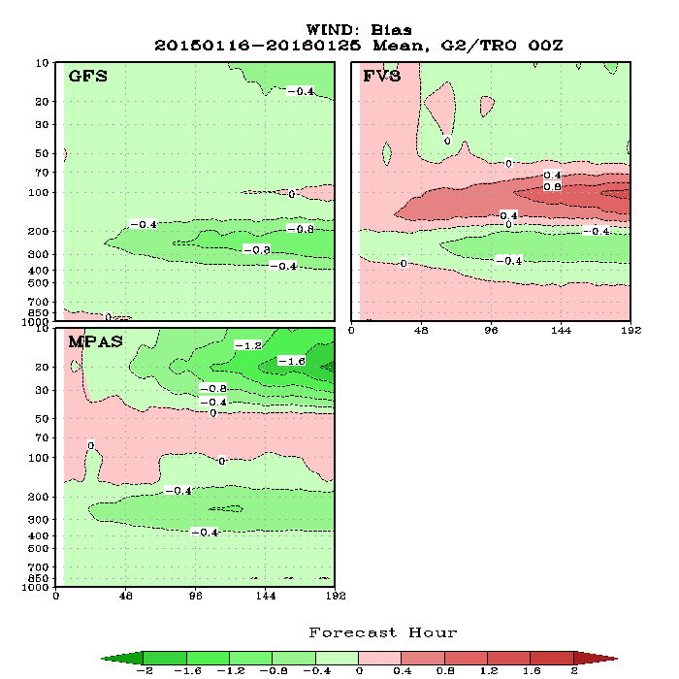
Wind Speed Bias Verified against Analyses
Pressure (hPa)
NH
SH
Fcst Hour
Pressure (hPa)
Tropics
6

Slide 7
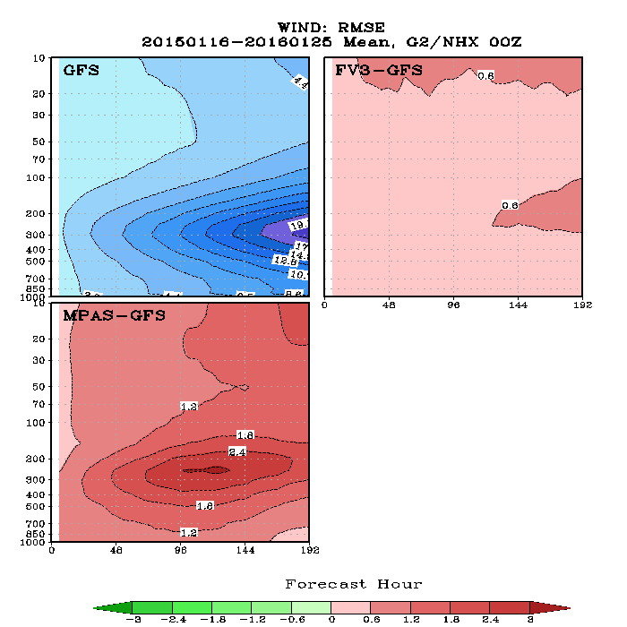
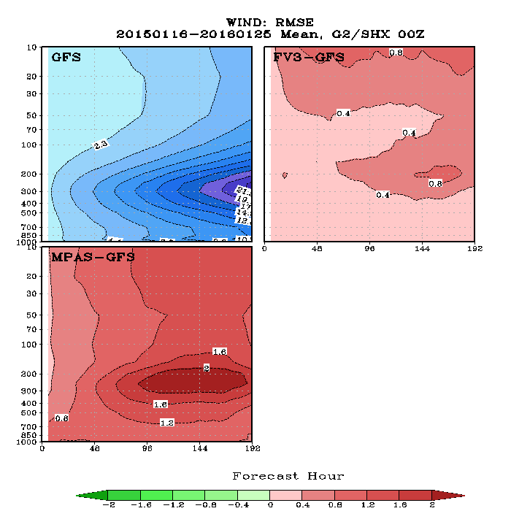
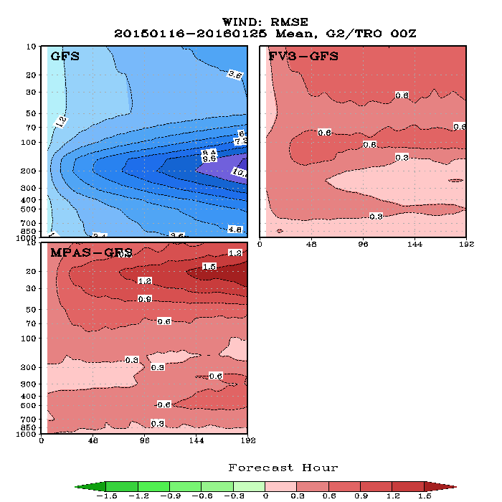
Vector Wind RMSE Verified against Analyses
NH
SH
Tropics
7

Slide 8
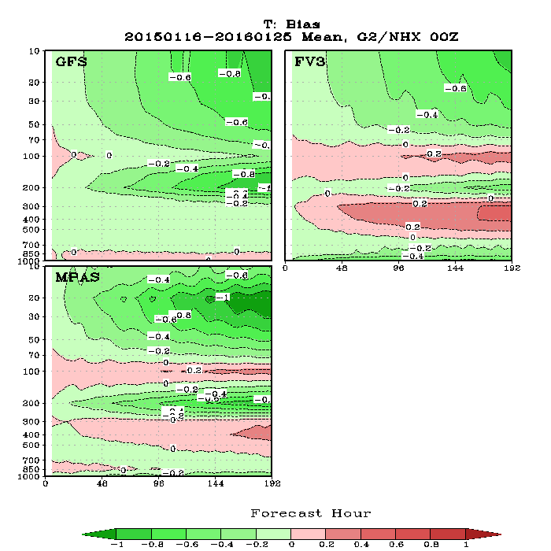
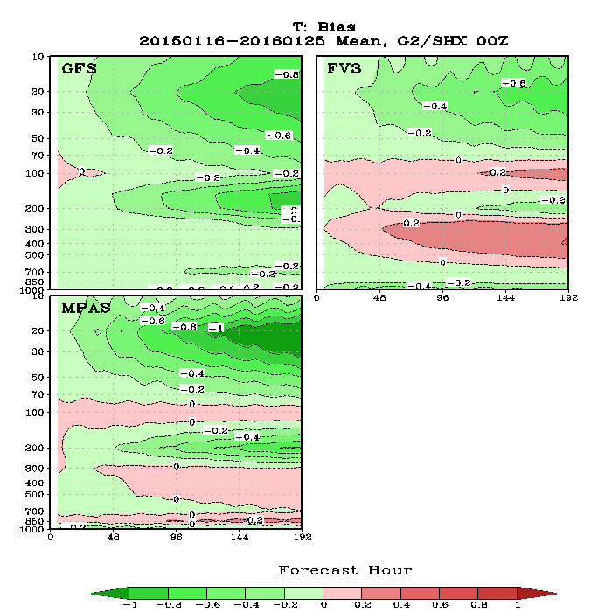
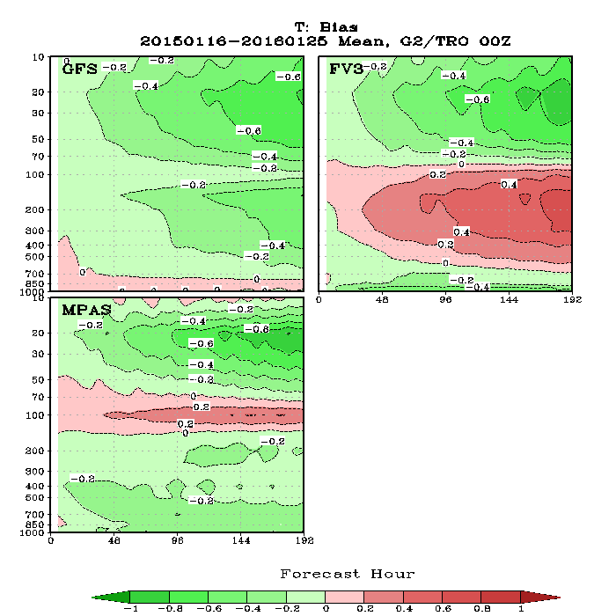
Temperature Bias Verified against Analyses
NH
SH
Tropics
8

Slide 9
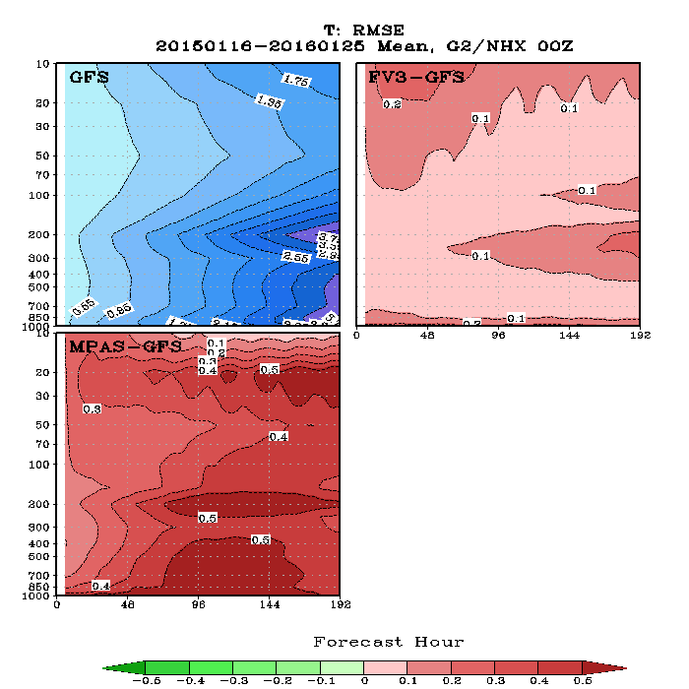
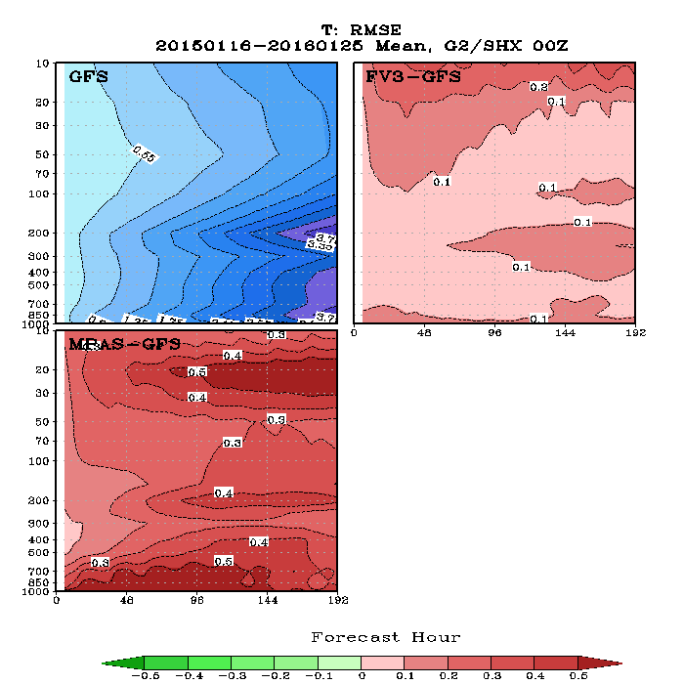
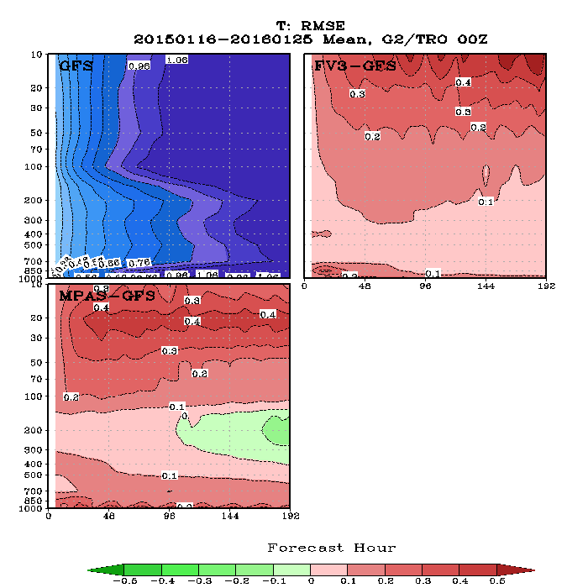
Temperature RMSE Verified against Analyses
NH
SH
Tropics
9

Slide 10
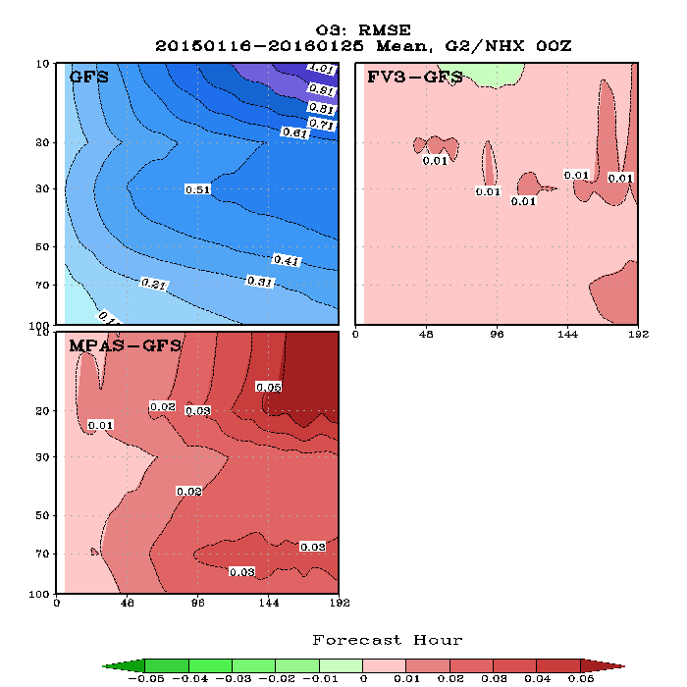
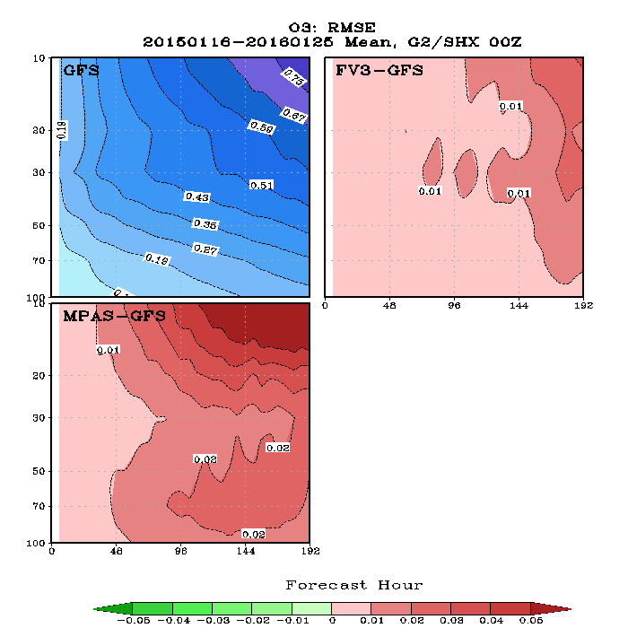
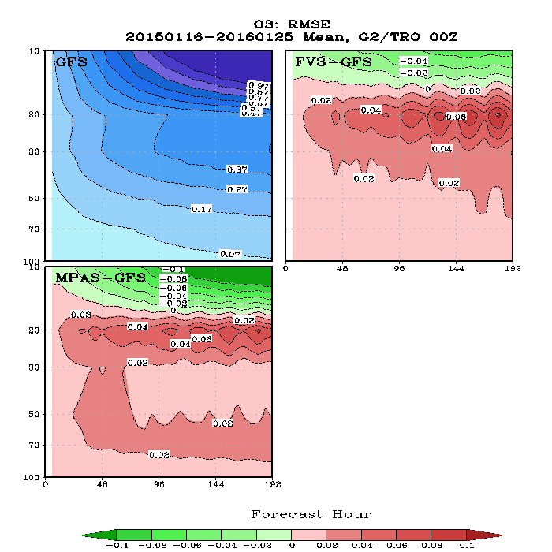
Ozone RMSE Verified against Analyses
NH
SH
Tropics

Slide 11
Outline
Verification against operational GFS analyses
Verification against surface station and rawinsonde observations
Precipitation ETS and Bias scores
Hurricane track and intensity
Forecast maps
Precipitation maps

Slide 12
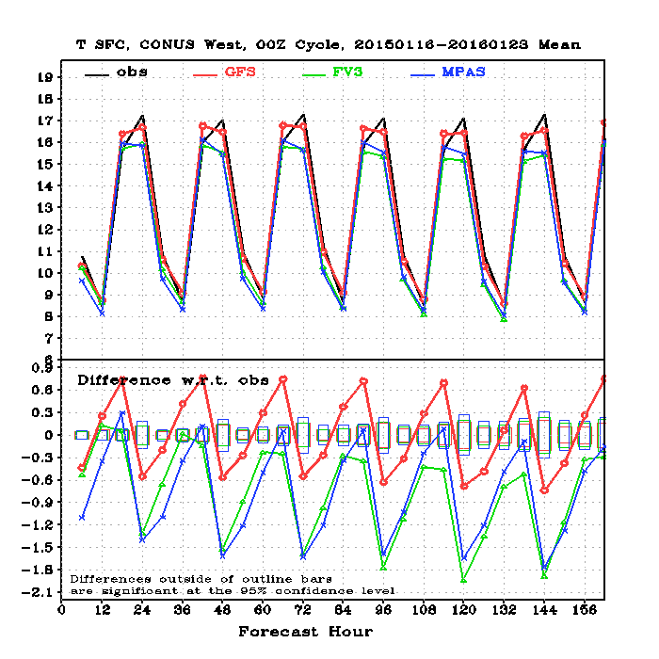
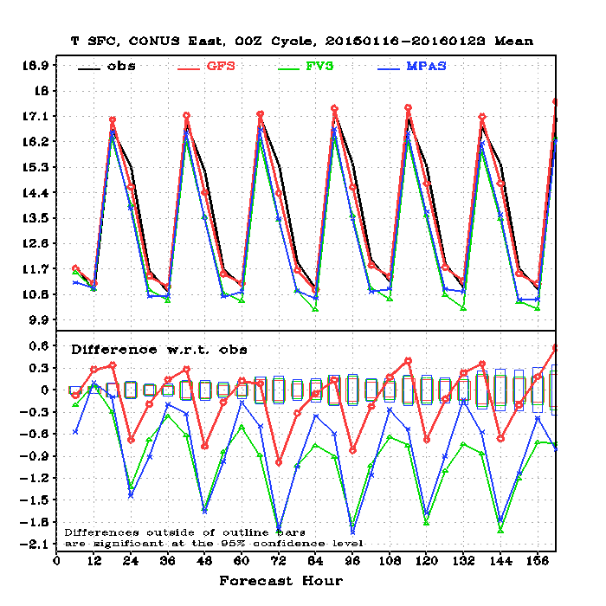
T2m – Verified Against Station Observations
CONUS West
CONUS East
12

Slide 13
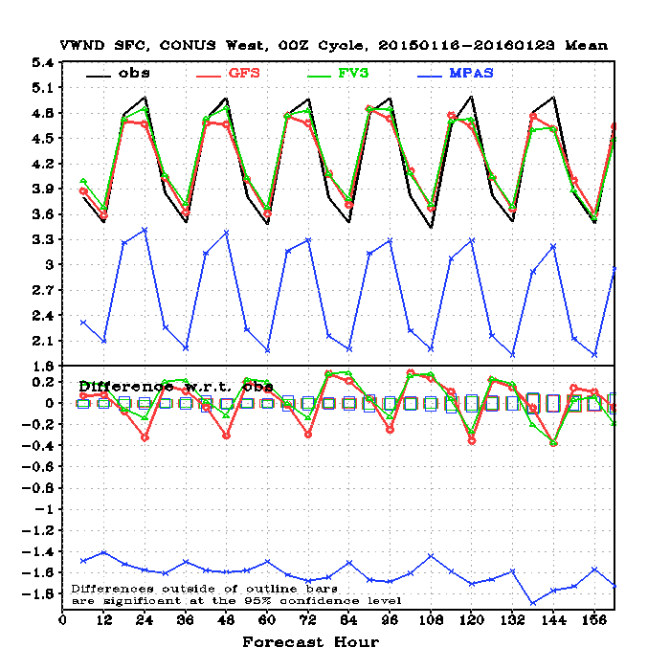
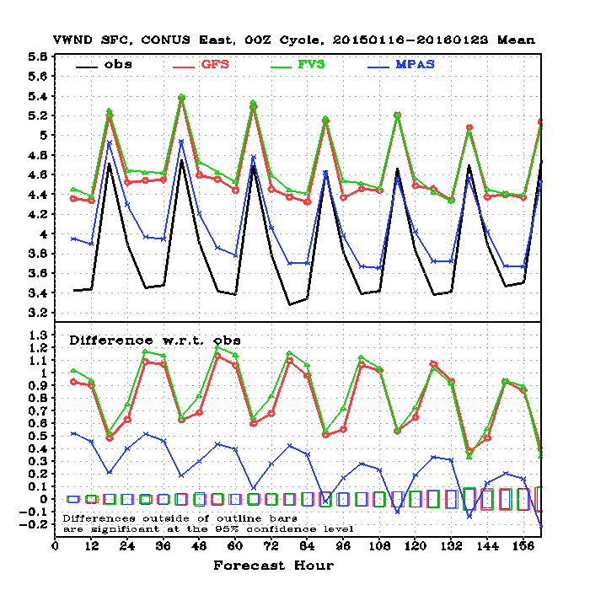
10m Wind -- Verified Against Station Observations
CONUS West
CONUS East
13

Slide 14
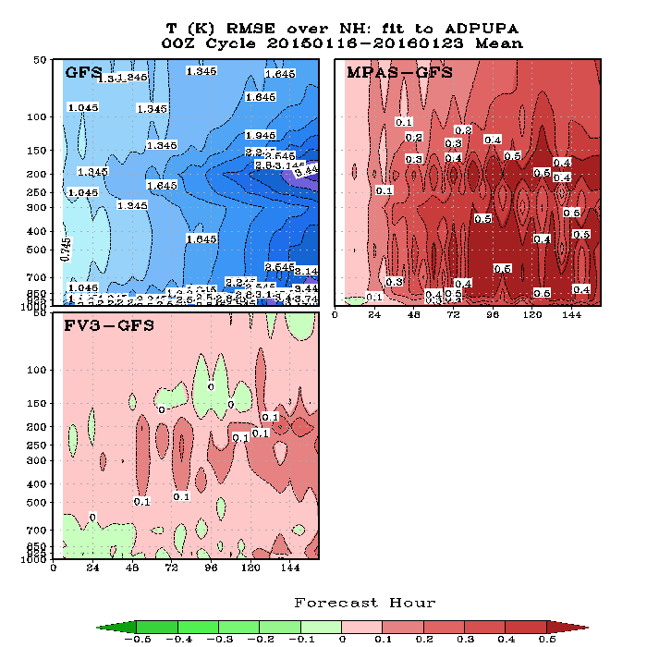
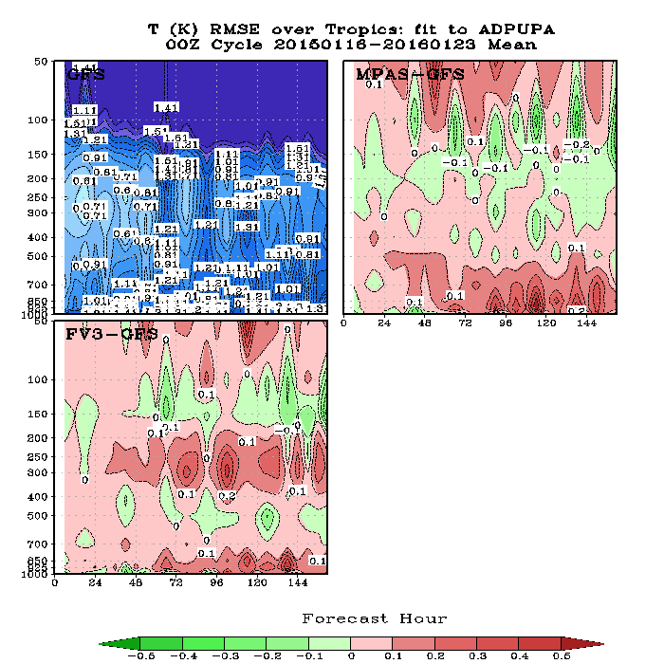
Temperature RMSE -- Verified Against RAOBS
NH
Tropics

Slide 15
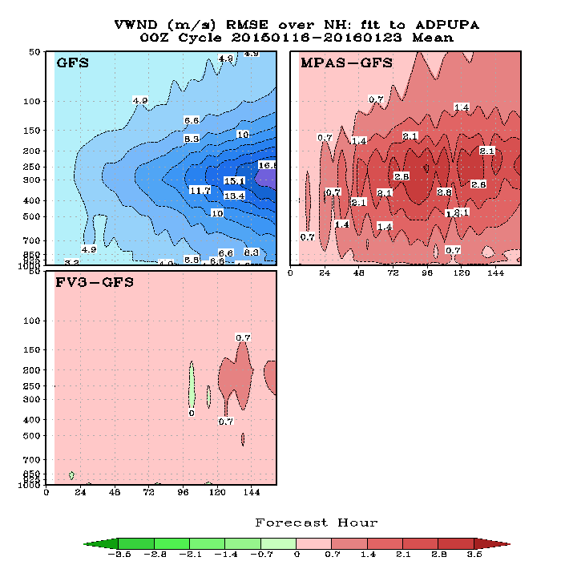
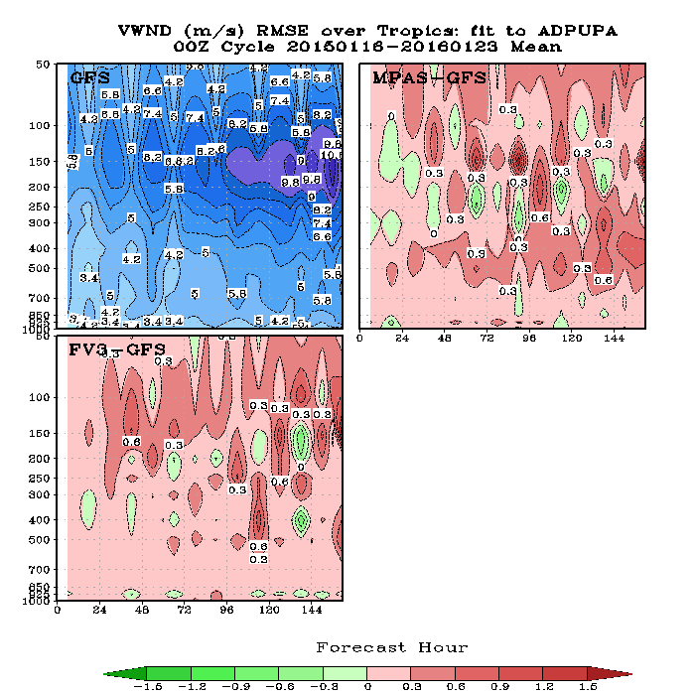
Wind RMSE -- Verified Against RAOBS
NH
Tropics

Slide 16
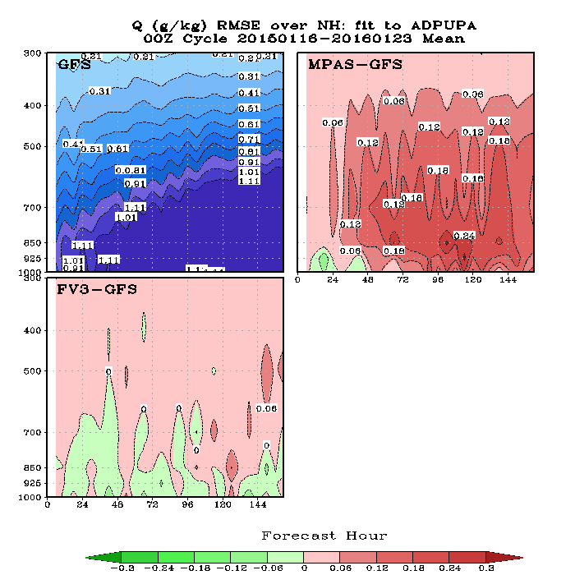
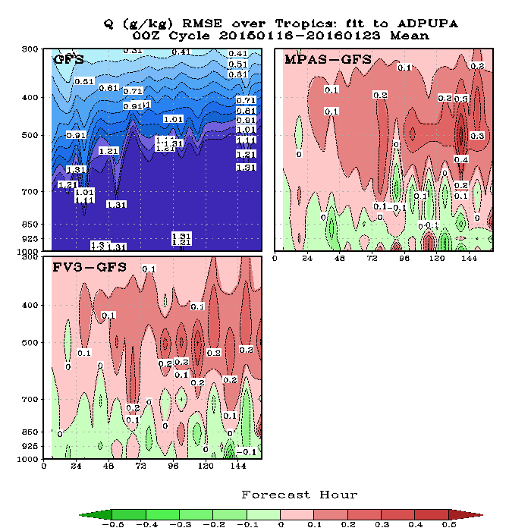
Specific Humidity RMSE -- Verified Against RAOBS
NH
Tropics

Slide 17
Outline
Verification against operational GFS analyses
Verification against surface station and rawinsonde observations
Precipitation ETS and Bias scores over CONUS
Hurricane track and intensity
Forecast maps
Precipitation maps

Slide 18
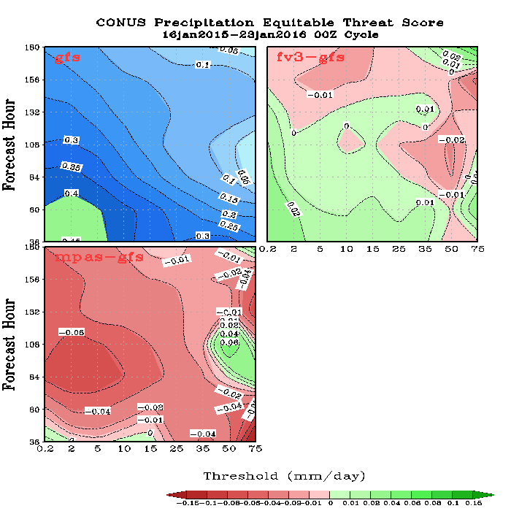
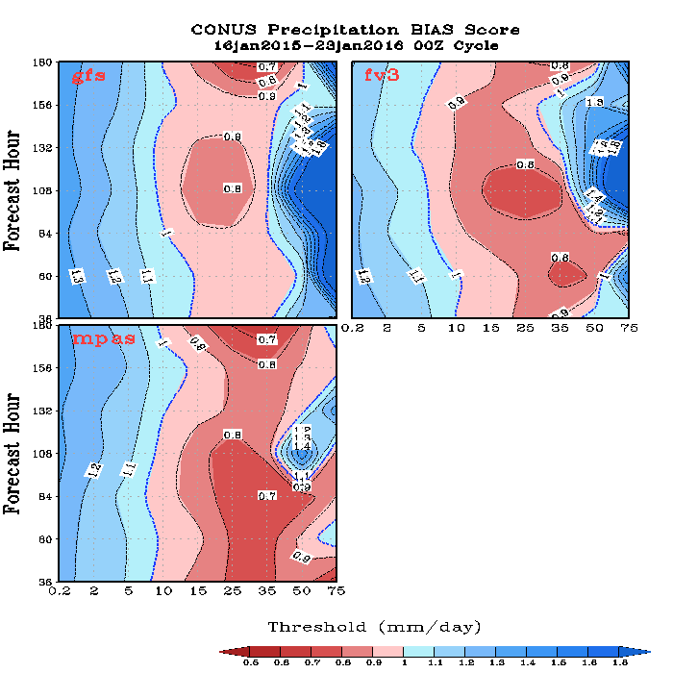
Precipitation ETS and BIAS Scores over the CONUS – All Forecast Hours
ETS
BIAS
Red: lower than GFS; Green: higher than GFS
Red: dry bias; Blue: wet bias
18

Slide 19
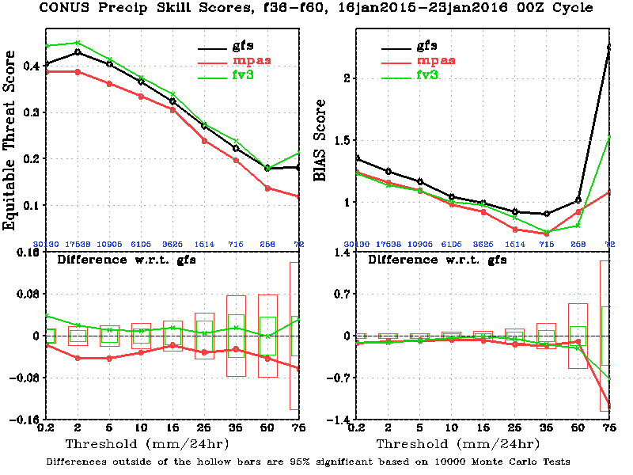
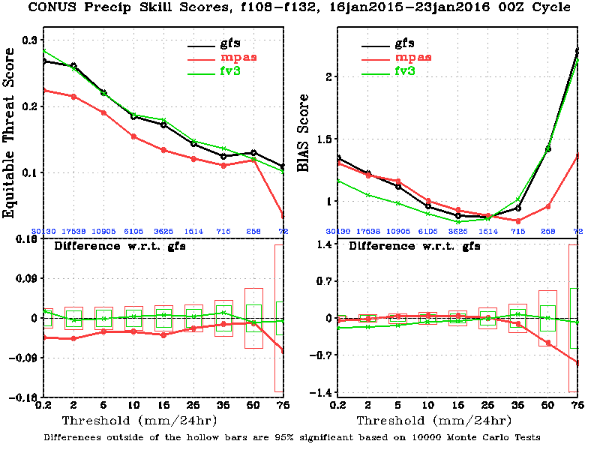
Precipitation ETS and BIAS Scores over the CONUS – Selected Forecast Hours
Fh 36-60
19
Fh 108-132

Slide 20
Outline
Verification against operational GFS analyses
Verification against surface station and rawinsonde observations
Precipitation ETS and Bias scores over CONUS
Hurricane track and intensity
Forecast maps
Precipitation maps

Slide 21
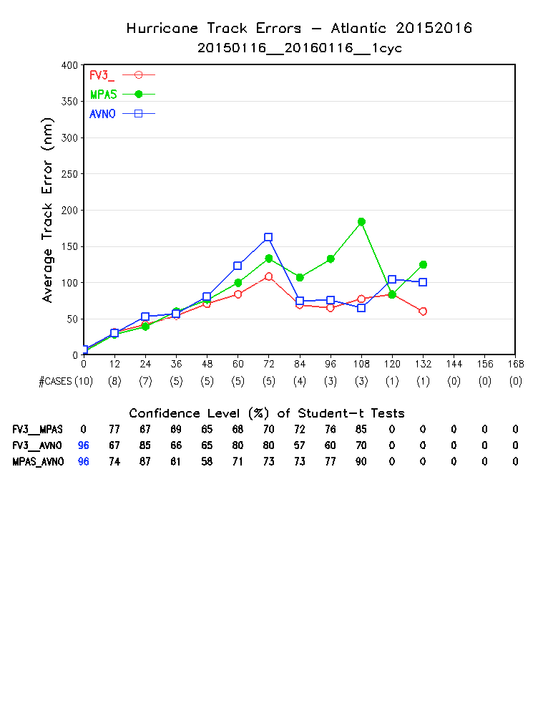
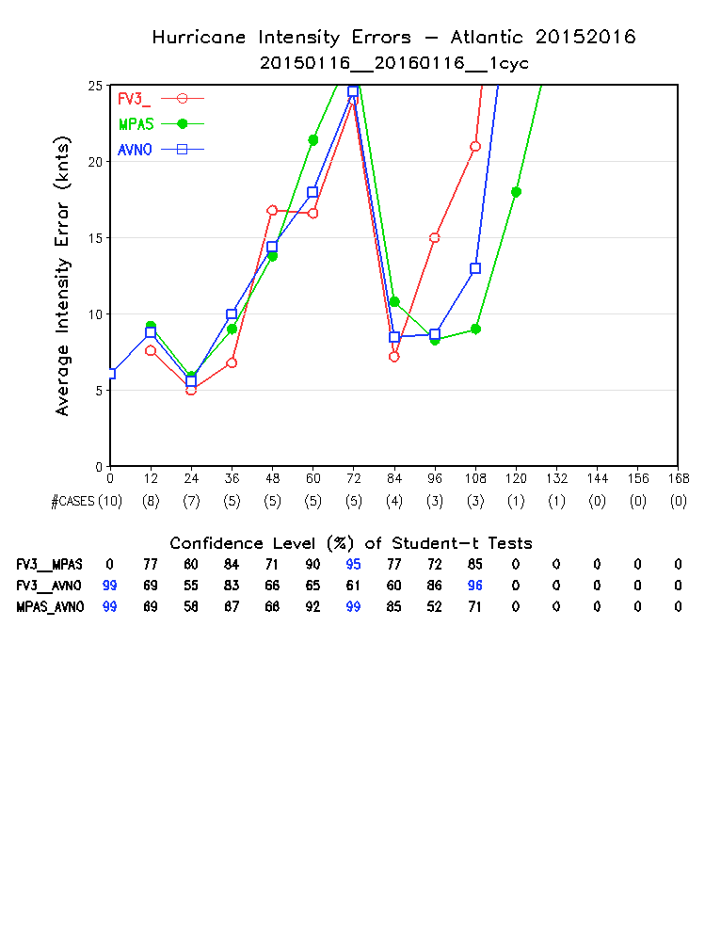
Track and Intensity Errors, Atlantic

Slide 22
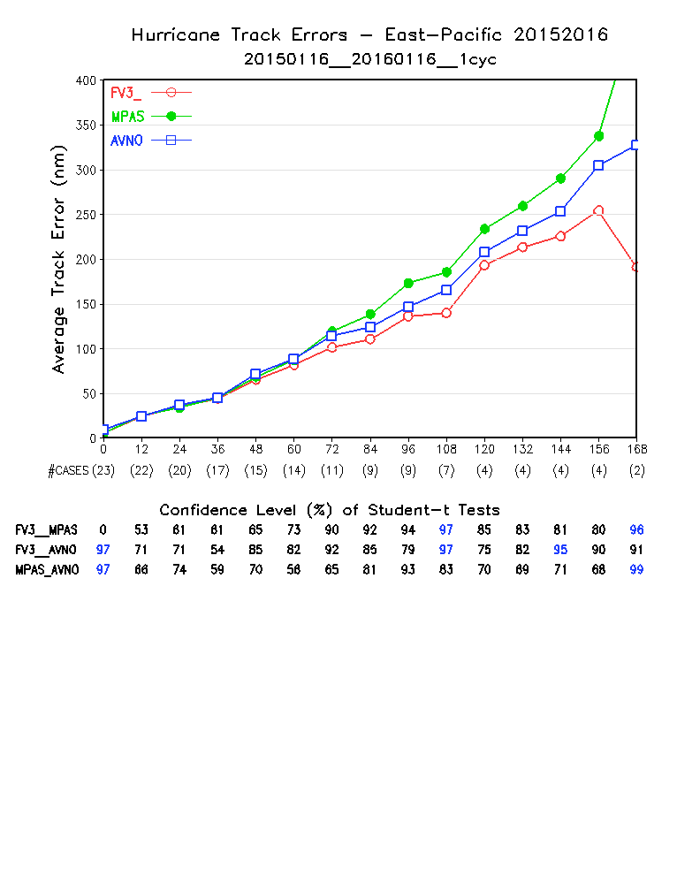
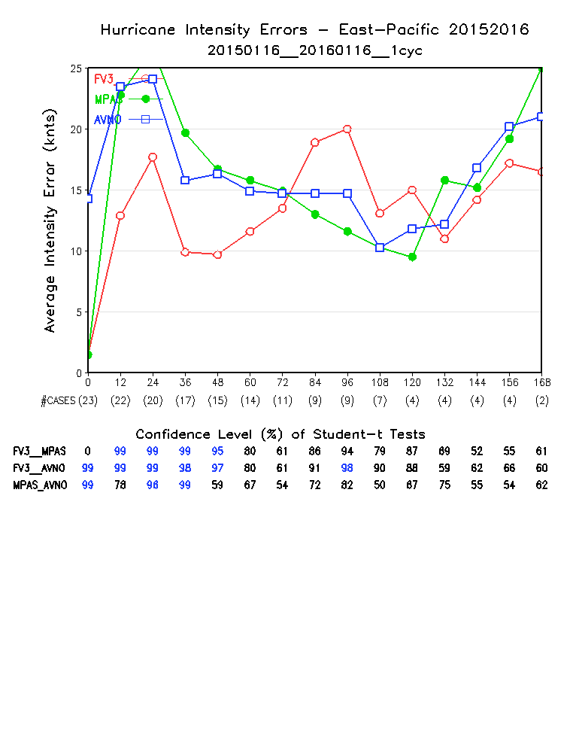
Track and Intensity Errors, Eastern Pacific

Slide 23
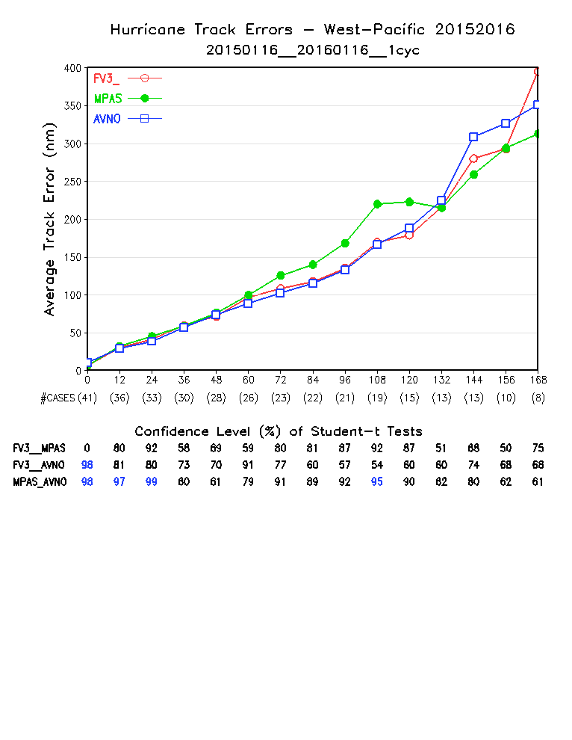
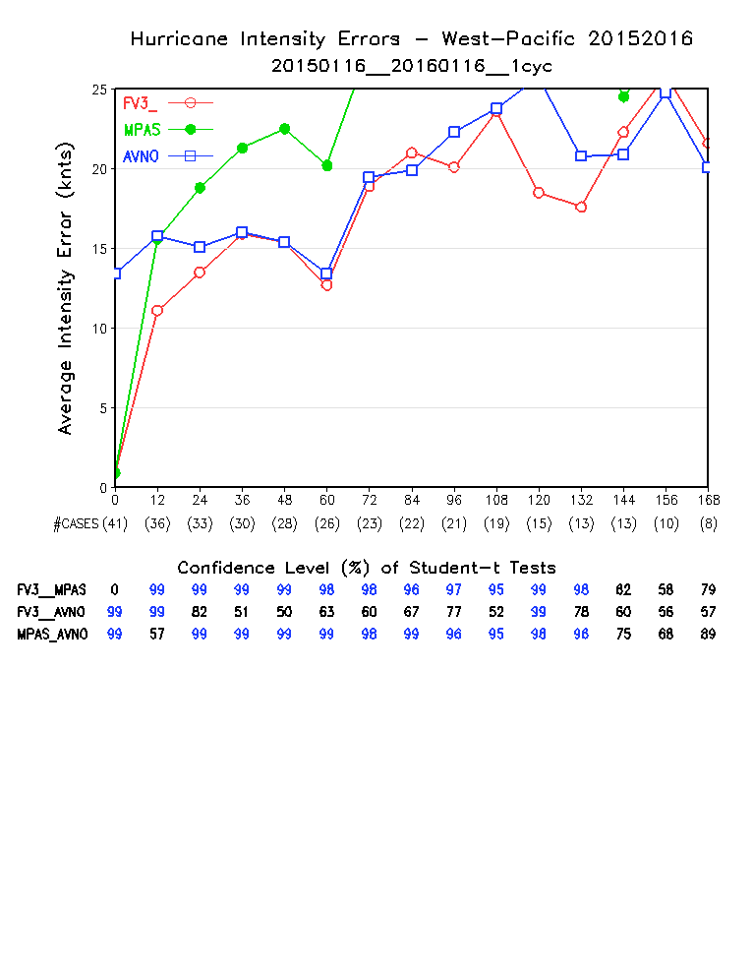
Track and Intensity Errors, Western Pacific

Slide 24
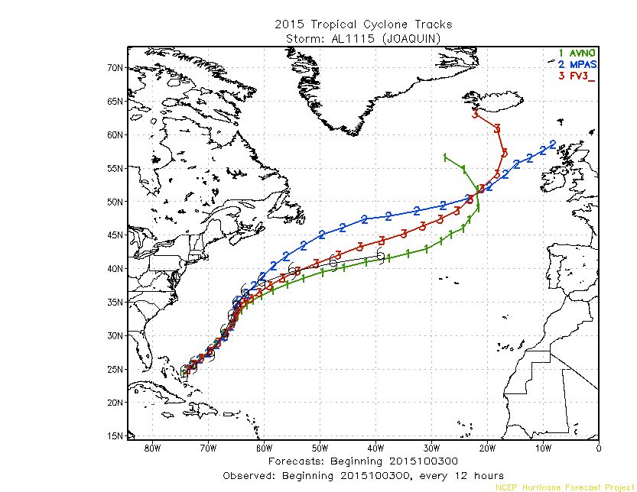
Hurricane Joaquin
IC: 2015092800
IC: 2015100300

Slide 25
Outline
Verification against operational GFS analyses
Verification against surface station and rawinsonde observations
Precipitation ETS and Bias scores over CONUS
Hurricane track and intensity
Forecast maps
Precipitation maps

Slide 26
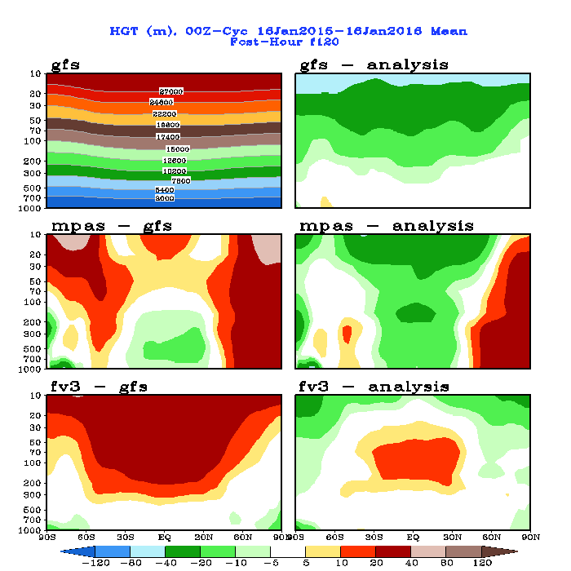
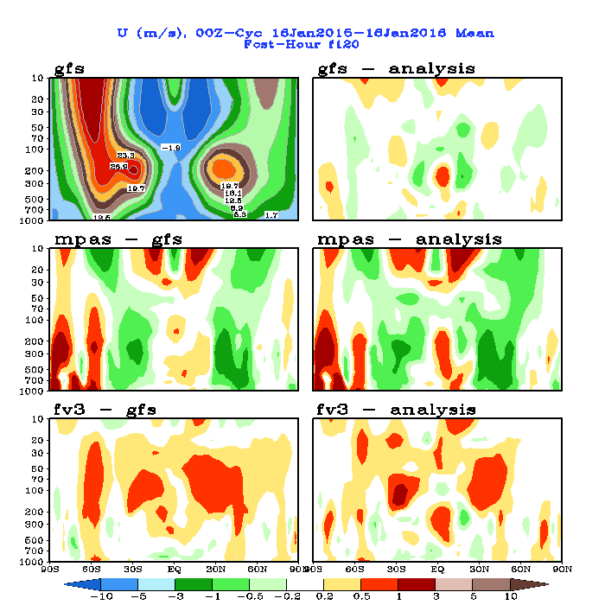
Zonal Mean Height and Zonal Wind , 120-hr Fcst
26

Slide 27
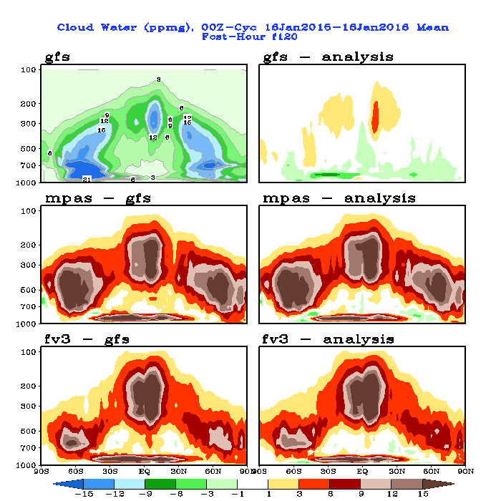
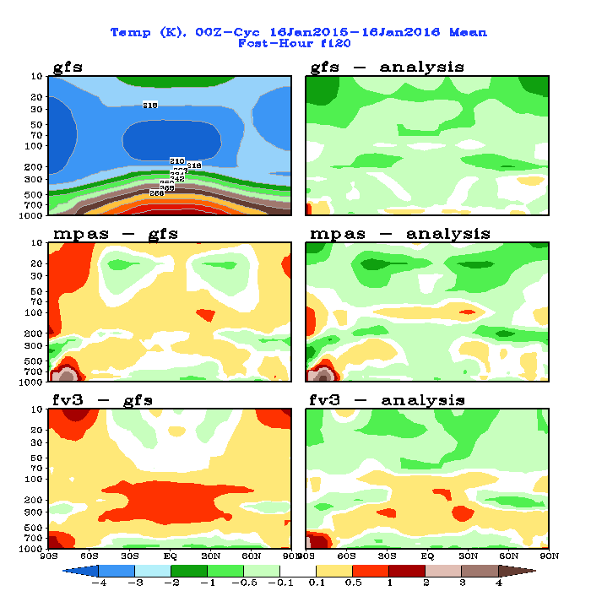
Zonal Mean Cloud Water and Temperature, 120-hr Fcst
27

Slide 28
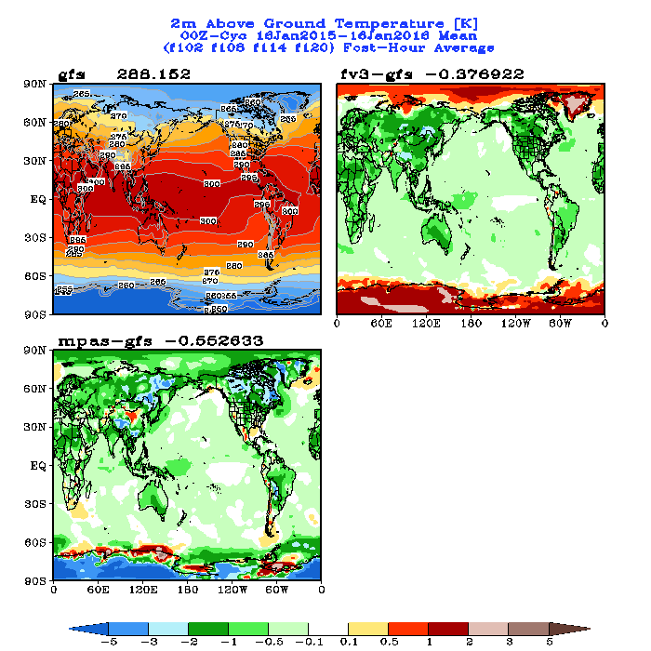
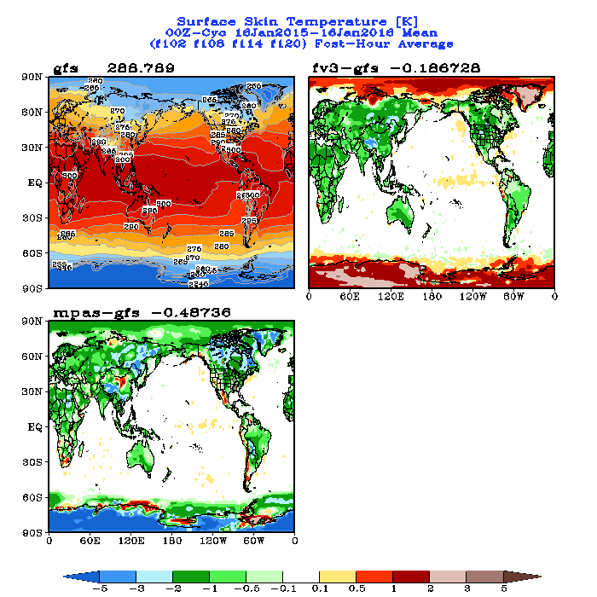
T2m and Skin Temperature, Day-5 Fcst Mean
28

Slide 29
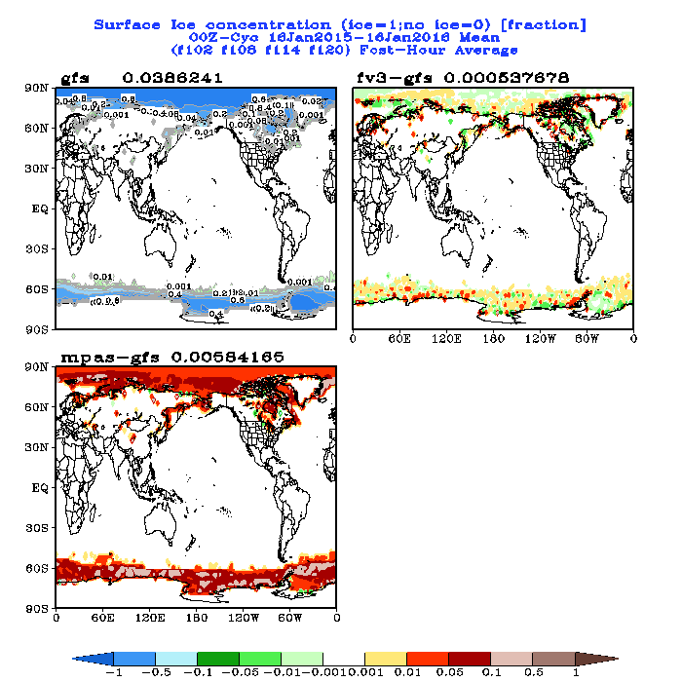
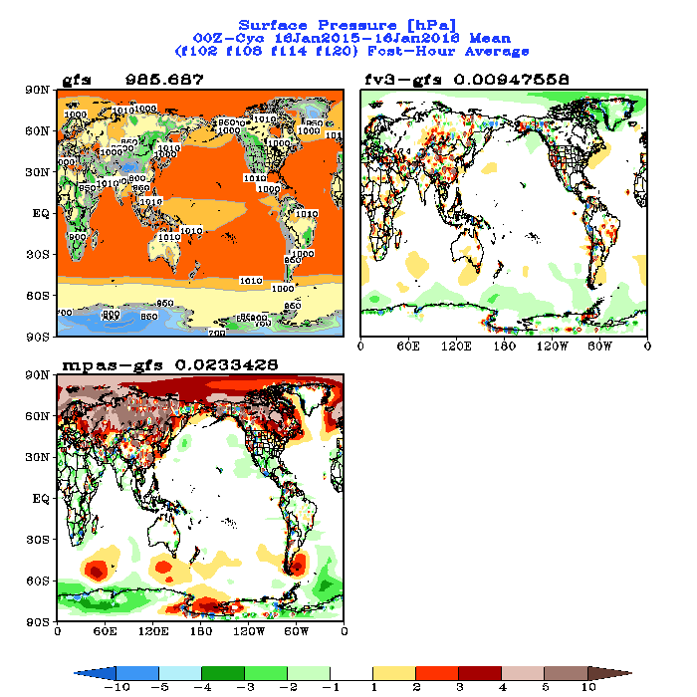
Surface Pressure and Ice Fraction, Day-5 Fcst Mean
29

Slide 30
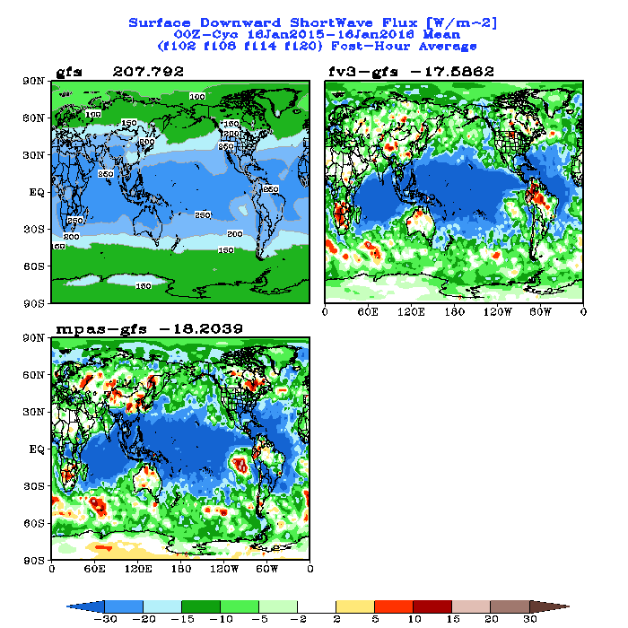
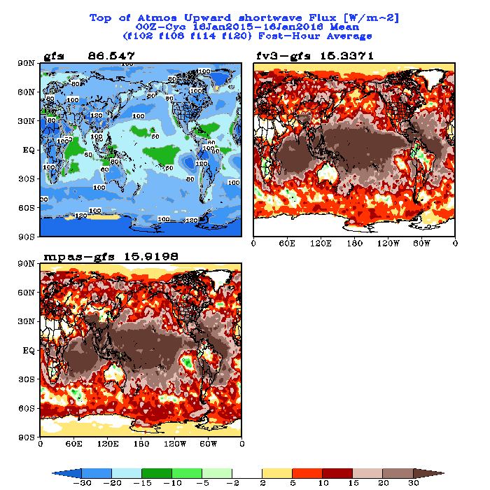
Surface Downward SW and TOA Upward SW, Day-5 Fcst Mean
30

Slide 31
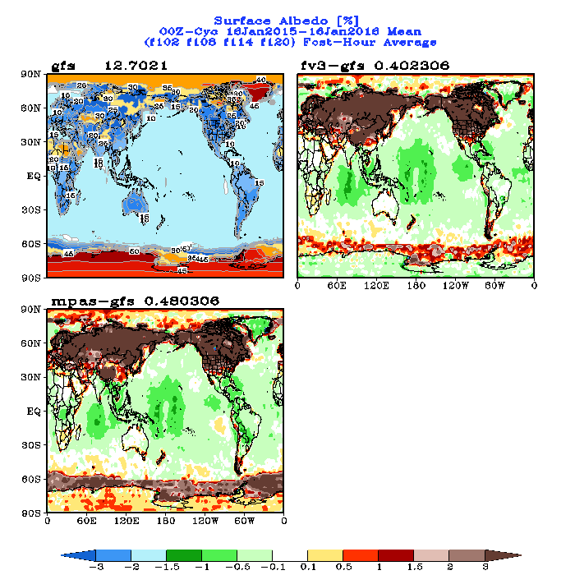
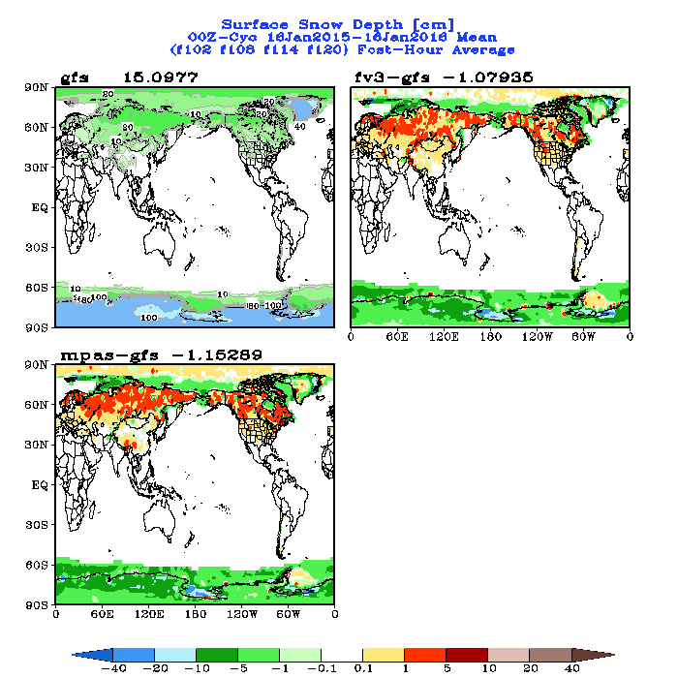
Surface Snow Depth and Surface SW Albedo, Day-5 Fcst Mean
31

Slide 32
Outline
Verification against operational GFS analyses
Verification against surface station and rawinsonde observations
Precipitation ETS and Bias scores over CONUS
Hurricane track and intensity
Forecast maps
Precipitation maps http://www.emc.ncep.noaa.gov/gmb/wx24fy/nggps/rain/maps/rainmap_na.html

Slide 33
Global Mean Precipitation Day-5 forecasts, average of all 72 cases
 | Total (mm/day) | Convective (mm/day) | Large-Scale (mm/day) | % of convective/total
GFS | 3.14 | 1.99 | 1.15 | 63%
FV3 | 3.11 | 1.53 | 1.58 | 49%
MPAS | 3.00 | 1.63 | 1.37 | 54%

Slide 34
Rainfall Maps over CONUS: Animation of All 72 Cases 36-60hr Accumulation
34

Slide 35
Rainfall Maps over CONUS: Animation of All 72 Cases 108-132hr Accumulation
35

Slide 36
Rainfall Maps over Asia: Animation of All 72 Cases 108-132hr Accumulation
36

Slide 37
Rainfall Maps over Europe: Animation of All 72 Cases 108-132hr Accumulation
37
37

Slide 38
Rainfall Maps over South America: Animation of All 72 Cases 108-132hr Accumulation
38
38

