Slide 1

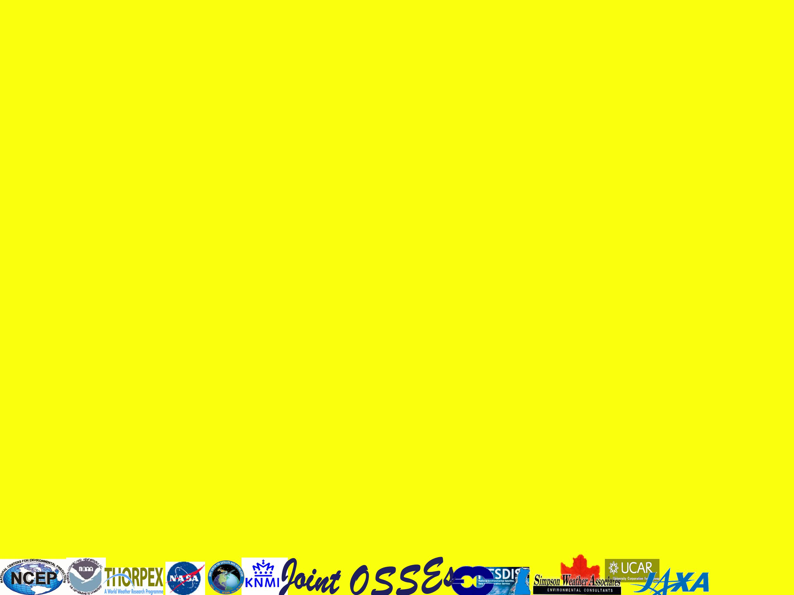
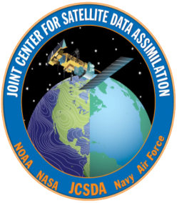
Simulation of observation for Joint OSSE based on 2012 systems
Michiko Masutani[1,2,#], Jack S. Woollen[1,+], Sean Casey [2.$],
Tong Zhu[3,@], Zaizhong Ma[3,$], Lidia Cucurull[1]
Lars Peter Riishojgaard [2,$], Steve Greco [5], Fuzhong Weng [3]
[1]NOAA/National Centers for Environmental Prediction (NCEP)
[2]Joint Center for Satellite and Data Assimilation (JCSDA)
[3]NOAA/ NESDIS/STAR,
[5] Simpson Weather Associates
# Wyle Information Systems, McLean, VA,
+IM Systems Group)IMSG), MD
$Earth System Science Interdisciplinary Center, Univ. of Maryland, College Park,,
@Cooperative Institute for Research in the Atmosphere (CIRA)/CSU, CO
http://www.emc.ncep.noaa.gov/research/JointOSSEs/
Acknowledgement
The nature runs for Joint OSSEs were produced by Dr. Erik Andersson of ECMWF.

Slide 2
Full OSSEs
There are many types of simulation experiments. Sometimes, we have to call our OSSE a ‘Full OSSE’ to avoid confusion.
Advantages
A Nature Run (NR, proxy true atmosphere) is produced from a free forecast run using the highest resolution operational model which is significantly different from the NWP model used in Data Assimilation Systems.
Calibrations is performed to provide quantitative data impact assessment.
. Without calibration quantitative evaluation of data impact is not possible.
Data impact on analysis and forecast will be evaluated.
A Full OSSE can provide detailed quantitative evaluations of the configuration of observing systems.
A Full OSSE can use an existing operational system and help the development of an operational system
OSSE Calibration
Existing Data assimilation system and verification method are used for Full OSSEs. This will help development of DAS and verification tools.
Calibration of OSSEs verifies the simulated data impact by comparing it to real data impact. In order to conduct an OSSE calibration, the data impact of existing instruments has to be compared to their impact in the OSSE.
International Joint OSSE capability
Full OSSEs are expensive
  Sharing one Nature Run and simulated observation saves costs
  Sharing diverse resources
OSSE-based decisions have international stakeholders
  Decisions on major space systems have important scientific, technical, financial and political ramifications
  Community ownership and oversight of OSSE capability is important for maintaining credibility
Independent but related data assimilation systems allow us to test the robustness of answers

Slide 3
Joint OSSE Nature Run by ECMWF
Evaluation of Nature Run cloud
Steve Greco (SWA)
Based on discussion with JCSDA, NCEP, GMAO, GLA, SIVO, SWA, NESDIS, ESRL, and ECMWF
ECMWF Nature run used at NOAA
Spectral resolution : T511
13 month long. Starting May 1st,2005
Vertical levels: L91, 3 hourly dump
Daily SST and ICE: provided by NCEP
Model: Version cy31r1
Supplemental in 1degx1deg
Pressure level data: 31 levels,
Potential temperature level data: 315,330,350,370,530K
Selected surface data for T511 NR:
Andersson, Erik and Michiko Masutani 2010: Collaboration on Observing System Simulation Experiments (Joint OSSE), ECMWF News Letter No. 123, Spring 2010, 14-16.
Note: This data must not be used for commercial purposes and re-distribution rights are not given. User listslists are maintained by Michiko Masutani and ECMWF

Slide 4
Simulated observation for Control experiments
posted from NASA/NCCS portal and NCAR
- Entire Nature run Period -
Michiko Masutani and Jack Woollen (NOAA/NCEP/EMC)
Simulated radiance data,
with and without MASK in BUFR format for entire Nature run period
Type of radiance data and location used for reanalysis from May 2005-May2006
Simulated using CRTM1.2.2
No observational error added
NASA/NCCS
http://portal.nccs.nasa.gov/osse/index.pl
ID and Password required
http://portal.nccs.nasa.gov/josse/index.pl
Ellen Salmon Ellen.M.Salmon@NASA.gov
Bill McHale wmchale@nccs.nasa.gov
NCAR
Currently saved in HPSS
Data ID: ds621.0
http://dss.ucar.edu/datasets/ds621.0/matrix.html
Contact:
Chi-Fan Shih chifan@ucar.edu
Steven Worley worley@ucar.edu
Conventional data
Entire Nature run Period
Restricted data removed
Cloud track wind is based on real observation location
No observational error added

Slide 5
Upgrade in Simulated observation for Control experiments at JCSDA
Only Clear Sky radiance are posted
(Cloudy radiance are also simulated. Radiance with mask based on GSI usage is also simulated. But these data are not posted.)
Saved in BUFR format
No observational error added
Set A
Entire Nature run period
Type of radiance data and location used for reanalysis from May 2005-May2006
Simulated using CRTM1.2.2 (OPTRAN)
Set B
Type of radiance data location used in 2012
July, August, January and February (July and August completed)
CRTM 2.0.5 (RTTOV) are used.
Set A
AIRS (Aqua),
AMSU-A (Aqua, NOAA-15, 16, 18),
AMSU-B (NOAA-15, 16, 17),
HIRS2 (NOAA 14),
HIRS-3 (NOAA 15, 16, 17),
HIRS-4 (NOAA-18),
MSU (NOAA-14),
MHS (NOAA-18)
GOES sounder (GOES-10, 12)
All conventional data available in 2005-2006
Set B
IASI(METOP-A), AIRS(AQUA), ATMS(NPP), CrIS(NPP)
HIRS-2(NOAA14),
HIRS-3(NOAA 15, 16,17),
HIRS-4(NOAA 18, 19, METOP-A), AMSUA(NOAA 15, 16, 17,18,19, AQUA, METOP-A),
AMSUB(NOAA 15, 16, 17),
MSU(NOAA 14), HSB(AQUA), MHS(METOP-A,NOAA18,19), SSMIS(DMSP F16), SEVIRI(MSG)
GOES sounder (10,12, and 13)
GPSRO,
Addition to Set A ASCAT and WINDSAT are included in conventional data.

Slide 6
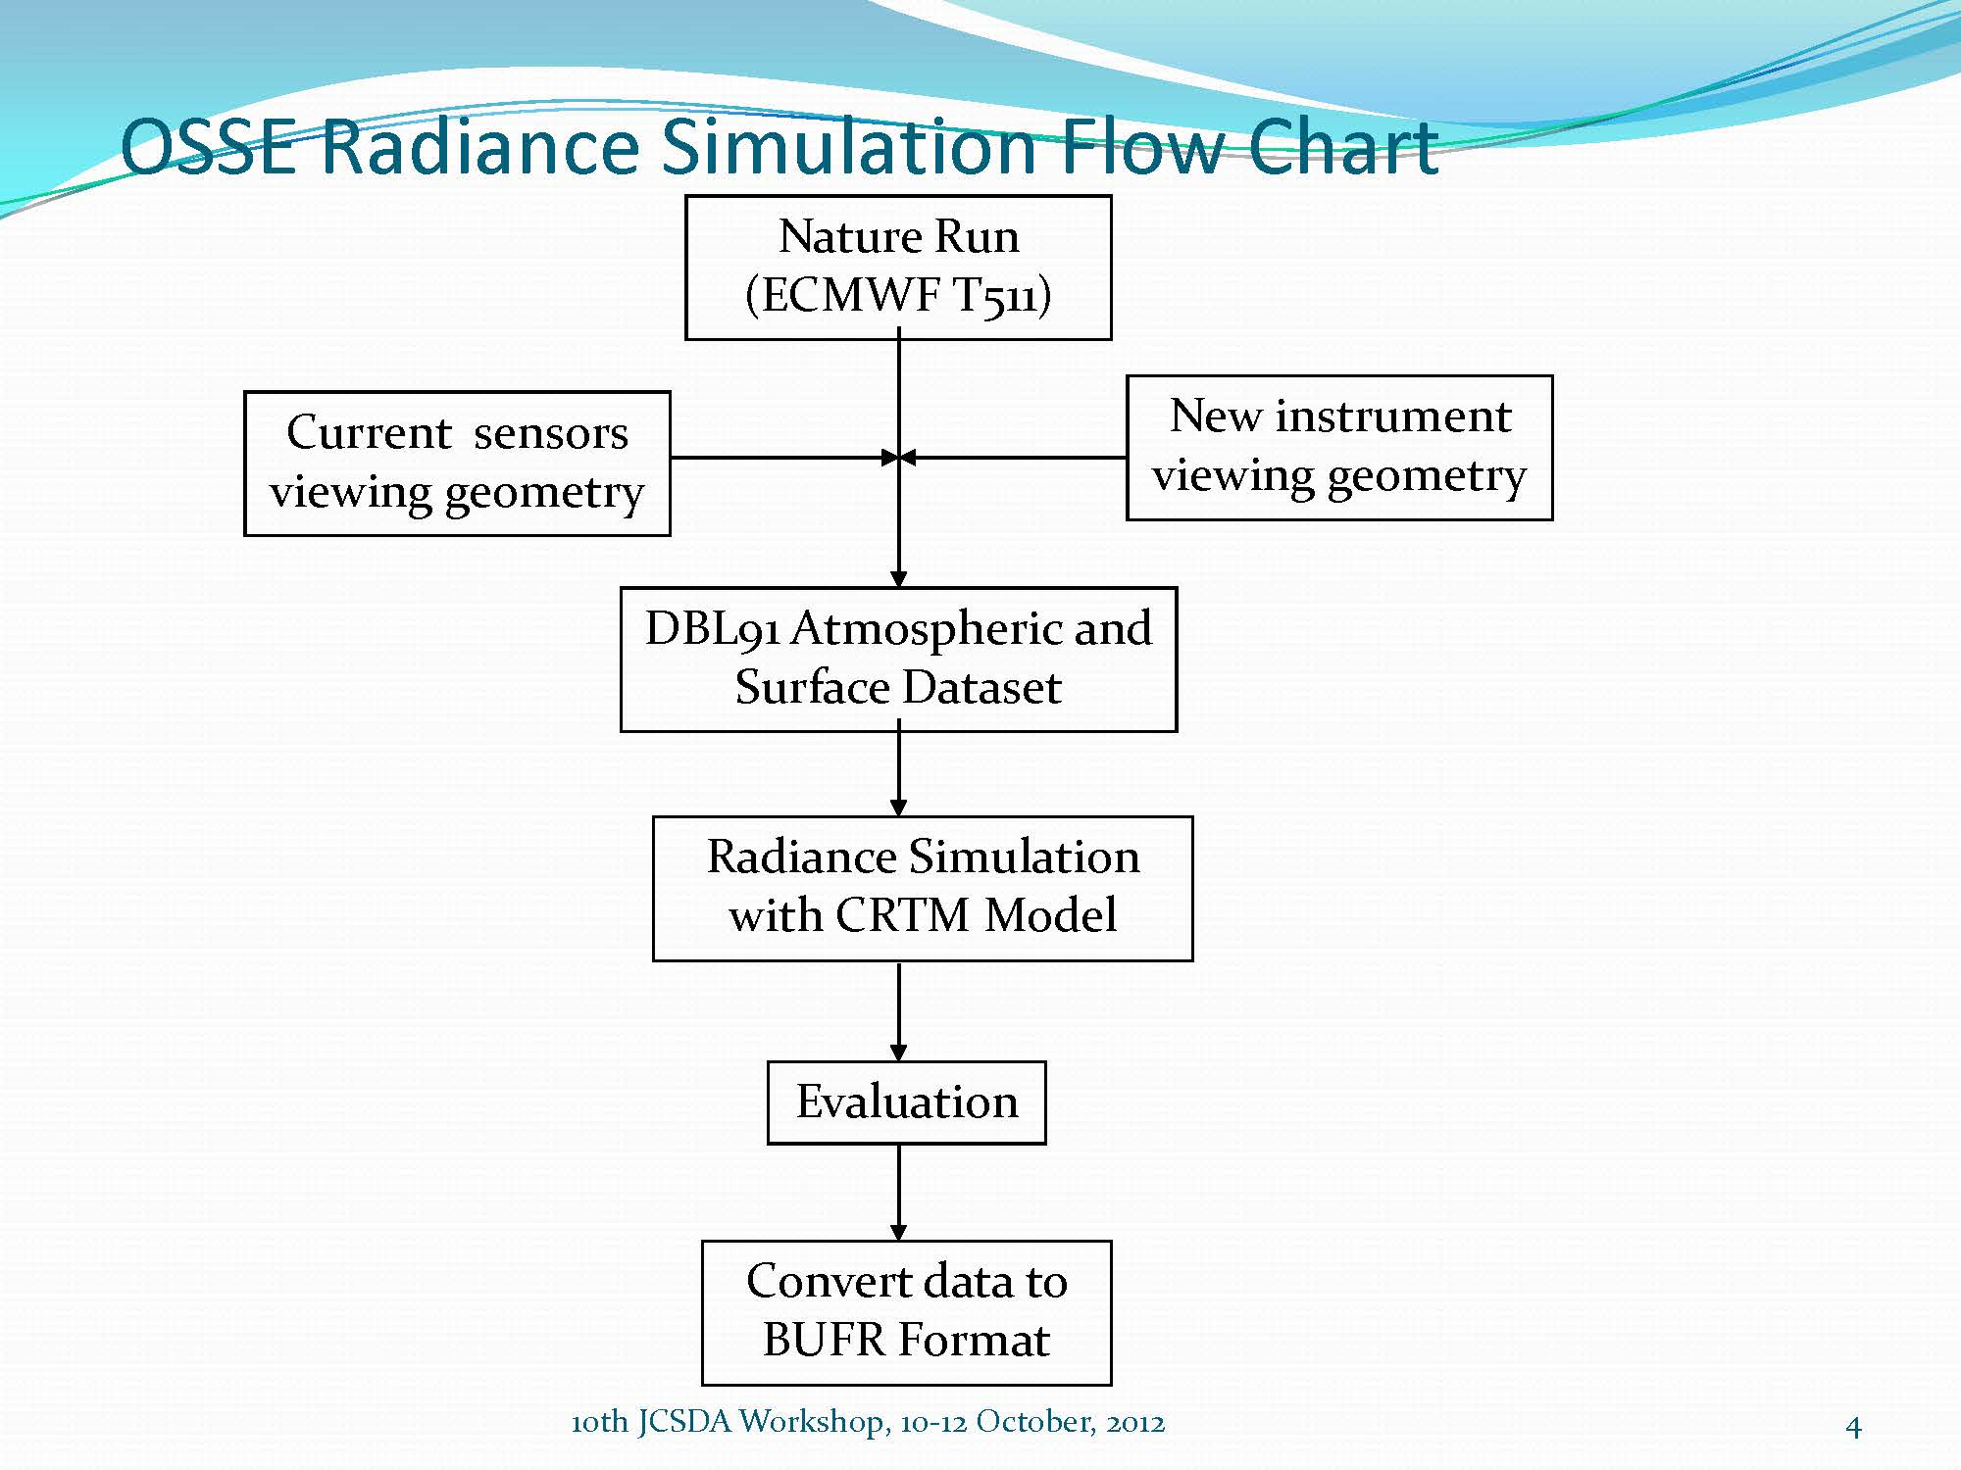
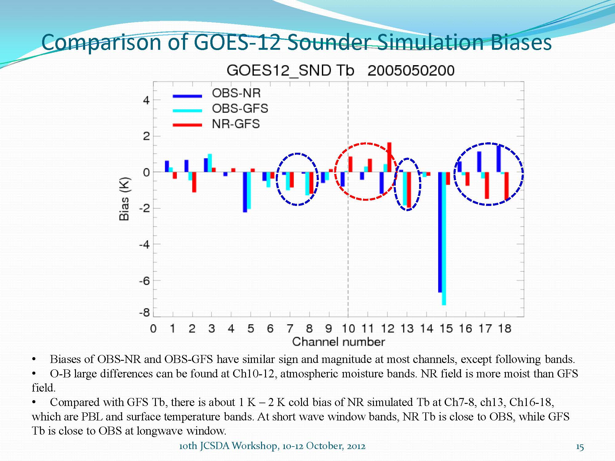
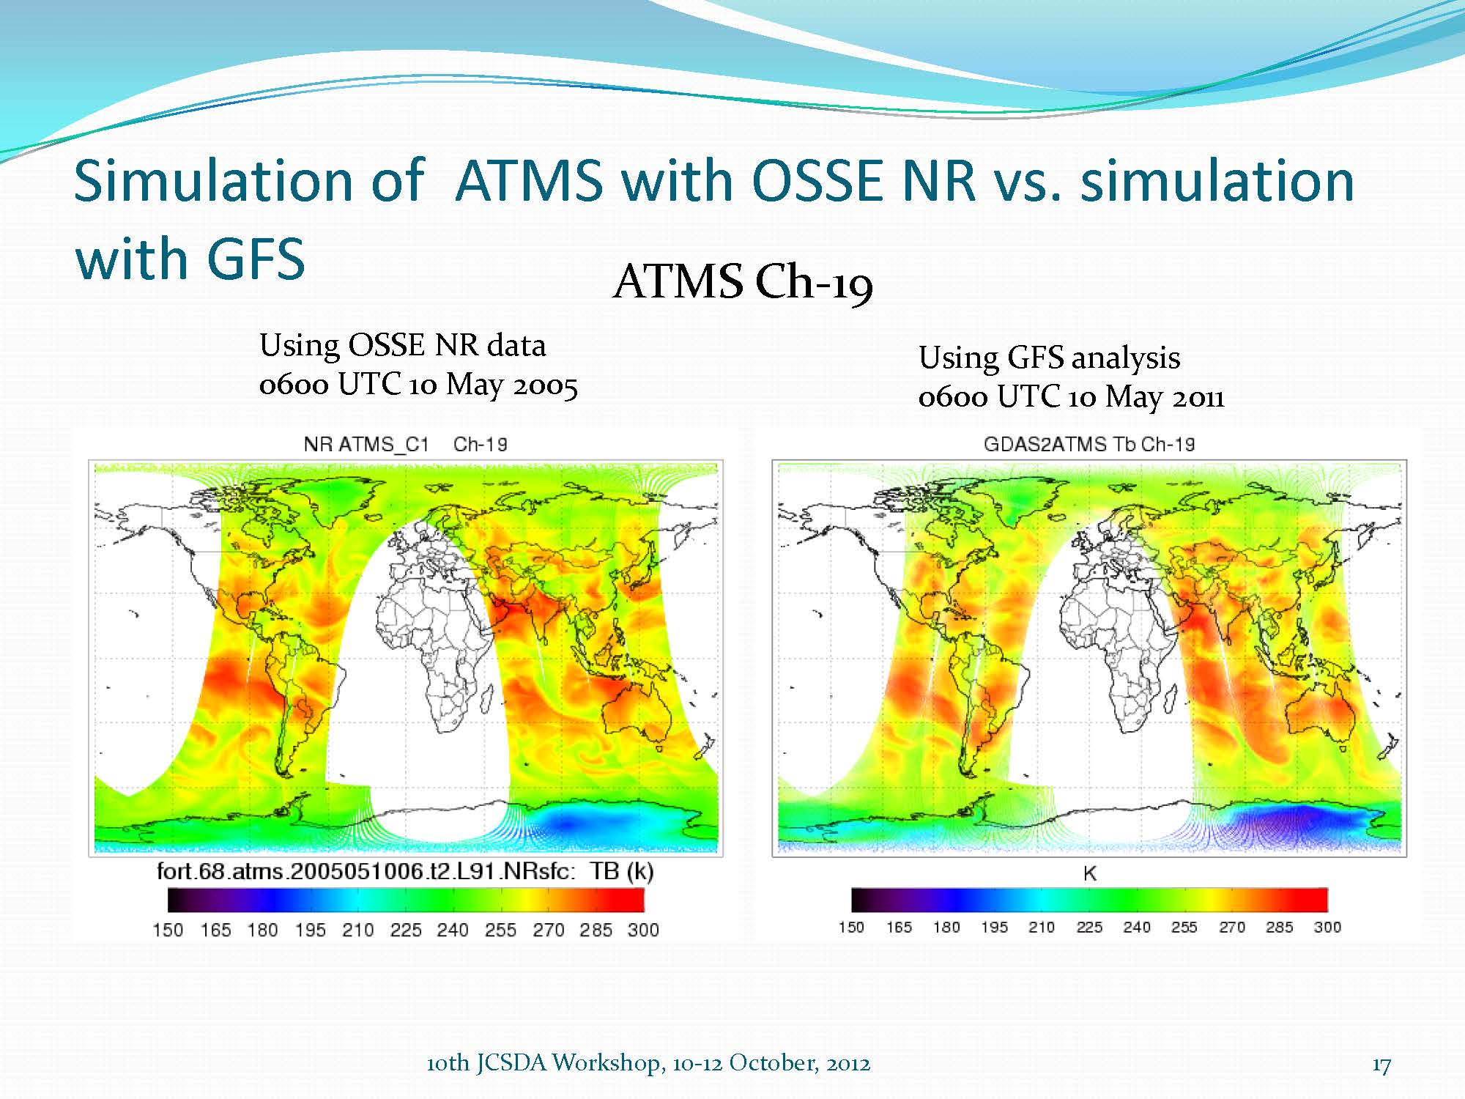
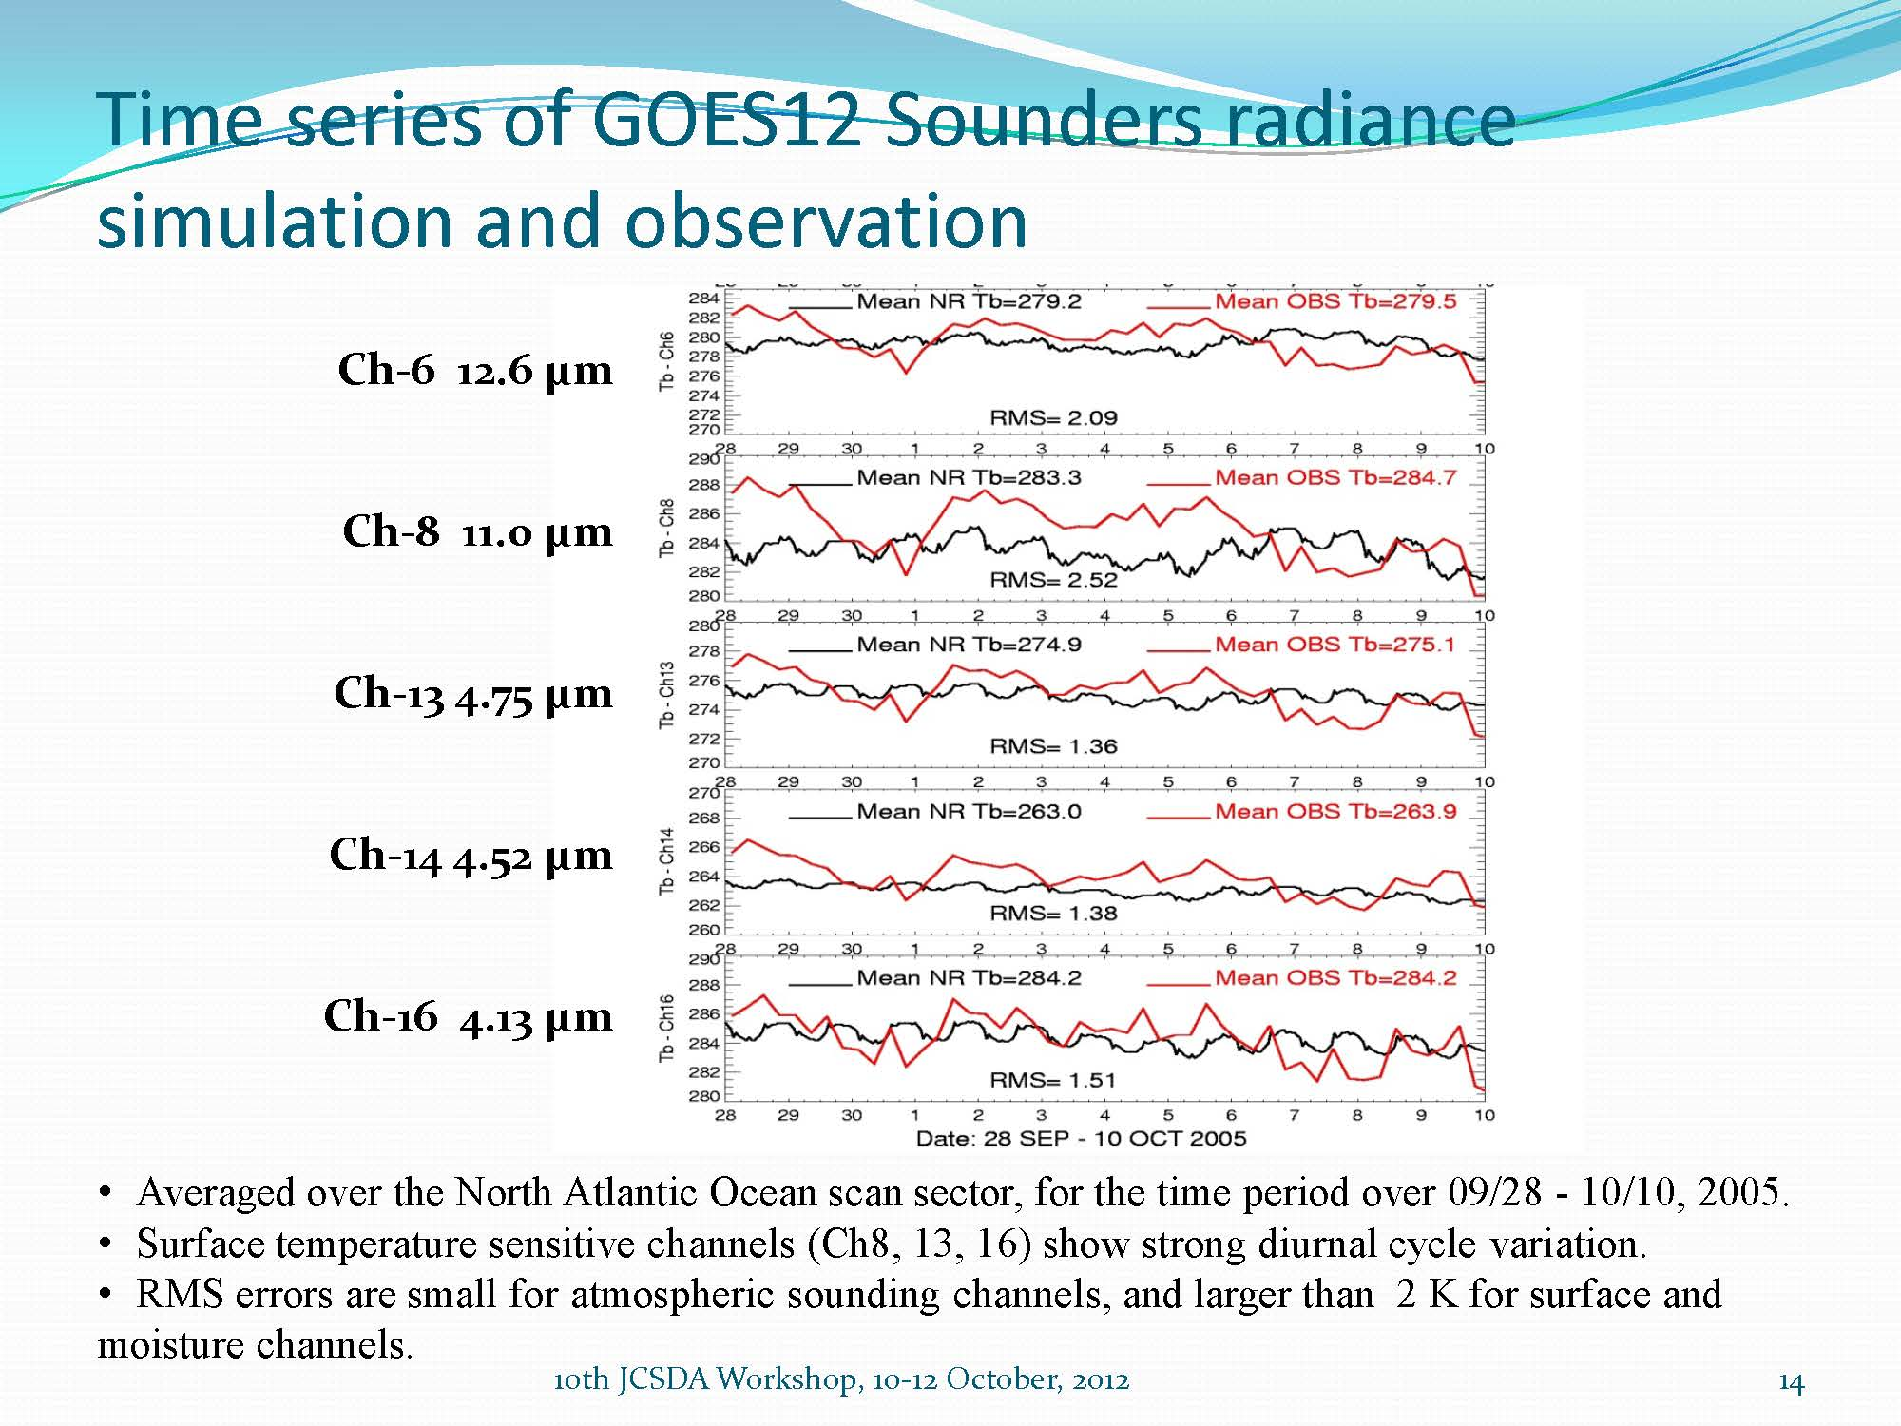
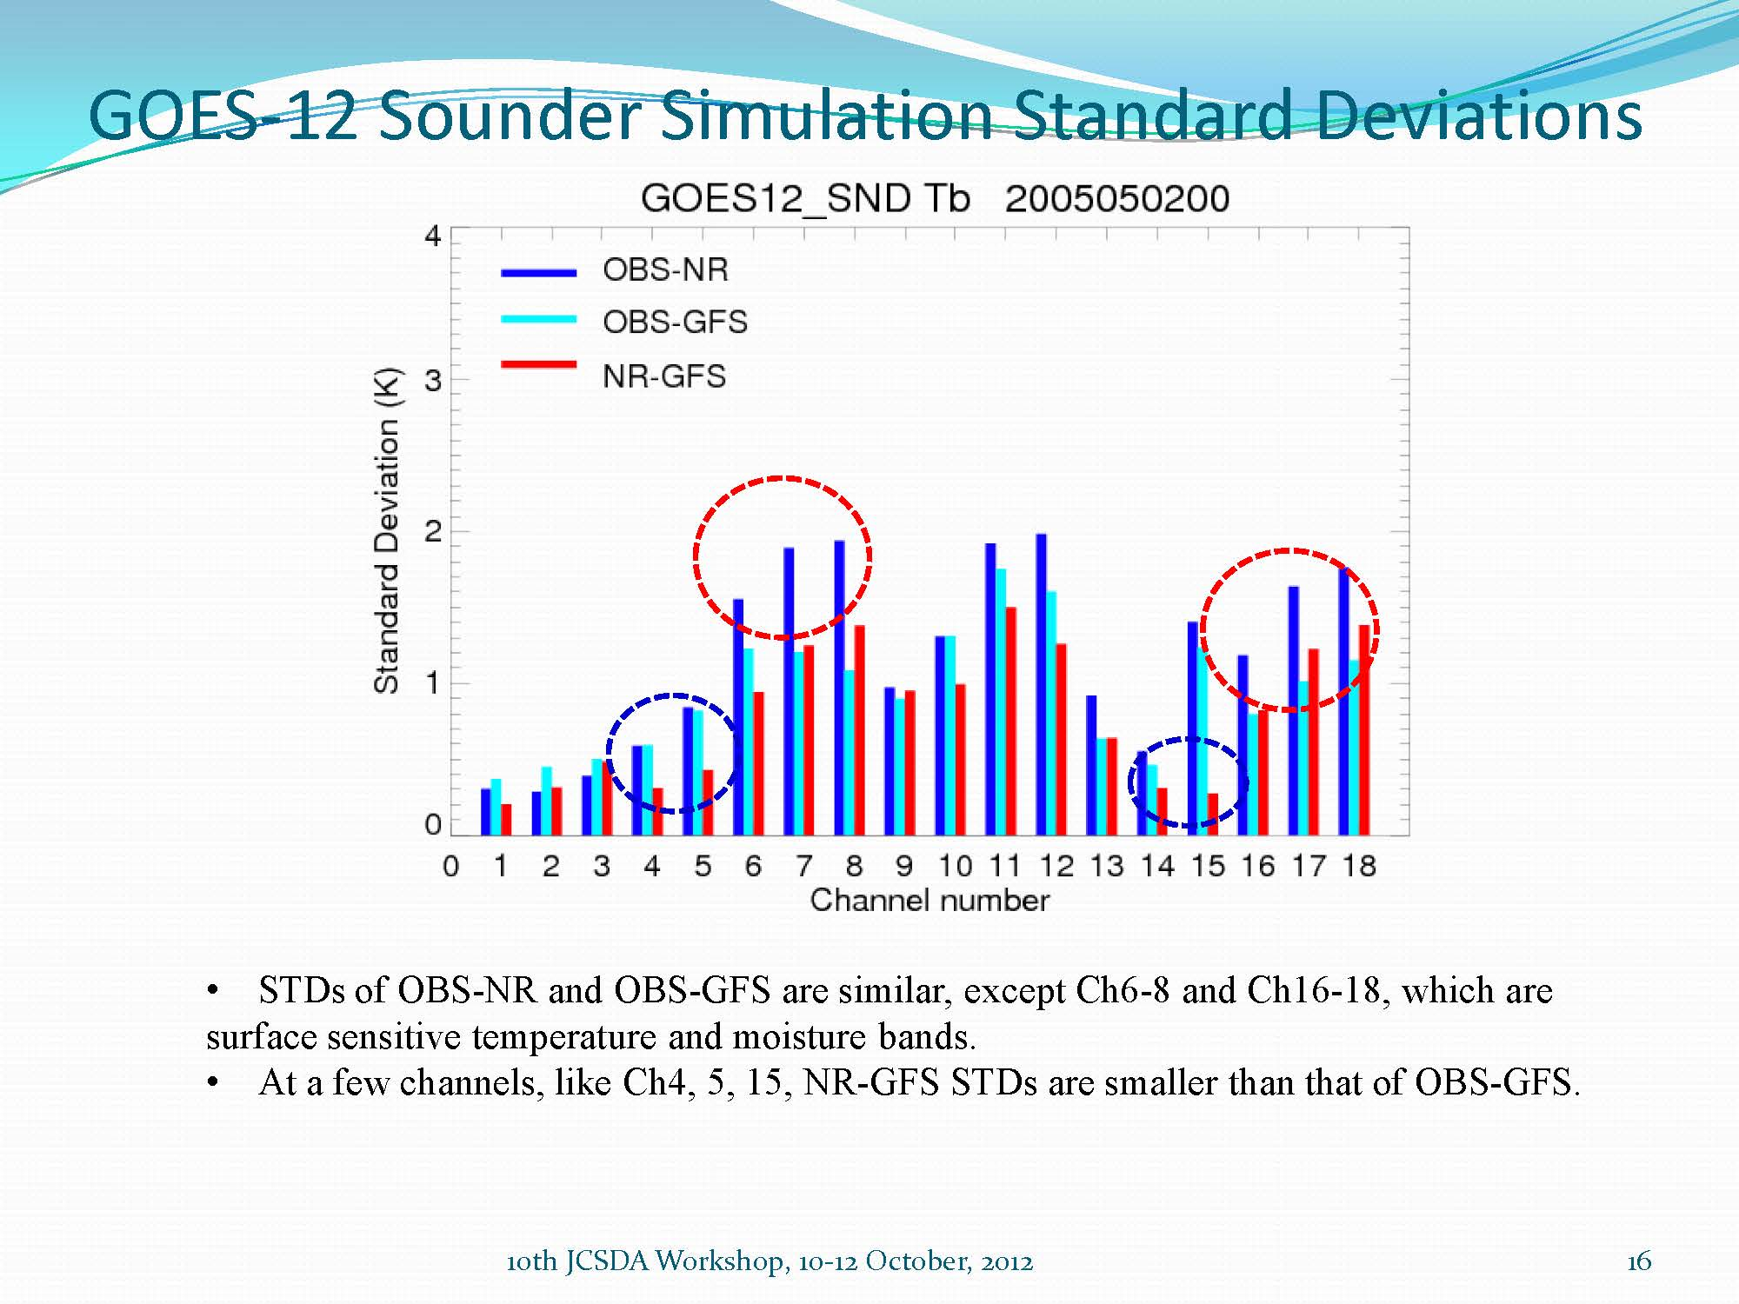
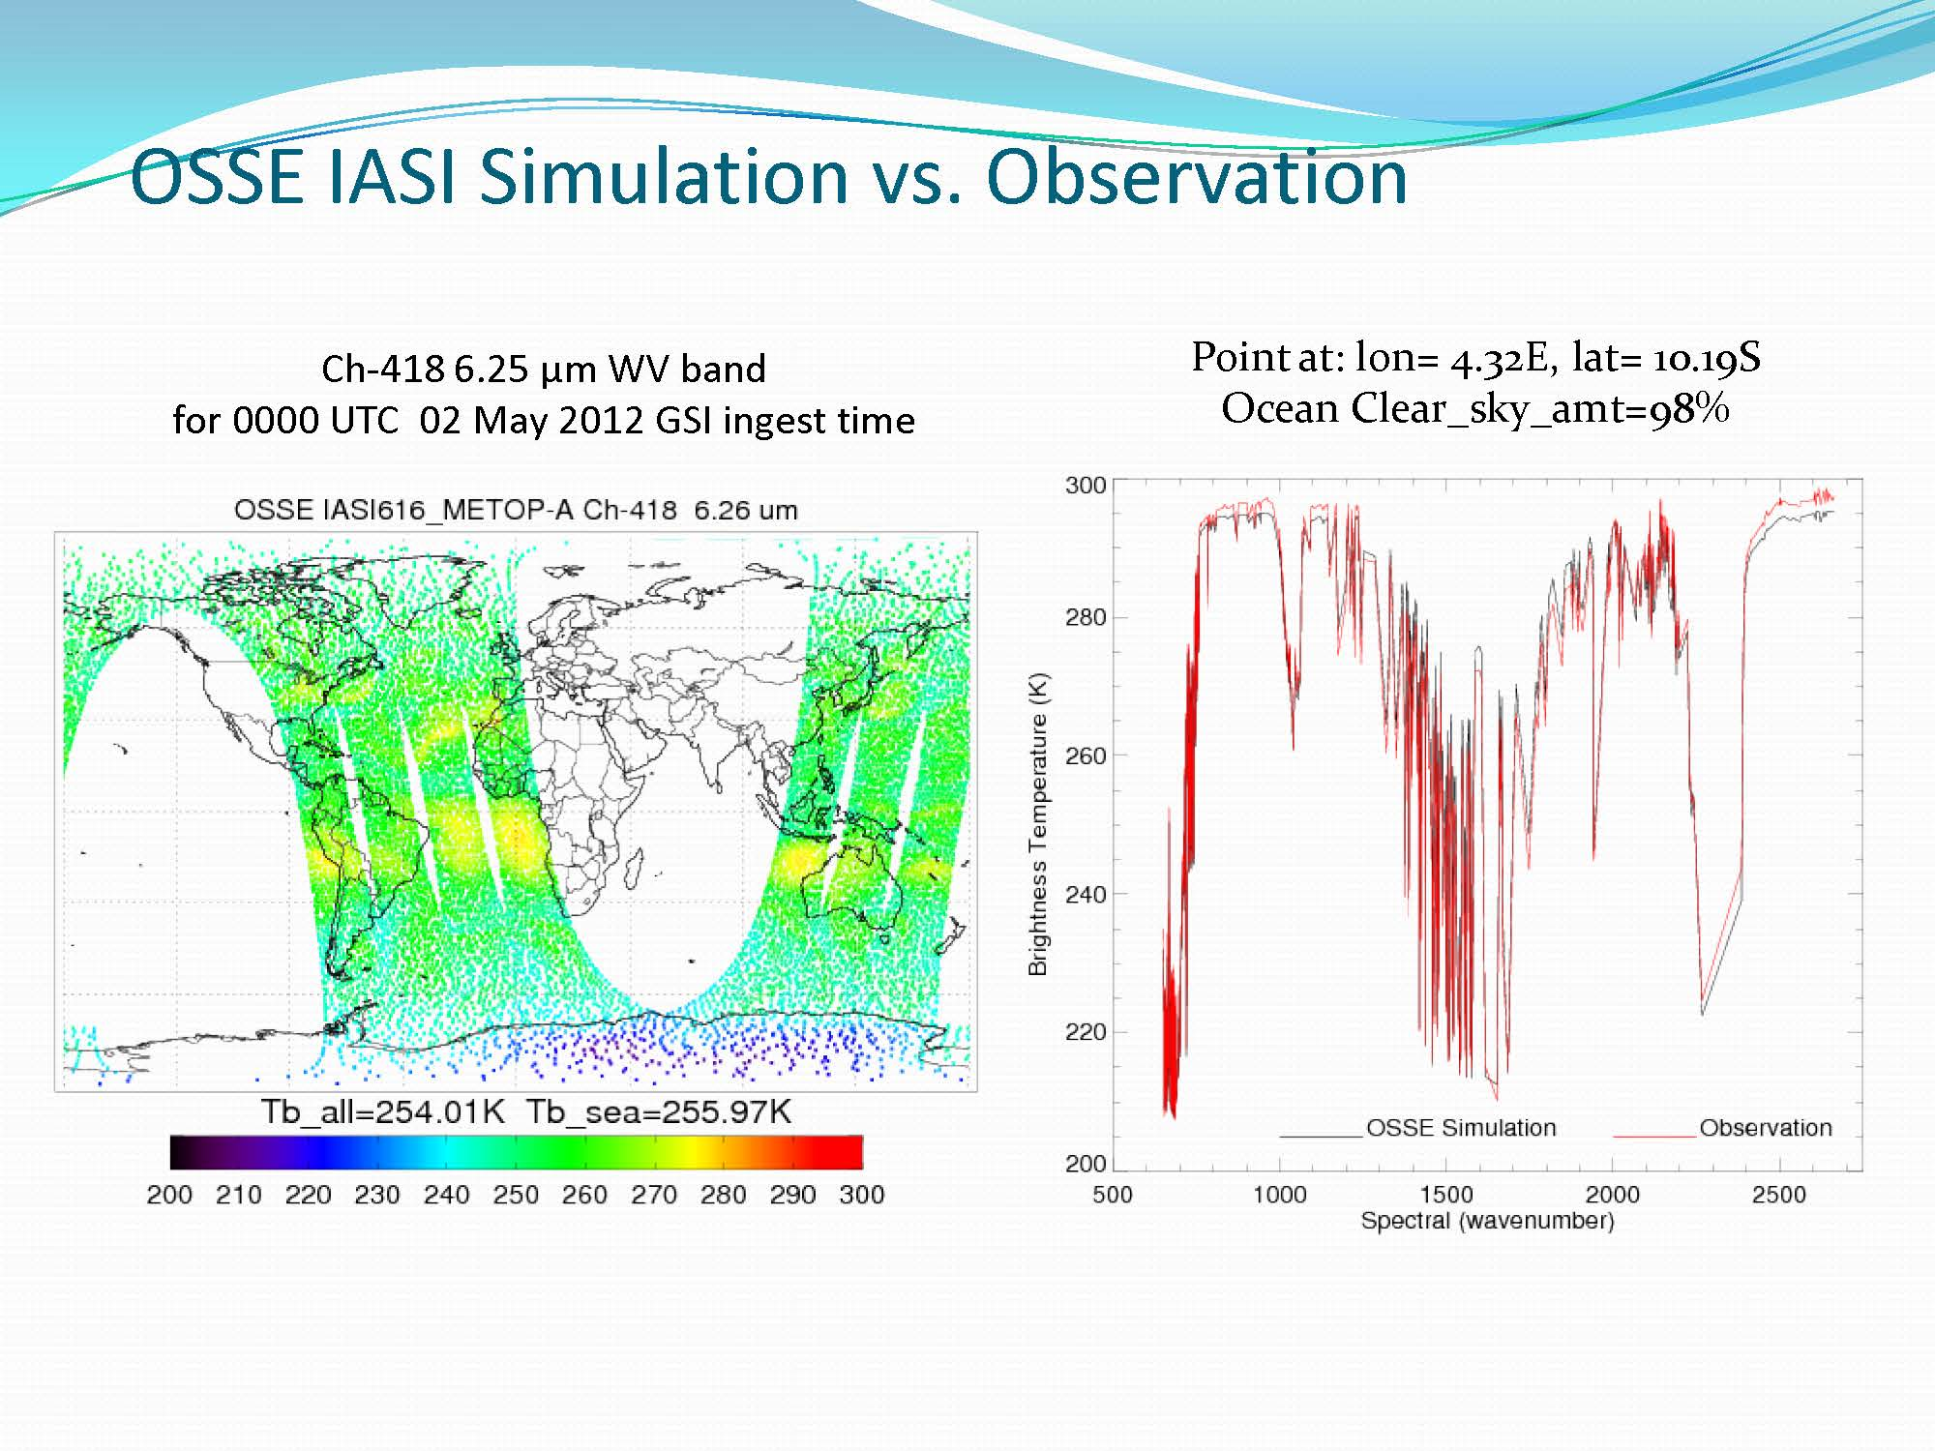
Evaluation of simulated radiance of the Nature Run
simulated with 2012 template
Tong Zhu, Fuzhong Weng (NESDIS) et al.
♦ In general, the simulated radiances display similar statistical characteristics (bias & STD) as those derived from the operational GSI analysis for AMSU-A.
♦ The AMSU-A synthetic radiances can reproduce inter-channel correlation features, and symmetric angular dependent features. The asymmetric angular dependent bias cannot be simulated.
♦ The error characteristics of simulated GOES-12 temperature sounding channels are similar to those from operational GFS analysis; while those biases of moisture and surface channels are approximately 2K.
♦ Using the ECMWF T511 NR data, we are simulating all satellite radiances data for 2012 in order to include the sensors used in GSI after 2006.
♦ Simulate future instruments, such as GOES-R ABI.
♦ Simulate synthetic radiance with ECMWF T799 NR data.

Slide 7
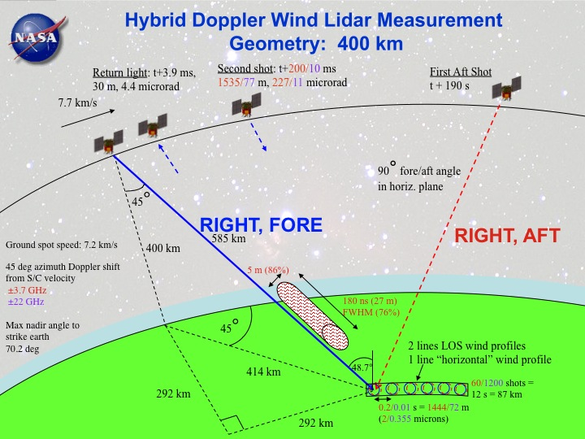
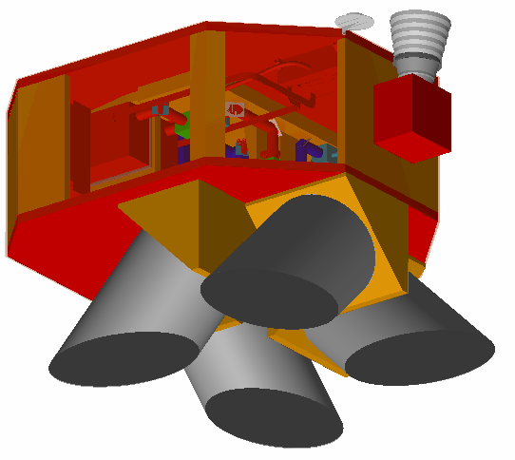
OSSE to evaluate Impact of GWOS DWL
GWOS: Global Wind Observing Sounder
( TJ43.7 IOAS-AOLS)
Riishojgaard, L. P., Z. Ma, M. Masutani, J. S. Woollen, G. D. Emmitt, S. A. Wood, and S. Greco 2012: “Observation System Simulation Experiments for a Global Wind Observing Sounder,” Geophys. Res. Lett., 39, L17805, doi:10.1029/2012GL051814.
The coherent subsystem provides very accurate (< 1.5m/s) observations when sufficient aerosols (and clouds) exist.
The direct detection (molecular) subsystem provides observations meeting the threshold requirements above 2km, clouds permitting.
Simulated observation
Control data: Observation type and distribution used by reanalysis for 2005.
Observational error is not added to the control data but calibration was performed to demonstrate the impact of observational error in control data.
DWL data: GWOS concept DWL simulated by Simpson weather associates.
Star Tracker
Nadir
Telescope Modules (4)

Slide 8
Case Study to compare impact of DWL with model resolution
AC difference in AC, with and without GWOS
Atlantic Hurricane in the nature run for the analysis period of 9/25-10/10
NH 12 hourly sampling, Average of 1000, 700, 500, 250 hPa Height Oct1-Oct10, 2005
Initial Summary of Hurricane OSSE
At least T170 resolution is required to utilize DWL data for hurricane case. Impact of DWL is larger in T254 than in T170 model forecast. T382 model for OSSE with T511 Nature run may not be the best.
Increasing resolution and adding DWL are equally important to improve large scale forecast skill.
DWL data is more effective in improving forecast for small scale event.
OSSE with control observation without observational error is useful to provide initial outlook of data impact a new type of observation.
Further experiments with observational error is required.
Impact in short wave is much stronger than that in large scale wave. Impact in wind is stronger than that in height.in fact the impact on V only is even stronger

Slide 9
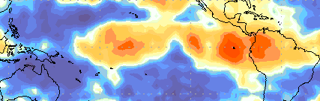
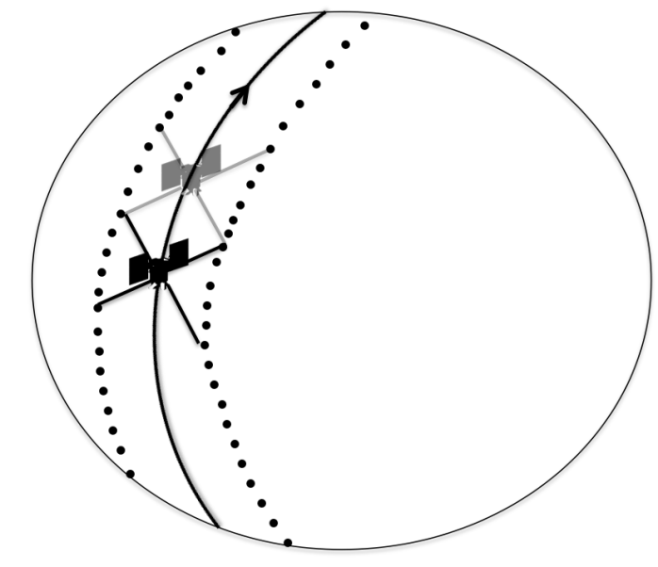
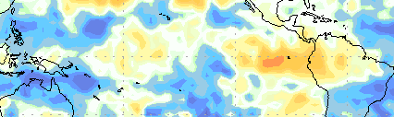
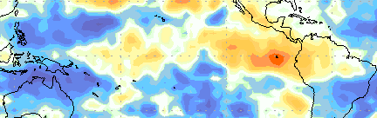
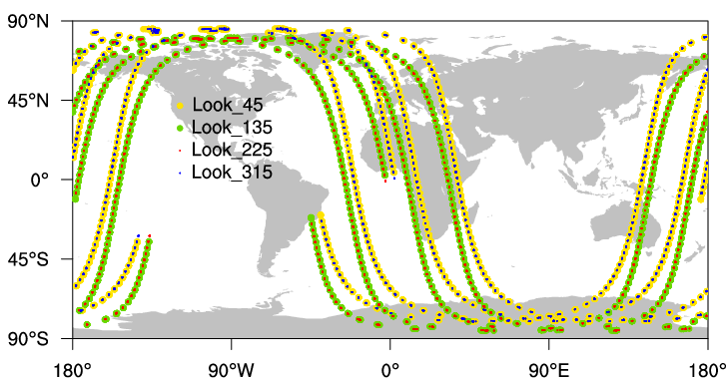
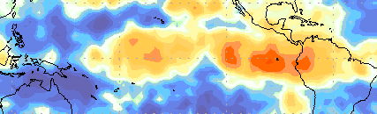
Some subtle results which require OSSEs
Testing advantage of producing vector wind.
GWOS Lidar Wind obs
Reduction of RMSE from NR in H500 Analysis (Averaged between July 7-August 15)
Four Looks
315°
135°
Four time more observation
45°
225°
315°
One Look
(right fore only)
Two front looks
(righr fore and left fore)
Distribution of Lidar observations at 2005072100
Same number of observation
Two one side looks
(right fore and right aft deg)
To produce vector wind
Two synchronized one side looks right fore and right aft look which provide vector winds show advantage in tropics compare with two left and right fore look. To be published in Masutani et al (2012), proceeding for SPIE Asia-Pacific Remote Sensing 2012.
Diagram by Zaizhong Ma
9

Slide 10
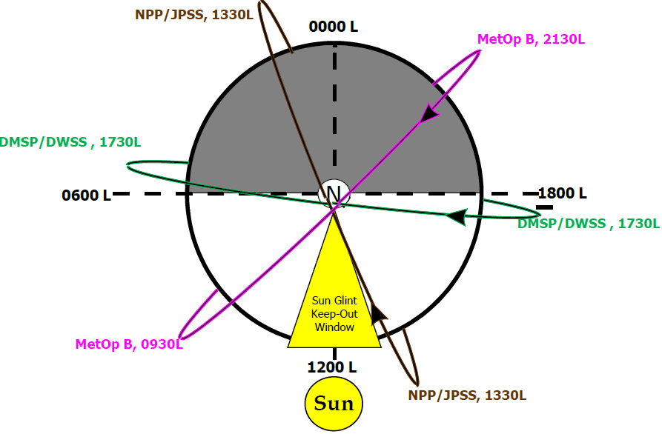
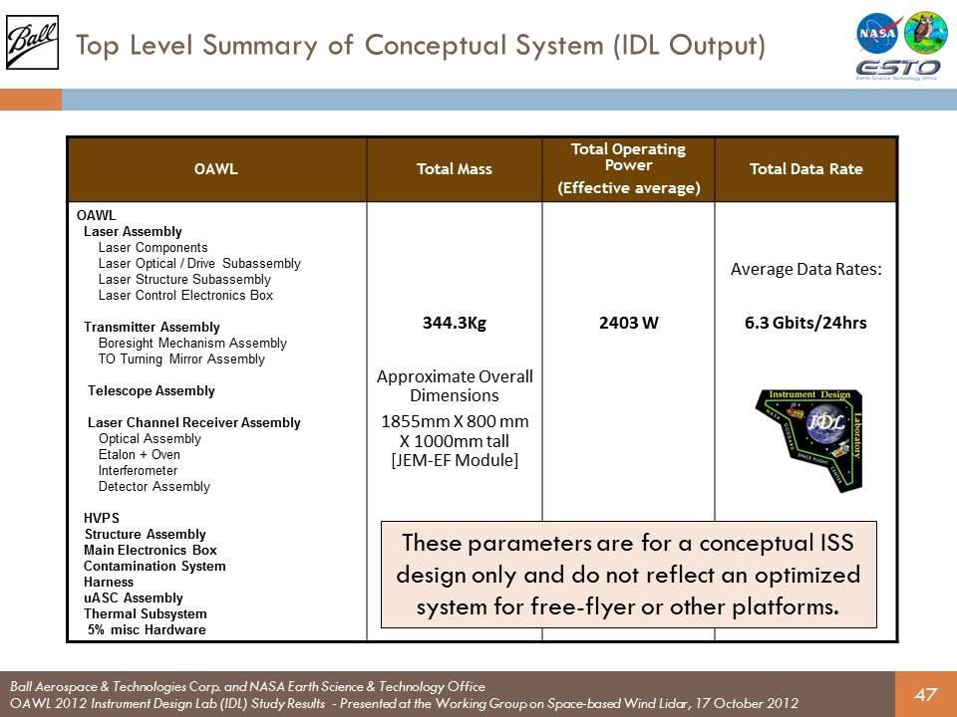
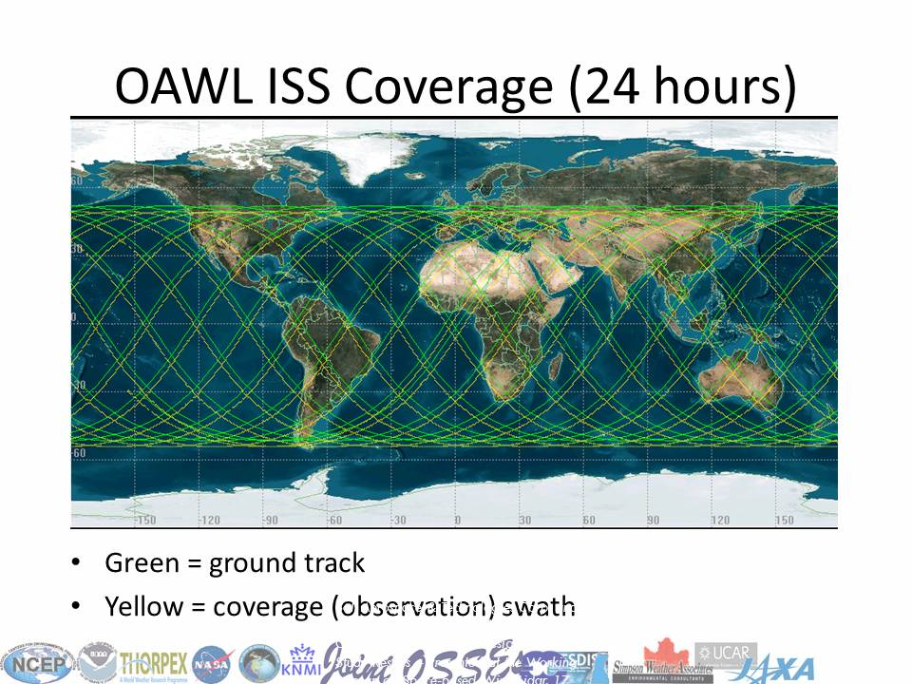
Work in progress on OSSE at JCSDA
OSSE to evaluate the third polar orbits
From Sean Casey et al (JCSDA) , J4.4 JCSDA session part3
Conduct OSSE to evaluate satellite system in early-morning orbit (The third polar orbit)
Conduct OSSE to evaluate Optical Autocovariance Wind Lidar (OAWL) developed by Ball Aerospace
Further evaluation of space based DWL (Stand by for further resource)
Add various observational errors to control observations and study data sensitivity to the data impact. Use teplate from real observation.
Designing OSSE on Arctic Observing Network
Upgrade simulation of radiance
Exchange control observation with other institutes
Following the cancellation of the NPOESS program in February 2010, US plans for sounding coverage in the early morning orbit (~5:30 AM ECT) were put on hold indefinitely. How might the lack of early morning sounding coverage affect medium-range weather forecasts? Which of three suggested replacement satellites would have the greatest forecast impact?
Image Courtesy F. Weng
Key Questions
Three polar orbits? Or two?
How might the lack of early morning sounding coverage affect medium-range weather forecasts?
Which of three suggested replacement satellites would have the greatest forecast impact?
Initial outlook of the results
Current OSSE work demonstrates the importance of a meteorological satellite in the early-morning orbit
Losing SSMI/S causes significant decreases in model analysis and forecast skill, especially in Southern Hemisphere and tropical winds
Best performing replacements for SSMI/S are a combination of ATMS/CrIS or a combination ATMS/VIIRS; VIIRS alone causes little improvement
Future work will include continuing experiment for Jan/Feb, to compare hemispheric seasonal effects

