Slide 1
OSSEs in the JCSDA
Presentation at AMS annual meeting
Observing System Simulation Experiments in the Joint Center for Satellite Data Assimilation, 18th Conference on Satellite Meteorology, Oceanography and Climatology/ First Joint AMS-Asia Satellite Meteorology Conference, Lars Peter Riishojgaard et al.
Impact of Different Wind Lidar Configurations on NCEP Forecast Skill. 16th Symposium on Integrated Observing and Assimilation Systems for the Atmosphere, Oceans, and Land Surface (IOAS-AOLS), Zaizhong Ma et al.
Posters
Internationally Collaborative Joint OSSEs - Progress At NOAA, T. N. Krishnamulti Synposium, Michiko Masutani (EMC) et al.
Joint OSSEs at NOAA, Evaluation of DWL, JPSS, and DWSS, Eighth Annual Symposium on Future Operational Environmental Satellite Systems, Michiko Masutani et al

Slide 2
Observing System Simulation Experiments in the Joint Center for Satellite Data Assimilation
Lars Peter Riishojgaard^{1,2}, Zaizhong Ma^{1,2},
Michiko Masutani³, Jack Woollen^{3,}
Dave Emmitt⁴, Sid Wood⁴, Steve Greco⁴
¹Joint Center for Satellite Data Assimilation
²University of Maryland College Park
³NCEP Environmental Modeling Center
⁴Simpson Weather Associates

Slide 3
Role of a National OSSE Capability
Impact assessment for future missions
  Future operational observing systems (NOAA)
  Decadal Survey and other science and/or technology demonstration missions (NASA)
  Other agencies (e.g. DoD/DWSS)
Objective way of establishing scientifically sound and technically realistic user requirements
Tool for assessing performance impact of engineering decisions made throughout the development phases of a space program or system
Preparation/early learning pre-launch tool for assimilation users of data from new sensors

Slide 4
Joint OSSE history
NASA/NOAA collaboration started in 2007, involving NASA/GSFC, NOAA/NESDIS, NOAA/NWS, NOAA/OAR
Centered around common use of Nature Run provided free of charge by ECMWF
Coordinated through JCSDA
  Informal, loosely structured nature, lack of common funding stream has presented challenges
Successful joint validation of ECMWF Nature Run
Some collaboration on simulation and calibration of observations
ADM experiments (GMAO)
GWOS experiments (JCSDA)
UAS experiments (OAR)

Slide 5
Wind Lidar OSSEs
Impact experiments for GWOS mission concept
  NASA Tier-3 Decadal Survey mission concept
  Four telescopes, full vector winds on either side of spacecraft
  Two technologies, direct and coherent detection
Experiments funded under Wind Lidar Science element of NASA’s ROSES 2007
GWOS observations simulated by Simpson Weather Associates using DLSM

Slide 6
Which upper air observations do we need?
Numerical weather prediction requires independent and global observations of the mass (temperature) and wind fields
The global three-dimensional mass field is well observed from space
No existing space-based observing system provides vertically resolved wind information => horizontal coverage of wind profiles is sparse

Slide 7
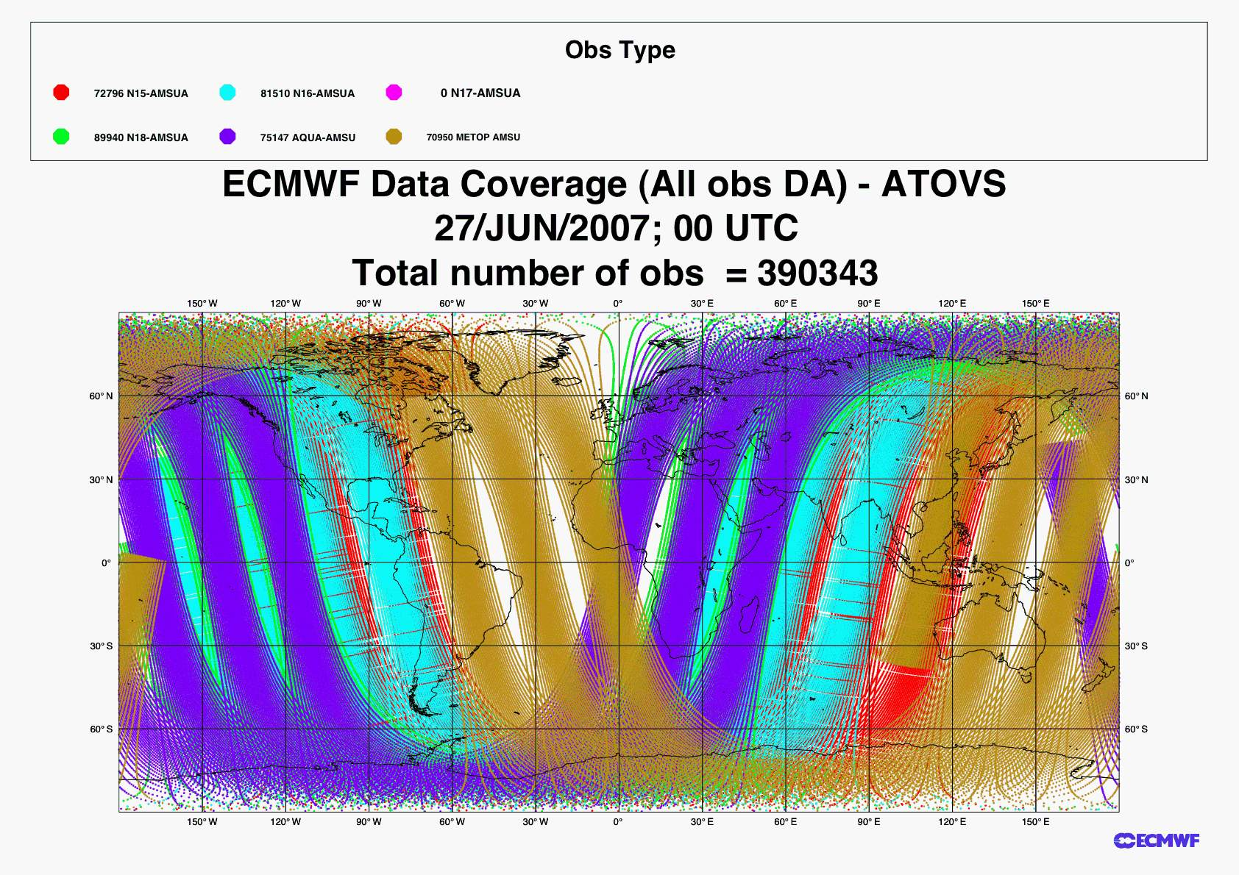
Temperature profiles (AMSU; 6 hours)

Slide 8
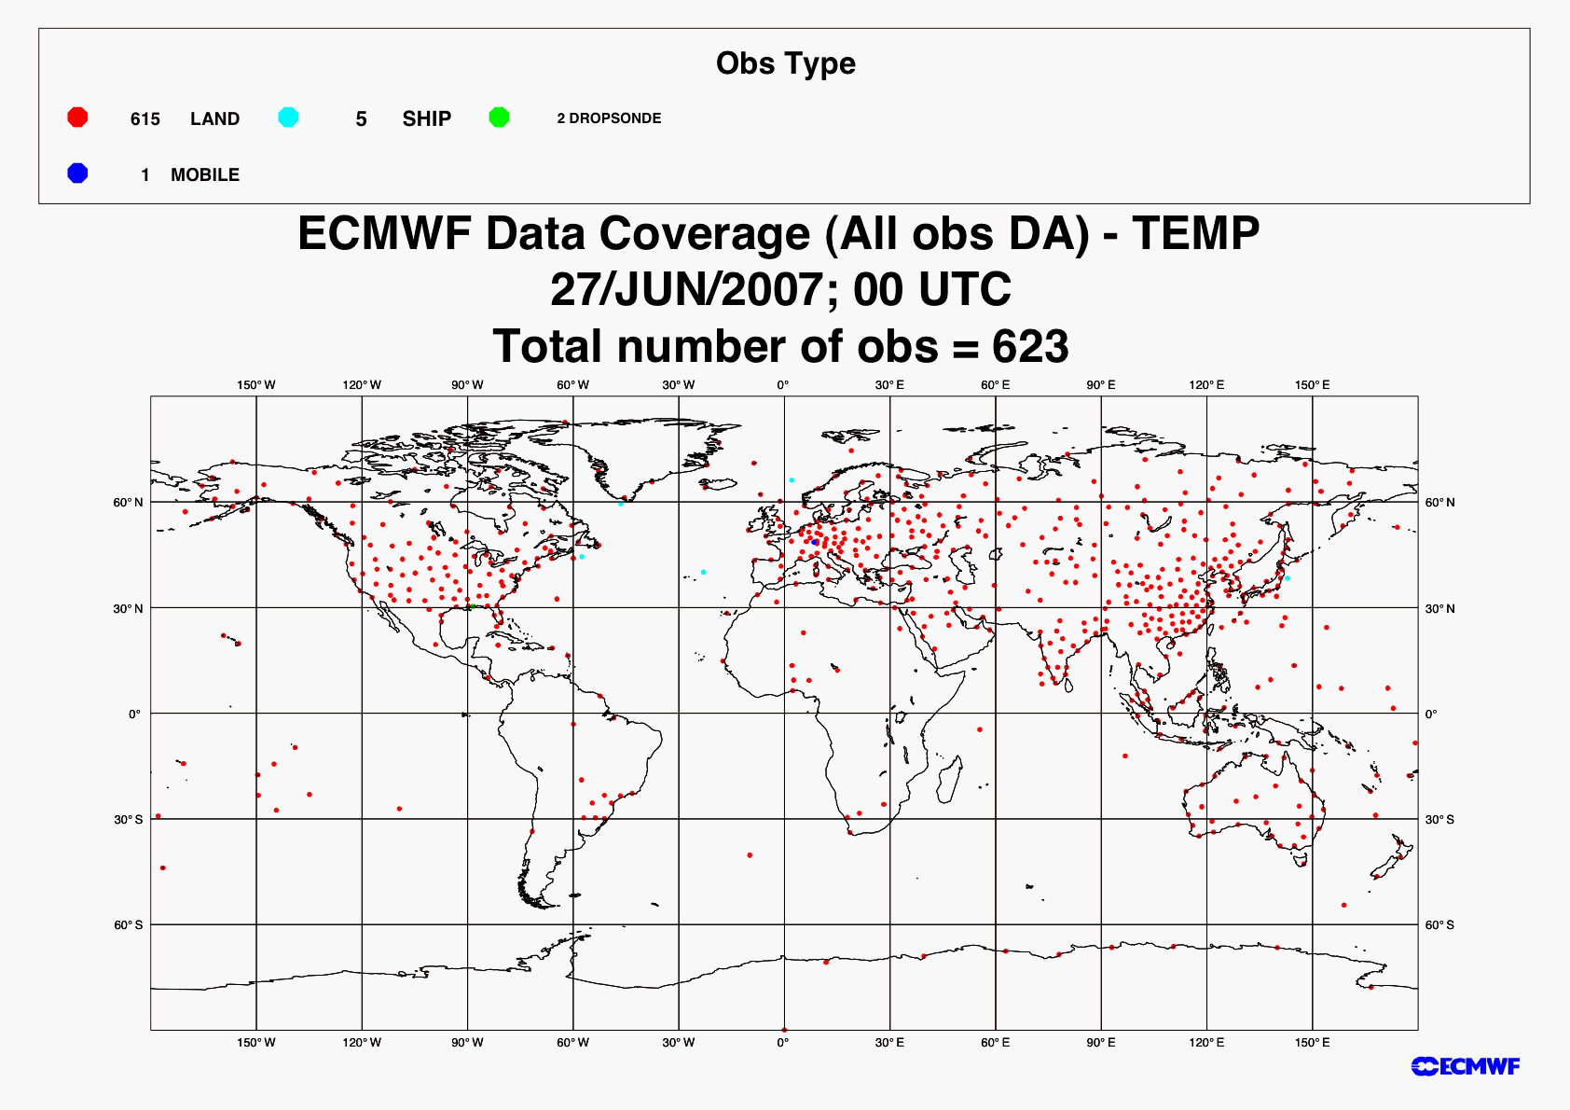
Observed wind profiles (RAOBs, 6 h)

Slide 9
Doppler Lidar Measurement Concept
DOPPLER RECEIVER - Multiple flavors - Choice drives science/ technology trades
Coherent or heterodyne aerosol Doppler receiver
Direct detection molecular Doppler receiver
Coherent
2 micron
355nm
Direct detection
Backscattered Spectrum
Δν_{DOP}
Aerosol (λ⁻²)
Molecular (λ⁻⁴)
Frequency

Slide 10
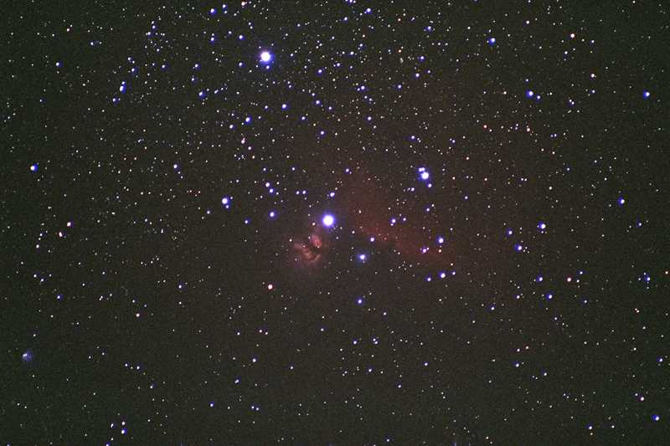

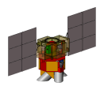
Hybrid Doppler Wind Lidar Measurement Geometry: 400 km
Return light: t+3.9 ms, 30 m, 4.4 microrad
Second shot: t+200/10 ms
1535/77 m, 227/11 microrad
First Aft Shot
t + 190 s
7.7 km/s
90° fore/aft angle
in horiz. plane
45°
RIGHT, FORE
585 km
RIGHT, AFT
Ground spot speed: 7.2 km/s
400 km
45 deg azimuth Doppler shift
from S/C velocity
±3.7 GHz
±22 GHz
Max nadir angle to
strike earth
70.2 deg
5 m (86%)
180 ns (27 m) FWHM (76%)
45°
2 lines LOS wind profiles
1 line “horizontal” wind profile
414 km
48.7°
60/1200 shots = 12 s = 87 km
292 km
0.2/0.01 s = 1444/72 m
(2/0.355 microns)
292 km

Slide 11
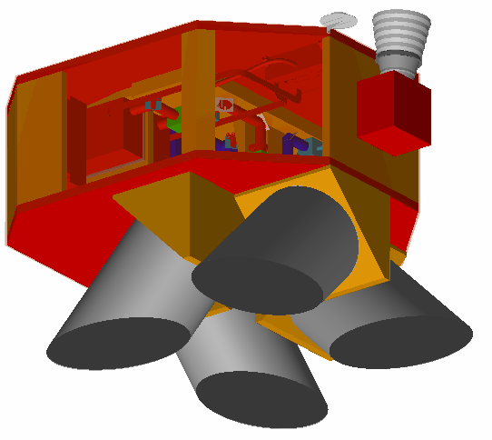
GWOS ISAL Instrument Quad Chart
GPS
Features of the Instrument Concept
Star Tracker
Utilizes Doppler lidar detection method
  Coherent (aerosol) detection @ 2 µm
  Direct (molecular) detection @ 355 nm
Direct channel laser based on GLAS;
Direct channel receiver based on TWiLiTE IIP
Coherent channel laser and receiver based on DAWN IIP
Telescopes are shared among all lasers
Pointing and knowledge requirements met with co-located star tracker and GPS
Nadir
Telescope Modules (4)
Payload Data
Technology Development Needs
Dimensions | 1.5m x 2m x 1.8m
Mass | 567 Kg
Power | 1,500 W
Data Rate | 4 Mbps
Direct detection system requires 6 billion shots for mission lifetime (2 years)
  Direct channel baseline is 3 lasers + 1 backup
  Demonstration of reliable performance at higher or lower lifetimes will determine number of lasers for direct detection channel, impacting mission cost
Coherent detection system requires demonstration of the 316M shot lifetime in a fully conductively cooled laser
Both Lidar technologies require aircraft validation flights

Slide 12
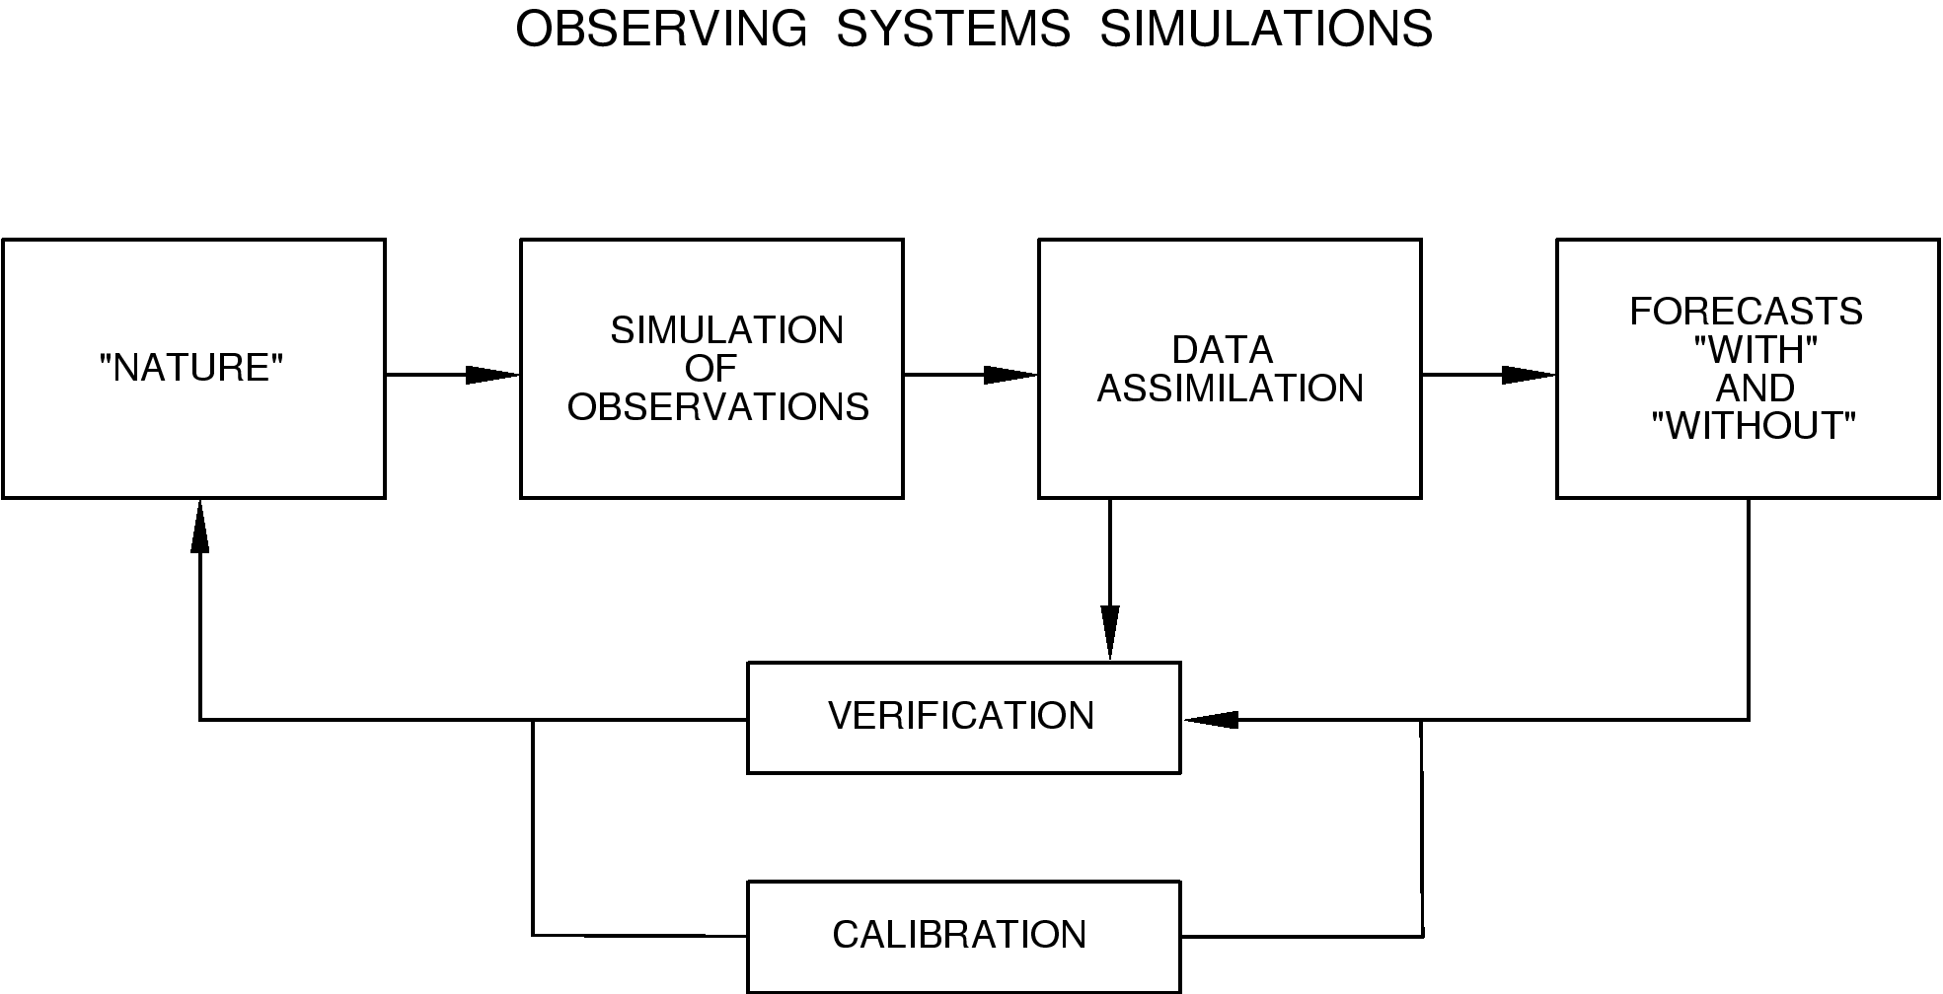
Observing System Simulation Experiments
Data assimilation system(s)
  NCEP/EMC Global Forecast System (T-382) coupled with GSI
Nature run
  ECMWF T-511, commissioned for Joint OSSE
    13 month period (May 2005-June 2006)
    Validated extensively through Joint OSSE collaboration
Simulated observations
  Reference observations, including satellite radiance data (all observation)
  Perturbation (“candidate”) observations
  GWOS observations simulated by Simpson Weather Associates
Diagnostics capability
  NCEP operational verification system

Slide 13
Experimental setup
NCEP GFS at a range of horizontal resolutions between T-126 and T-382 (previous operational resolution at NCEP; NR cannot accommodate current T-574 resolution)
“OSSE period”: July 01-Aug 15，2005 (simulated)
  Five-day forecast launched every day at 00Z
  Most observing systems used for routine operational NWP included, except GPSRO and IASI (will be included once we simulate 2010/11 GOS)
Four experiments, all verified against Nature Run
  CRTL: Observations as assimilated operationally by NCEP
  NOUV: as CTRL, but without RAOBS (220, 221 and 232)
  NONW: as CTRL, but without any wind observations
  DWL : as CTRL, plus simulated GWOS lidar wind data
Experiments done with “perfect data”
  No observation error added (simple random errors tested; no significant changes to conclusions)
  Simulated with assumed observation errors used in operations

Slide 14
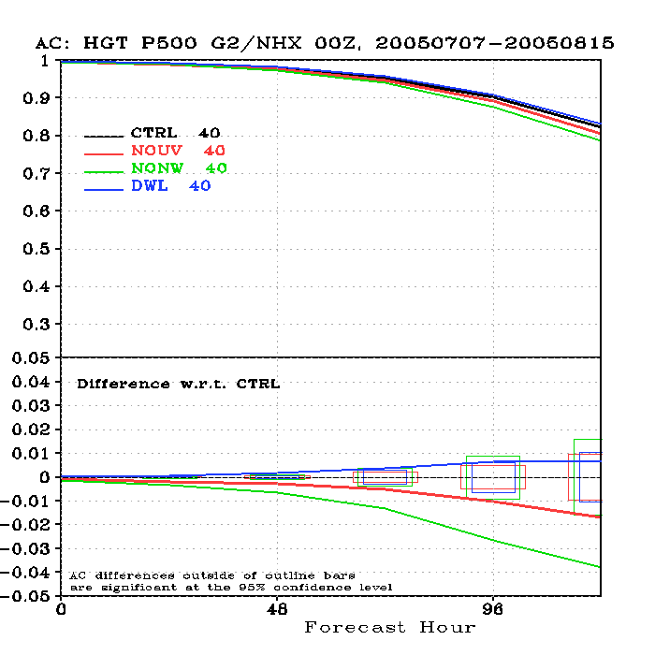
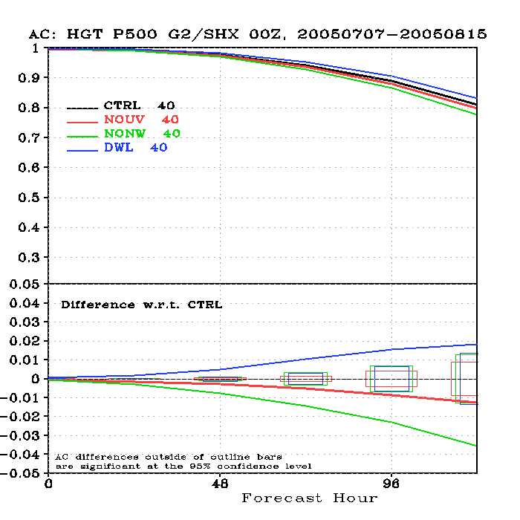
500hPa HGT anomaly correlation coefficients (T126)
NH
SH
1.8%
0.8%

Slide 15
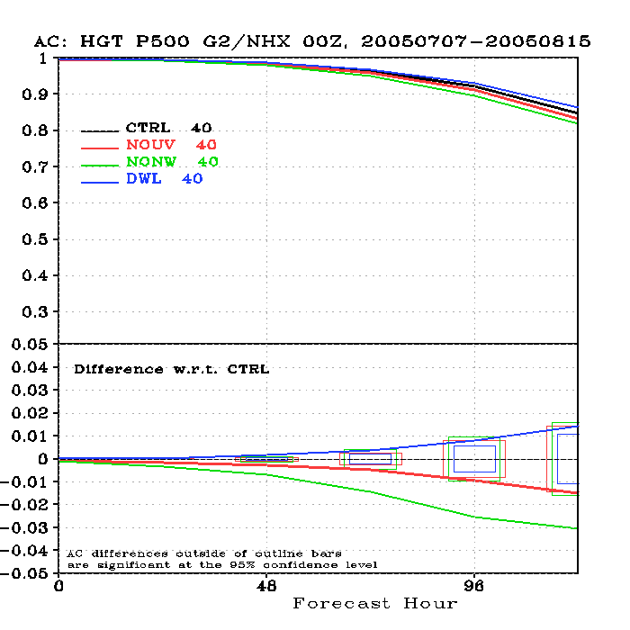
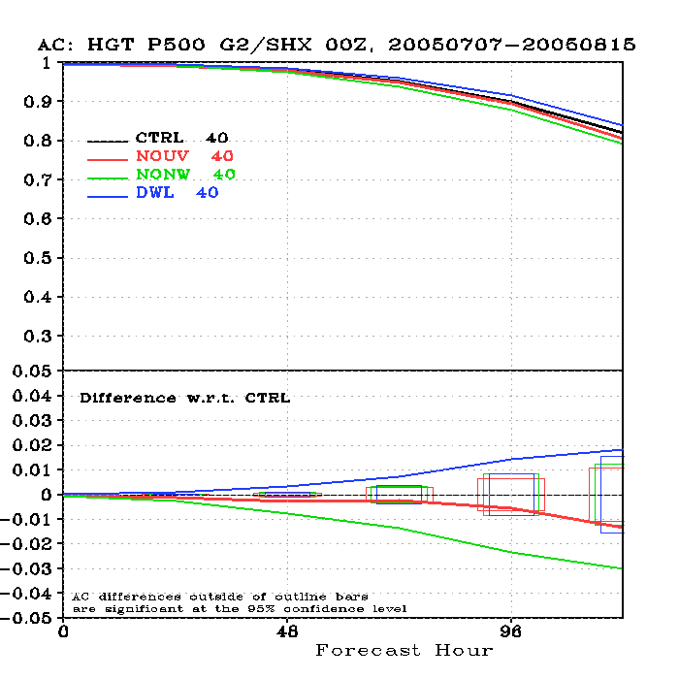
500hPa HGT anomaly correlation coefficients (T382)
NH
1.2%
SH
1.8%
Impact of DWL observations is larger at the higher resolution (T382), even though skill of control is higher

Slide 16
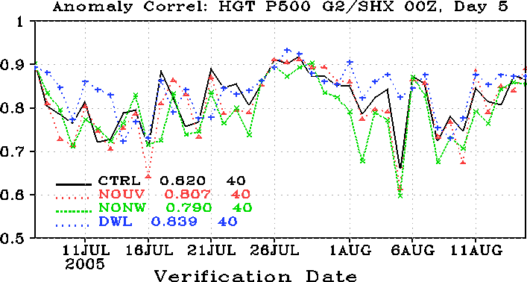
Time series of 500hPa geopotential height AC
Candidates for additional study
500hPa SH

Slide 17
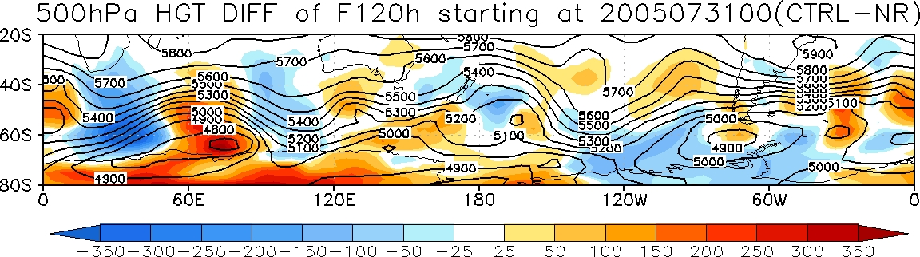
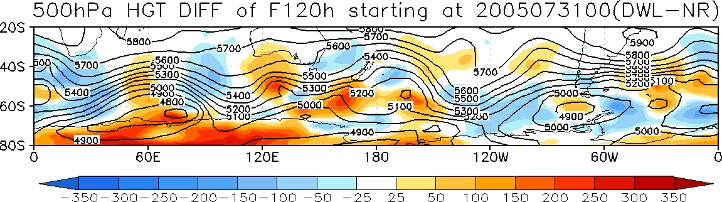
Special Case Study:
5 days forecast starting from July 31st
Open the link for the movies
http://www.emc.ncep.noaa.gov/seminars/presentations/2012/WLS_OSSE_20120214/fig_ctrl_100.gif
http://www.emc.ncep.noaa.gov/seminars/presentations/2012/WLS_OSSE_20120214/fig_dwl_100.gif

Slide 18
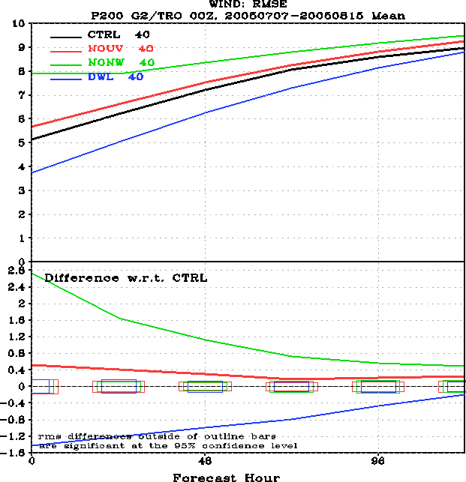
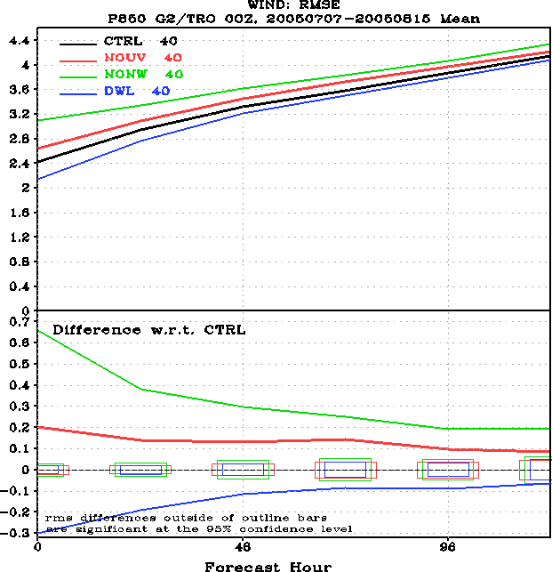
RMSE: 200, 850hPa Wind error in tropics
(T382)
200hPa
850hPa

Slide 19
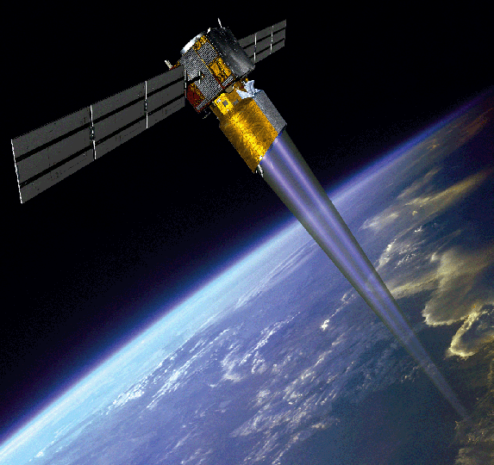
Impact of Different Wind Lidar Configurations on NCEP Forecast Skill.
Single LOS or Vector Winds?
Important configuration issue for GWOS (impact vs. cost); ESA’s ADM/Aeolus wind mission has single Light-of-Sight (LOS).
Experiments need to be performed with variable number of perspectives:
  One; single line of sight, similar to ADM/Aeolus
  Two; full horizontal wind vectors, left or right side of satellite track
  Four; full GWOS coverage; wind vectors on both sides of satellite track
ADM
GWOS

Slide 20
Experiment Design
Four experiments, all verified against Nature Run
  CTRL :Observations as assimilated operationally by NCEP ;
  DWL1: As CTRL with one-telescope DWL data added, single perspective (45°);
  DWL2: As CTRL with two-telescope DWL data added, two-perspective (45° and 315°);
  DWL : As CTRL with four-telescope DWL data added (four looks);
0100 July
0200 July
……
1500 Aug
Cycling experiments with 6h assimilation window from July 01 to Aug 15, 2005
EXP: CTRL, DWL1, DWL2, DWL
5-day Forecast
5-day Forecast
  Five-day forecast launched every day at 00Z

Slide 21
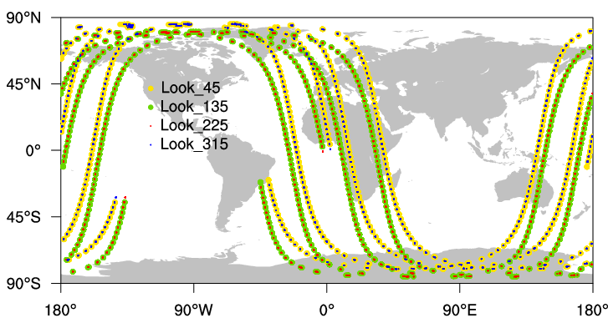
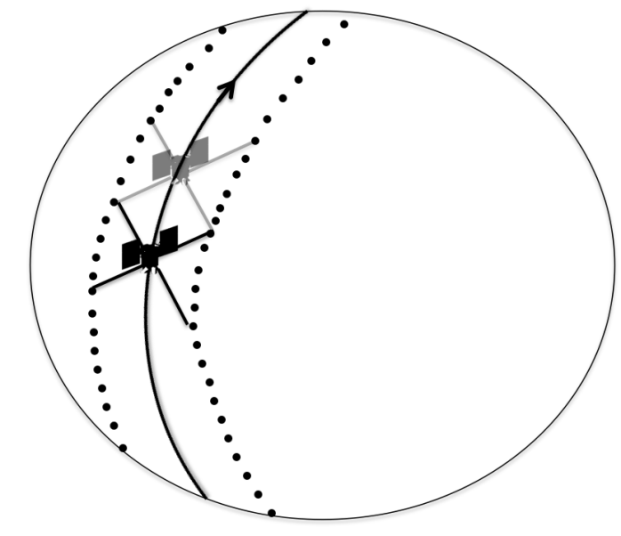
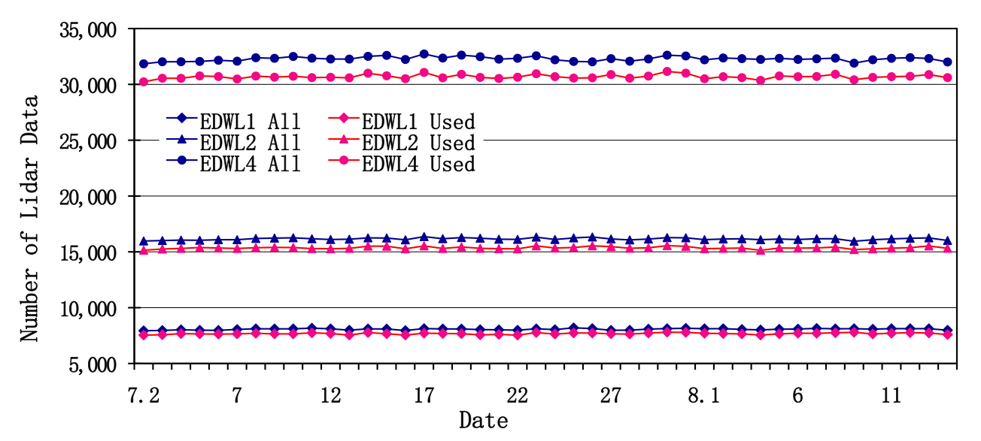
GWOS Lidar Wind obs
135°
45°
225°
315°
Distribution of Lidar observations at 2005072100
Number of Lidar obs per analysis cycle (shown only for 00Z)

Slide 22
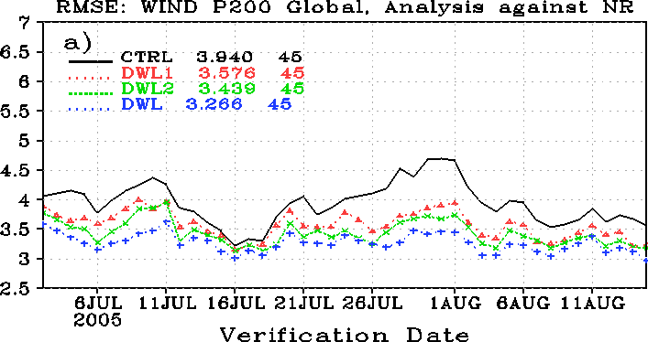
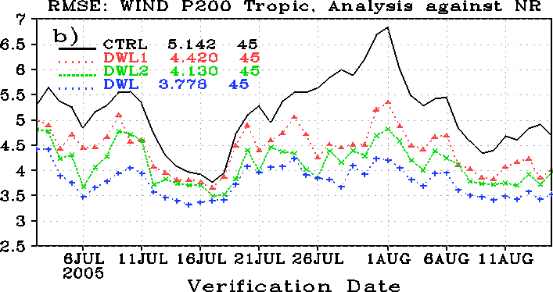
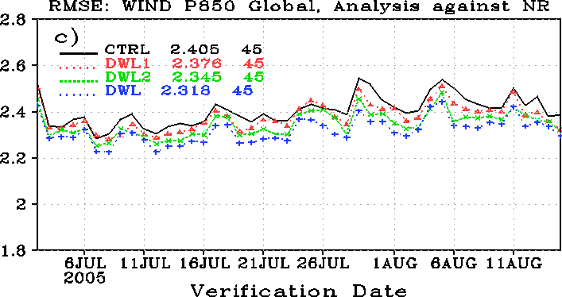
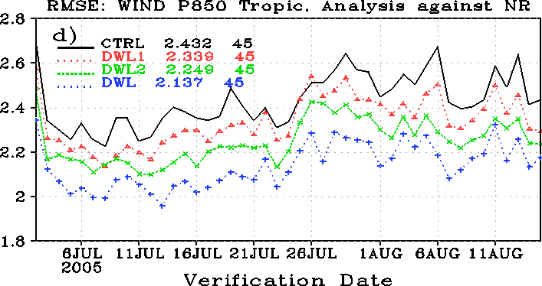
Analysis Impact: Wind

Slide 23
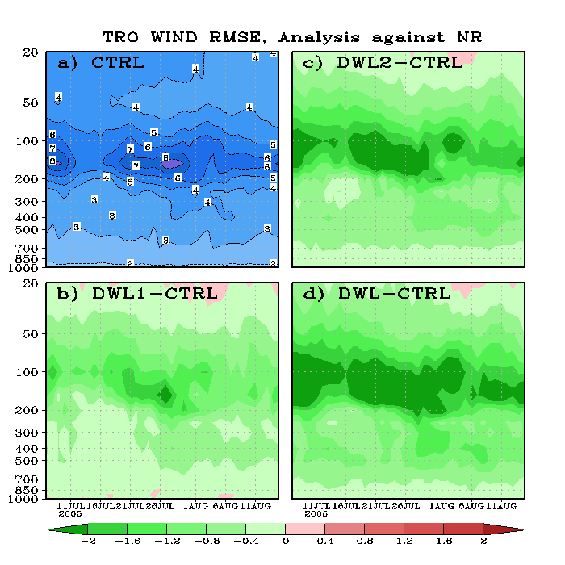
Analysis Impact: Wind …
(Tropical Wind RMSE)

Slide 24
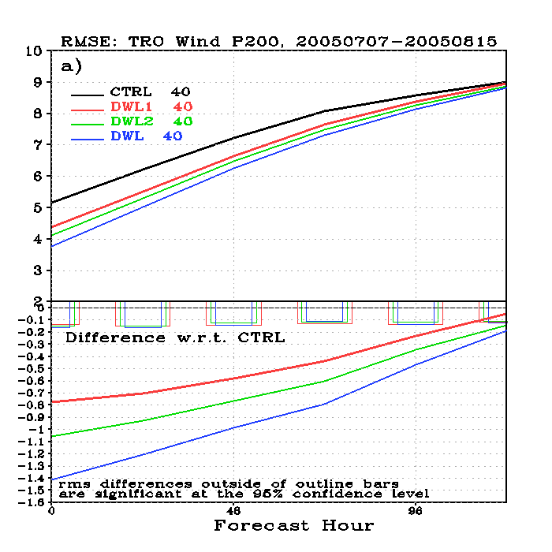
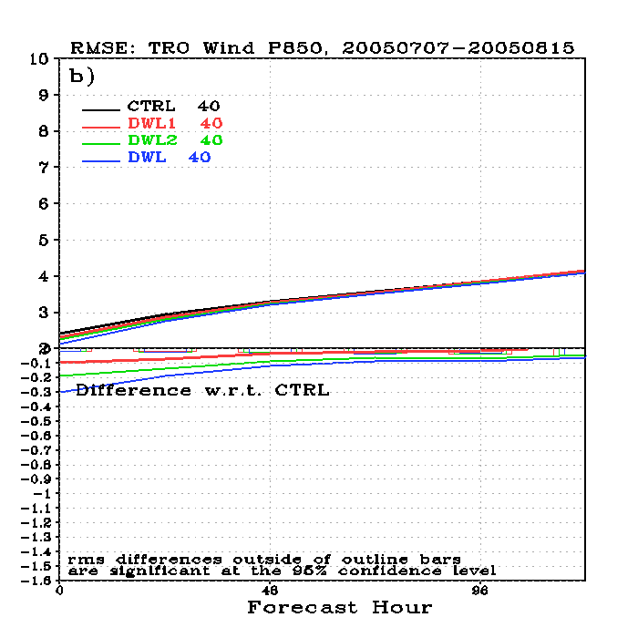
Forecast: Tropical Wind
(RMSE at 200, 850hPa)
200hPa
850hPa

Slide 25
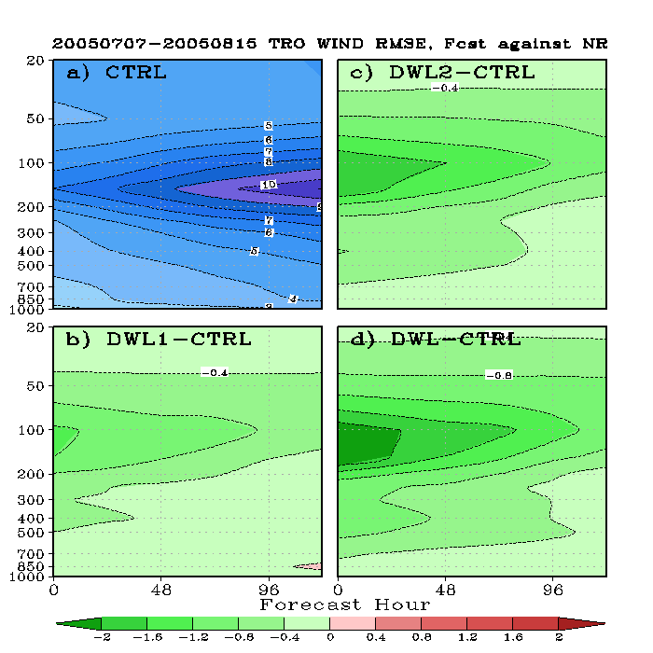
Forecast: Tropical Wind …
(RMSE for the whole pressure levels)

Slide 26
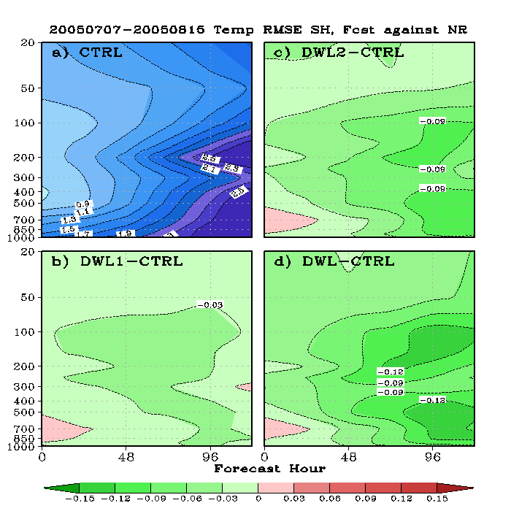
Forecast: Tropical Temperature
(RMSE for the whole pressure levels)

Slide 27
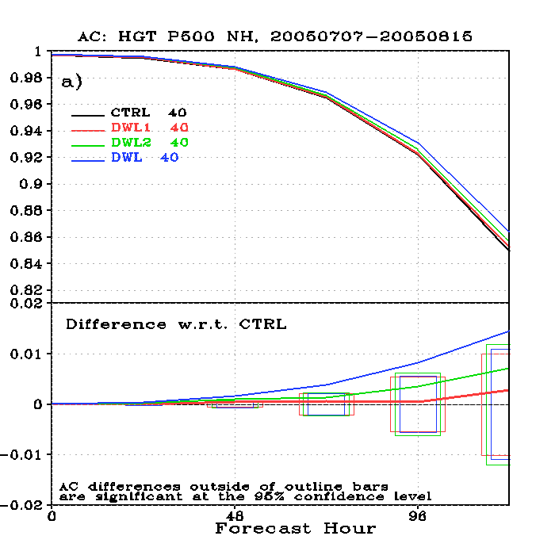
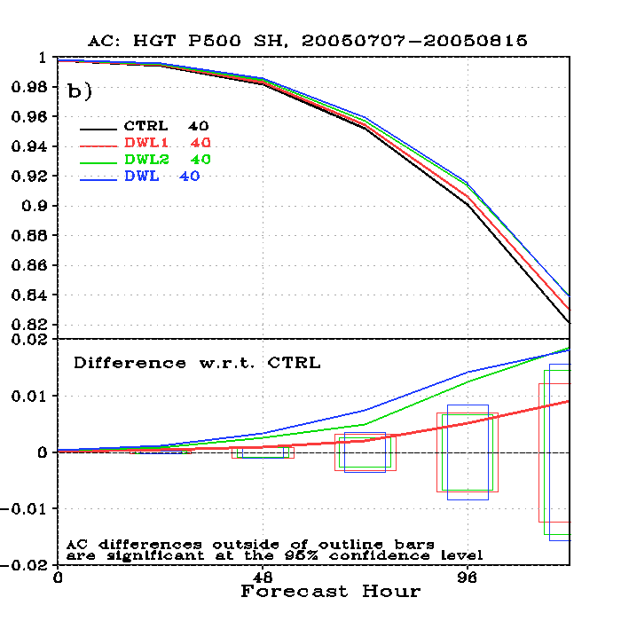
Forecast Impact: Geopotential Height AC
(500 hPa AC coefficients)
NH
SH

Slide 28
Summary and conclusions
The lack of vertically resolved wind observations continues to be a major shortcoming of the Global Observing System
  Here shown in the context of a modern, satellite radiance based assimilation system
A comprehensive OSSE system has been developed under the Joint OSSE collaboration
Results simulating expected impact of GWOS observations on NCEP GFS system are very encouraging
  Small positive impact in NH extratropics (summer)
  Larger positive impact in SH extratropics (winter)
  Large positive impact in tropics; hurricane relevance
  Two perspectives, more coverage lead to larger impact

Slide 29
Plans for WLS OSSE
Experiment in opposite season (NH winter/SH summer)
Increased horizontal resolution (T-574 and higher; requires new Nature Run)
Detailed case studies
Separate assessments of the impacts of Direct Detection and Coherent Detection
Other orbits, e.g. different altitude, lower inclination
Impact on applications other than NWP
Other OSSEs planned (e.g. DWSS; funding being negotiated with DoD)

Slide 30
Joint OSSE data set
Joint OSSE Nature run
and
Simulated Observations

Slide 31
Joint OSSE Nature Run Data
Joint OSSE Nature Run by ECMWF
Spectral resolution : T511, Vertical levels: L91, 3 hourly dump
13 month long. Starting at 12Z May 1, 2005
Daily SST and ICE: provided by NCEP
Andersson, Erik and Michiko Masutani 2010: Collaboration on Observing System Simulation Experiments (Joint OSSE), ECMWF News Letter No. 123, Spring 2010, 14-16.
Copies are available to designated users for research purposes & to users known to ECMWF
User list is maintained by Michiko Masutani (NOAA/NCEP)
contact: michiko.masutani@noaa.gov
Complete Nature Run data set is posted at NASA/NCCS portal
http://portal.nccs.nasa.gov/osse/index.pl
Password protected. Accounts are arranged by Ellen Salmon (Ellen.M.Salmon@NASA.gov)
Limited data set is available from NCAR
http://dss.ucar.edu/datasets/ds621.0/matrix.html
Contact: Chi-Fan Shih chifan@ucar.edu and Steven Worley worley@ucar.edu

Slide 32
Simulated observation for Control experiments
- Entire Nature run Period -
Michiko Masutani and Jack Woollen (NOAA/NCEP/EMC)
Simulated radiance data,
Only Clear Sky radiance are posted
(Cloudy radiance are also simulated. Radiance with mask based on GSI usage is also simulated. But these data are not posted.)
BUFR format for entire Nature run period
Type of radiance data and location used for reanalysis from May 2005-May2006
Simulated using CRTM1.2.2
No observational error added
Conventional data
Entire Nature run Period
Restricted data removed
Cloud track wind is based on real observation location
No observational error added

Slide 33
Simulation of radiance data at NOAA
Jack Woollen and Michiko Masutani
Step 1. Thinning of radiance data based on real use
GOES and SBUV are simulated as they are missing from the GMAO dataset.
PrepBUFR is simulated based on CDAS distribution and quality controls.
Radiance data for instruments used in 2005-2006 are generated at the foot print used by the NCEP reanalysis.
Simulation was conducted using CRTM 1.2.2.
Some calibration and validation will be conducted by NCEP and NESDIS. However, users are expected to perform their own calibrations and validation.

Slide 34
Step 2. Simulation of radiance data using cloudy radiance
Cloudy radiance is still under development. The simulation of cloudy radiance was completed but may be repeated with a newer version of CRTM when it is ready.

Slide 35
Nature Run
(grib1 reduced Gaussian)
91 level 3-D data (12 Variables)
2-D data (71 Variables)
Climatological data
Observation template
Geometry
Location
Mask
Need complete NR (3.5TB)
Random access to grib1 data
Need Data Experts
Decoding grib1
Horizontal Interpolation
DBL91
Need lots of cpu’s
Need Radiation Experts
Need Data Experts but this will be a small program
Running Simulation program (RTM)
Post Processing (Add mask for channel, Packing to BUFR)
Simulated Radiance Data

Slide 36
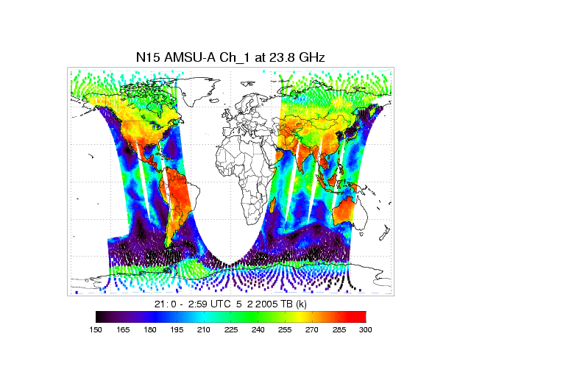
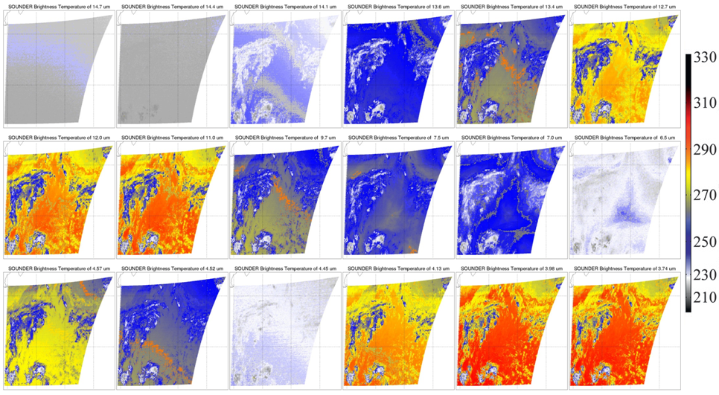
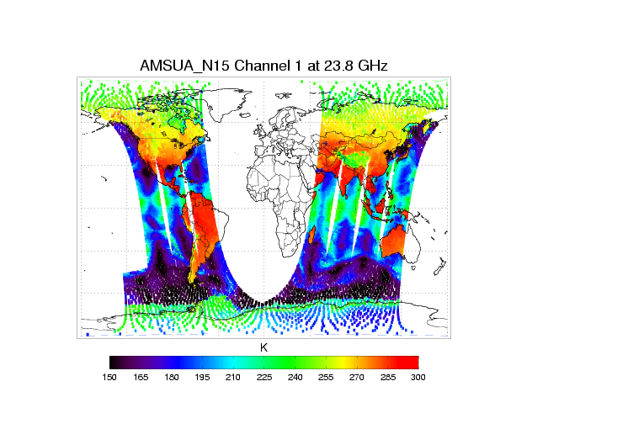
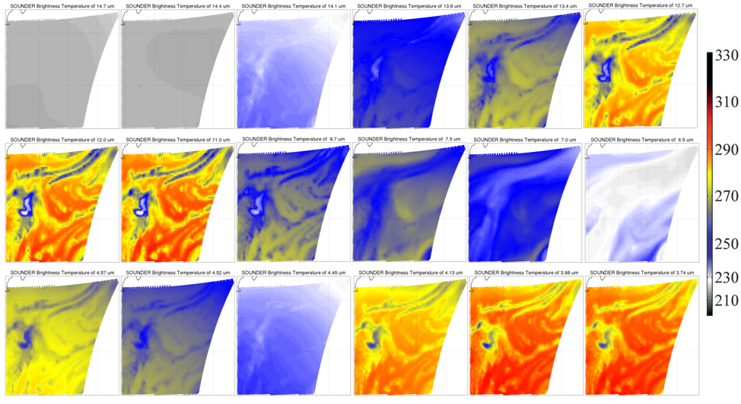
Th
Observation and simulation of GOES-12 Sounder 18 IR channels at over North Atlantic region at 1200 UTC October 1, 2005.
Tong Zhu (NESDIS)
Evaluation of simulated GOES and AMSUA at the 1st step (12hr fcst) of the Nature Run
simulated with 2005 template
Tong Zhu (NESDIS)
Observed
Observed
These figures do not have to be same as weathers are different , but similarities are observed.
These figures are expected to be very similar.
Simulated
Simulated
Fig. 1 NOAA -15 AMSU-A Channel 1 brightness temperature at GSI analysis time 0000 UTC May 2, 2005, time window 6 hours from (left) observation, (right)) CRTM simulation with NR atmospheric profiles.

Slide 37
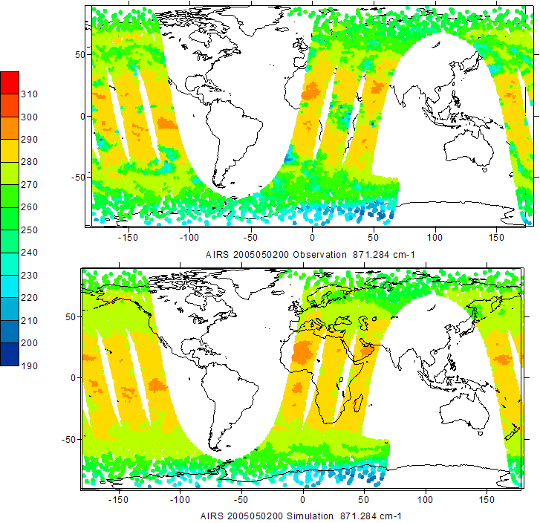
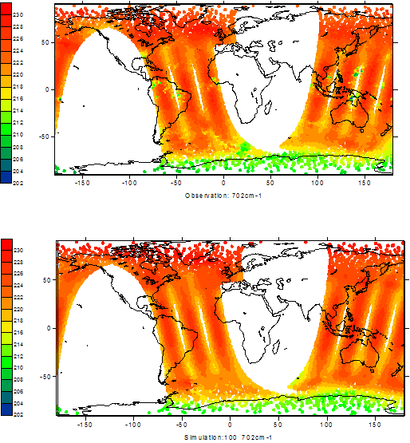
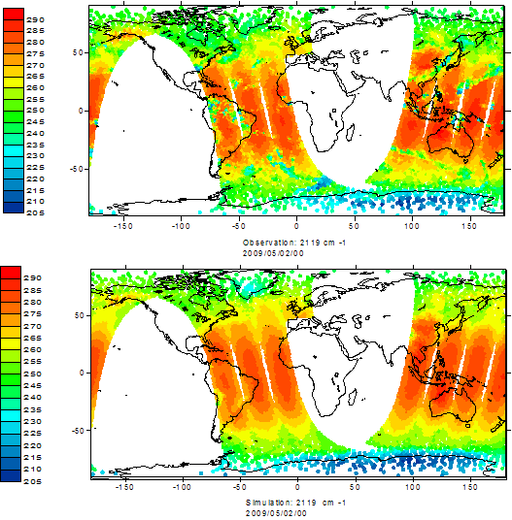
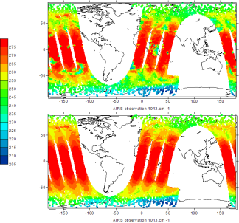
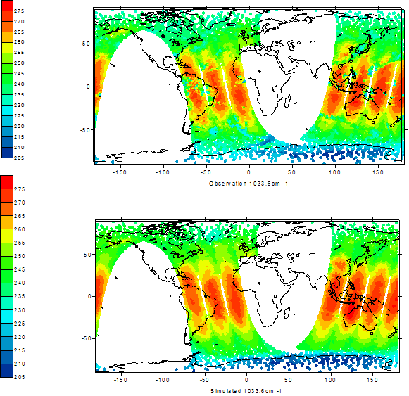
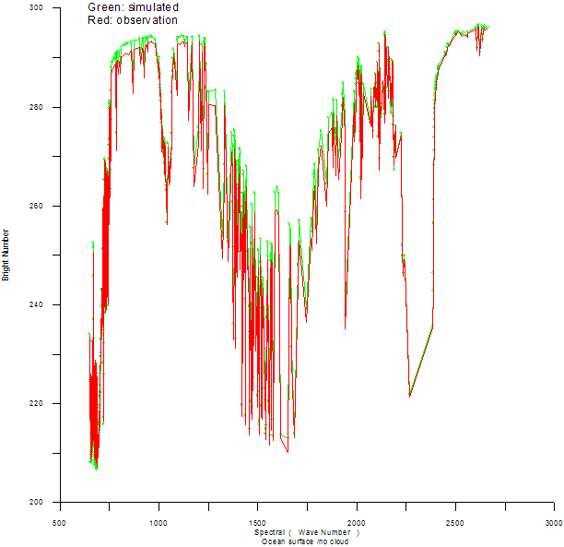
Evaluation of simulated AIRS and IASI at the 12hr fcst of the Nature Run
simulated with 2009 template
Haibing Sun (NESDIS)
AIRS
IASI
IASI simulation Evaluation at C0₂ Absorption Band
IASI simulation Evaluation at Windows channel
Observed
Observed
Simulated
Simulated
IASI simulation Evaluation at O₃ Absorb band
IASI Simulation over ocean
( Clear atmosphere)
The Nature run start at May 1st 12z. At 00z May 2nd (12hr forecast), the Nature Run fields are still very close to real atmosphere and simulated radiance can be compared with real observations.

Slide 38
Data Distribution
NASA/NCCS
http://portal.nccs.nasa.gov/josse/index.pl
Contact:
Ellen Salmon Ellen.M.Salmon@NASA.gov
Bill McHale wmchale@nccs.nasa.gov
NCAR
Currently saved in HPSS Data ID: ds621.0
http://dss.ucar.edu/datasets/ds621.0/matrix.html
Contact: Chi-Fan Shih chifan@ucar.edu and Steven Worley worley@ucar.edu
Additional Data posted at Joint OSSE Home page http://www.emc.ncep.noaa.gov/research/JointOSSEs/
[Simulation of TC vital]
TC vital was simulated using software originally written by Tim Marchock and currently developed by Guan Ping Lou of NCEP.
Software used for simulations are all posted.
CRTM used for simulation. CRTM1.2.2 (Different from the version posted at JCSDA website)

Slide 39
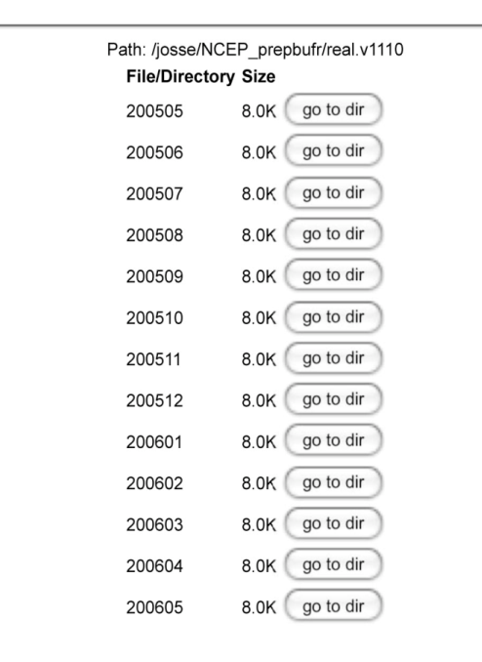
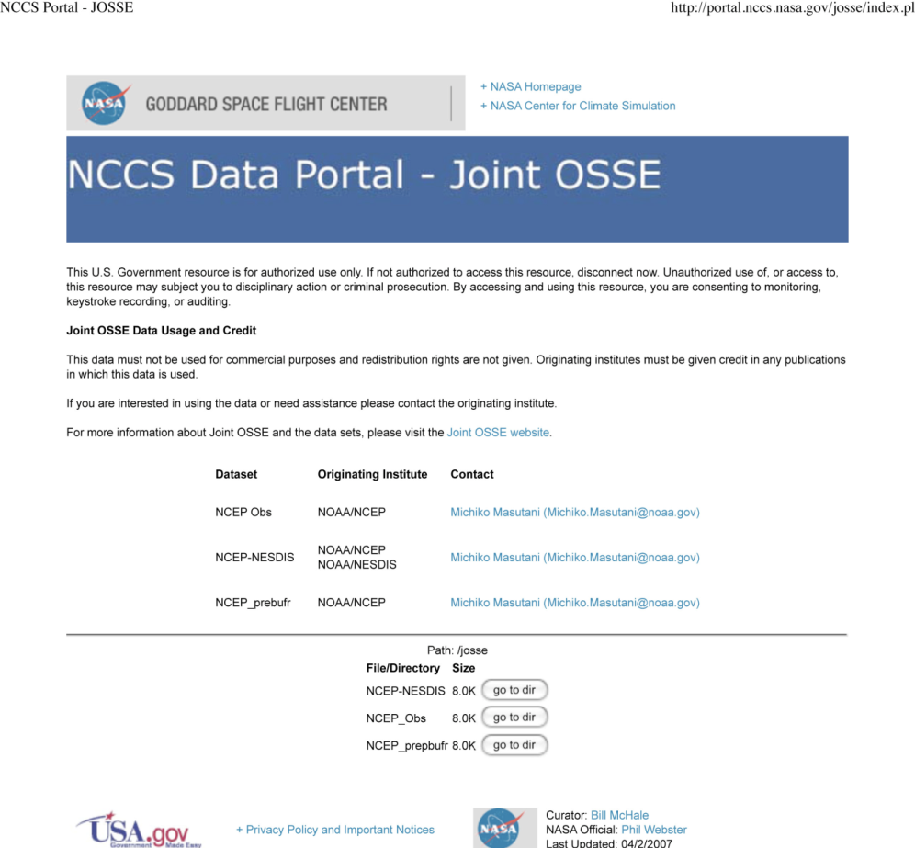
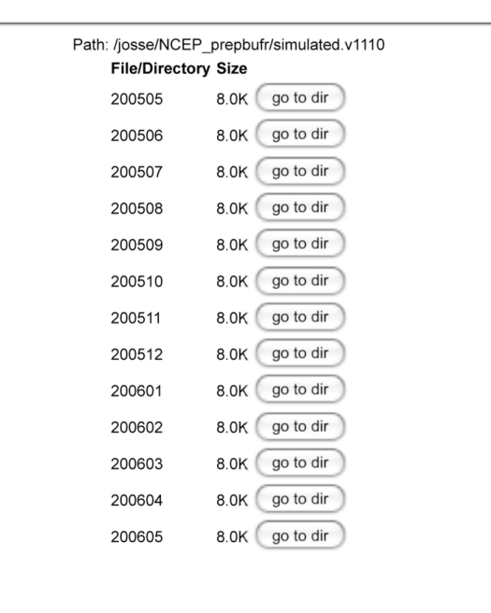

Conventional data posted at NASA/NCCS
Restricted data removed
Real
Simulated

Slide 40
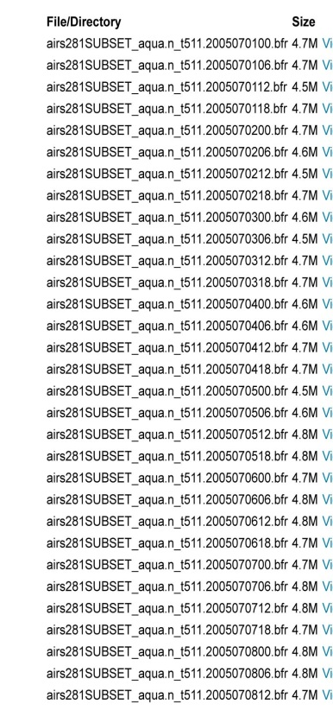
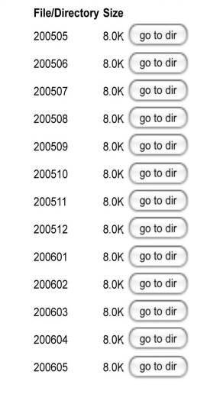
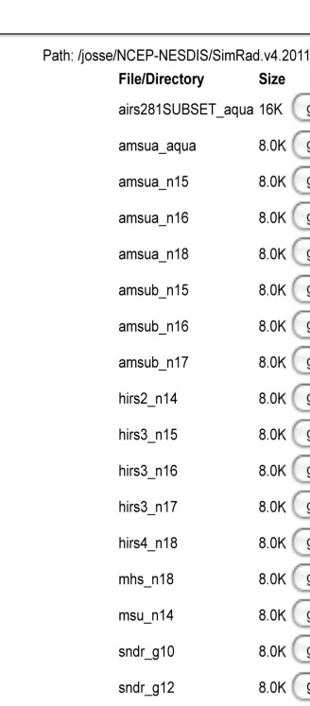
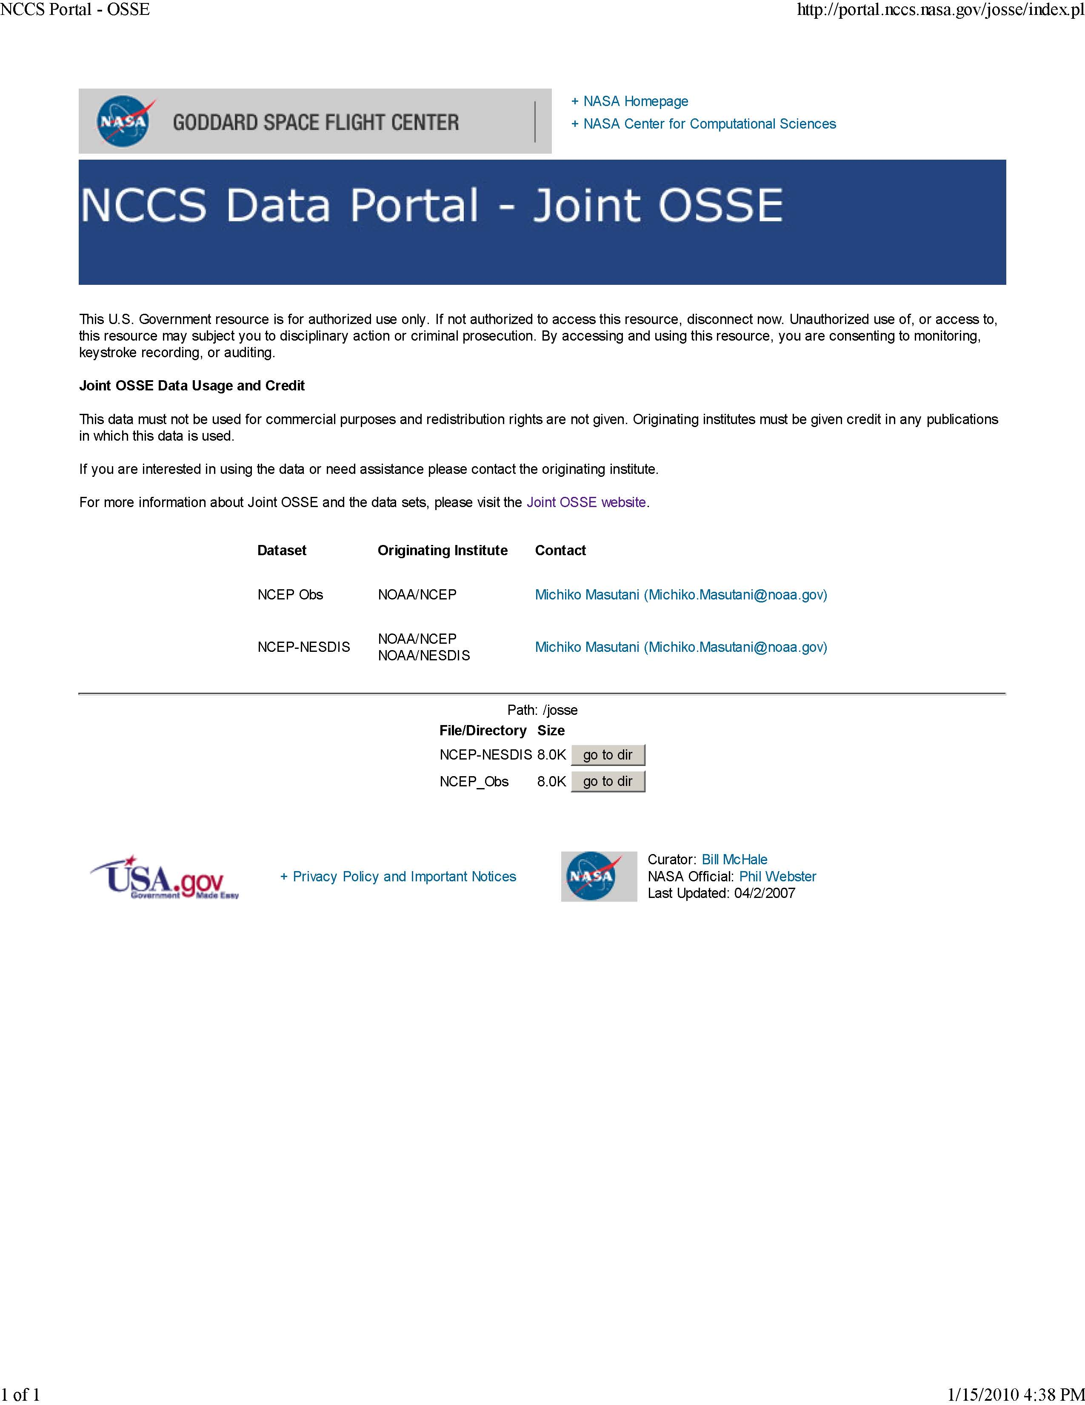

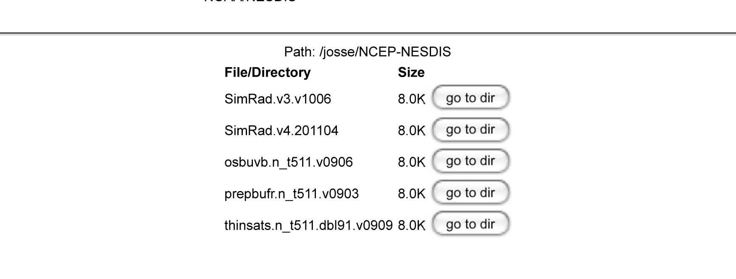
Radiance data at NASA/NCCS
Simulated radiance data, with and without MASK in BUFR format for entire Nature run period
Type of radiance data used for reanalysis from May 2005-May2006
Simulated using CRTM1.2.2

Slide 41
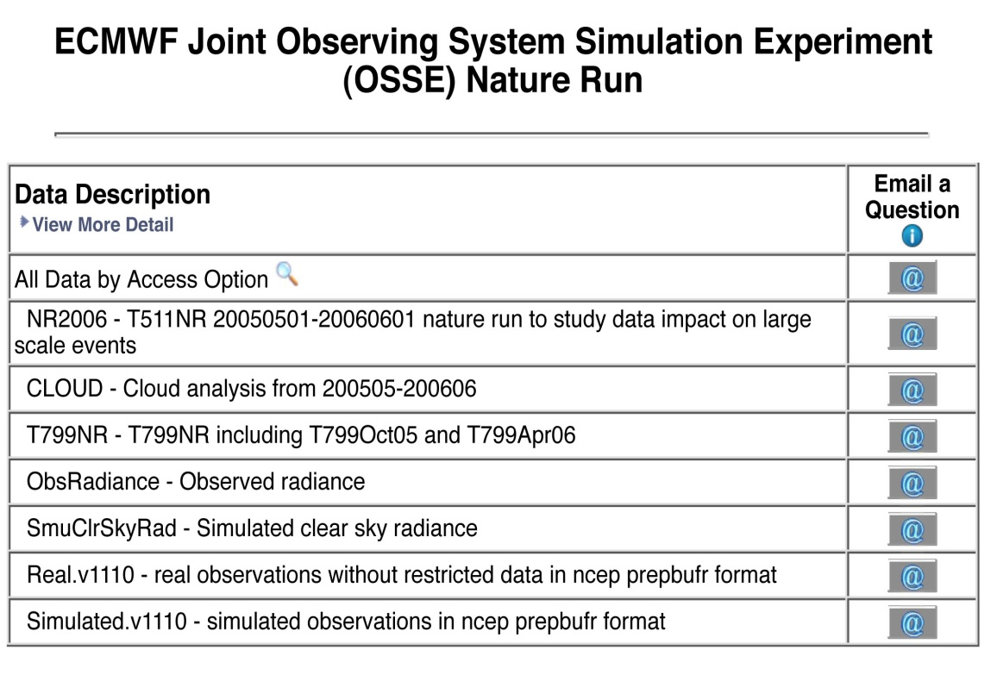
Joint OSSE Data set at NCAR
Currently saved in HPSS , Data ID: ds621.0
http://dss.ucar.edu/datasets/ds621.0/matrix.html
NCAR Contact:
Chi-Fan Shih chifan@ucar.edu Steven Worley worley@ucar.edu

Slide 42
Hurricane Case study
Michiko Masutani
Investigate design for OSSE experiments.
Experiments comparison between model resolution and GWOS data to find out the best resolution for the WLS OSSE
Effect of observational error in data impact

Slide 43
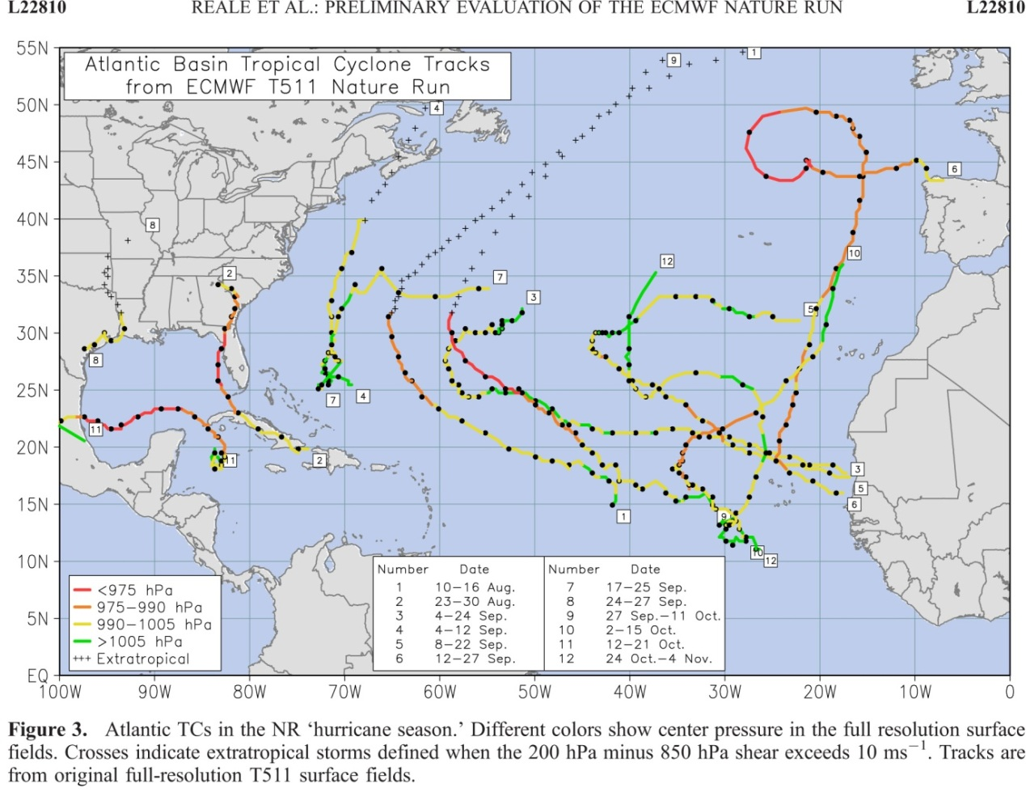
Atlantic Hurricane in the nature run for the analysis period of 9/25-10/10
Simulated observation
Control data: Observation type and distribution used by reanalysis for 2005.
Observational error is not added to the control data but calibration was performed to demonstrate the impact of observational error in control data.
DWL data: GWOS concept DWL simulated by Simpson weather associates.
The figure produced by Joe Terry

Slide 44










Minimum Mean Sea level Pressure
The verification period:
Sep28-Oct13, 2005
in 72 hour forecast
Evaluated at 00Z only
This display indicates the hurricane track and intensity
T126
With DWL
T126
T170
With DWL
T170
Nature run
Truth
T254
T254
WithDWL
T382
T382
With DWL

Slide 45


Evaluation of observational error in radiance
T170 with large obs error in radiance
DWL added
T170 with large obs error in radiance
Add DWL
Minimum Mean Sea level Pressure
The verification period Sep28-Oct13, 2005
72 hour forecast evaluated at 00Z only
Improve radiance data
Improve radiance data
Better radiance data help track and intensity forecast. DWL also will improve intensity forecast s even with perfect radiance data.
T170 No obs error in radiance
T170 no obs error in radiance
DWL added
Add DWL

Slide 46









Impact of resolution vs. GWOS DWL
Reduction of RMSE from NR in meridional wind
Zonal averaged
The verification period
Sep28-Oct13, 2005
in 72 hour forecast
Evaluated at 00Z only
Improvement by
Increasing resolution
Improvement by
Adding GWOS DWL
T126
T170
T126
T170
T254
T170
T170
T254
Add large error to radiance data
More verification planned.
Add forecast from 12z. Try DWL with other configuration.
Produce hurricane track diagnostics.
T254
T382
T382
4646
4646

Slide 47
Initial Summary of Hurricane OSSE
OSSE with control observation without observational error is useful to provide initial outlook of data impact a new type of observation.
Some interesting findings
DWL improves both intensity and location of a hurricane at all resolution even with perfect control observation.
In hurricane season, increasing model resolution will be more effective in large scale forecast. Improvement due to adding DWL is mainly over hurricane.
Random error do not have significant impact in large scale, but more impact in smaller scale.
With better radiance data impact of DWL was enhanced.
At least T170 resolution is required to utilize DWL data for hurricane forecast . Impact of DWL is larger in T254 than in T170 model forecast. T382 model for OSSE with T511 Nature run may not be the best.

Slide 48
Further work on Hurricane Case study
Add various observational errors to control observations and study data sensitivity to the data impact. This by itself is a major important project.
Increase forecast frequency to 12 hour to get better statistics
Produce standard EMC skill package and hurricane diagnostics for better comparison.
Acknowledgement
The nature runs for Joint OSSEs were produced by Dr. Erik Andersson of ECMWF. We appreciate GMAO to providing initial satellite data for calibration at ESRL. GMSO also provided code to add random error to simulated data and ESRL provided amplitude used for their experiments.

Slide 49
Beyond wind lidar OSSEs
OSSEs for JPSS (JPO)
OSSEs for DWSS (CAPE, OSD)
GPSRO
GOES-R

