Slide 1
2017-2019 GEFS-Couple Experiments TC Track/intensity Verifications
Jiayi Peng
AXIOM@EMC/NCEP/NWS/NOAA
REF----GEFSv12 Reforecast 10-member mean
EP1----GEFS-C384 experiments 10-member mean(P5)
EP2----GEFS-C384 experiment 10-member mean (P7)
EP3----GEFS-C384 experiment 10-member mean (P8)
Track data: 2017/10---- 2019/09

Slide 2
Track error, 2017-2019, AL/EP/WP(Atlantic, East/West Pacific)
average track errors (NM) FOR HOMOGENEOUS SAMPLE
HOUR 00 12 24 36 48 72 96 120 144 168
REF 34.3 27.3 40.0 50.9 65.3 121.0 170.3 198.8 324.1 447.1
EP1 18.5 25.9 35.4 47.0 64.9 108.9 166.9 203.8 356.8 447.1
EP2 18.1 25.8 35.1 47.0 64.1 104.8 172.5 194.0 333.9 355.6
EP3 18.2 26.6 35.2 46.0 61.8 97.3 160.1 176.4 296.7 394.8
#CASES 84 80 76 66 58 42 32 23 16 9
Intensity error, 2017-2019, AL/EP/WP(Atlantic, East/West Pacific)
AVERAGE INTENSITY ERRORS (KT) FOR HOMOGENEOUS SAMPLE
HOUR 00 12 24 36 48 72 96 120 144 168
REF 19.8 18.2 18.3 21.0 24.0 24.5 25.5 24.1 18.4 21.0
EP1 10.1 14.7 16.2 19.2 23.4 25.6 25.9 24.2 20.1 23.1
EP2 10.3 16.6 18.0 21.2 25.7 28.1 26.6 25.3 22.4 24.7
EP3 10.3 16.3 17.0 19.5 23.3 25.7 24.8 23.2 19.8 21.8
#CASES 84 80 76 66 58 42 32 23 16 9

Slide 3
Track error, 2017-2019, AL/EP/WP(Atlantic, East/West Pacific)
REF ----Reforecast
EP1 ----C384 (P5)
EP2 ----C384 (P7)
EP3 ----C384 (P8)
Track error (NM)
Forecast hours
CASES 84 80 76 66 58 42 32 23 16 9

Slide 4
Intensity error, 2017-2019, AL/EP/WP(Atlantic, East/West Pacific)
REF ----Reforecast
EP1 ----C384 (P5)
EP2 ----C384 (P7)
EP3 ----C384 (P8)
Intensity error (kt)
Forecast hours
CASES 84 80 76 66 58 42 32 23 16 9

Slide 5
Summary
The track error of EP3 is smaller than EP2 except for hour 168 forecast.
For TC intensity forecast, EP3 is better than EP2.

Slide 6
Track error, 2017, AL/EP/WP(Atlantic, East/West Pacific)
average track errors (NM) FOR HOMOGENEOUS SAMPLE
HOUR 00 12 24 36 48 72 96 120 144 168
REF 53.2 37.0 25.5 29.5 36.3 62.2 158.6 0.0 0.0 0.0
EP1 22.5 23.2 22.7 11.5 28.7 60.0 137.4 0.0 0.0 0.0
EP2 20.8 21.7 28.3 20.0 40.0 58.2 183.2 0.0 0.0 0.0
EP3 20.8 19.4 23.1 13.6 30.9 43.7 199.1 0.0 0.0 0.0
#CASES 5 5 4 3 3 3 3 0 0 0
REF----GEFSv12 Reforecast 10-member mean
EP1----GEFS-C384 experiments 10-member mean(P5)
EP2----GEFS-C384 experiment 10-member mean (P7)
EP3----GEFS-C384 experiment 10-member mean (P8)

Slide 7
Track error/spread, 2018, AL/EP/WP
average track errors (NM) FOR HOMOGENEOUS SAMPLE
HOUR 00 12 24 36 48 72 96 120 144 168
REF 35.7 23.0 34.3 44.8 59.5 114.3 134.3 194.9 321.3 415.6
SDR 9.0 17.1 25.6 37.6 52.6 88.7 130.9 167.7 244.9 332.4
EP1 18.0 23.8 31.2 44.4 62.5 113.2 162.9 224.5 396.7 479.8
SD1 10.6 19.9 32.5 46.0 64.2 102.9 137.7 173.2 283.8 404.3
EP2 17.5 23.6 30.0 45.9 64.3 113.9 161.3 190.3 326.0 337.8
SD2 10.4 20.3 31.4 44.6 61.1 96.7 141.8 172.8 251.1 358.2
EP3 17.5 24.0 30.0 43.1 60.1 102.8 146.3 198.1 327.6 467.6
SD3 10.4 20.8 35.2 50.3 68.9 107.6 159.3 206.9 320.5 511.5
#CASES 52 49 46 42 37 23 18 15 11 6
REF----GEFSv12 Reforecast 10-member mean
SDR----Spread for GEFSv12 Reforecast 10-member mean
EP1----GEFS-C384 experiments 10-member mean(P5)
SD1----Spread for GEFS-C384 experiments 10-member mean(P5)
EP2----GEFS-C384 experiment 10-member mean (P7)
SD2----Spread for GEFS-C384 experiment 10-member mean (P7)
EP3----GEFS-C384 experiment 10-member mean (P8)
SD3----Spread for GEFS-C384 experiment 10-member mean (P8)

Slide 8
Track error/spread, AL/EP/WP, 2018
EP1----GEFS-C384 experiments (P5)
SD1----Spread for GEFS-C384 experiments (P5)
EP2----GEFS-C384 experiment (P7)
SD2----Spread for GEFS-C384 experiment (P7)
EP3----GEFS-C384 experiment (P8)
SD3----Spread for GEFS-C384 experiment (P8)
Track error/spread (NM)
Forecast hours
CASES 52 49 46 42 37 23 18 15 11 6

Slide 9
Track error/spread, 2019, AL/EP/WP
average track errors (NM) FOR HOMOGENEOUS SAMPLE
HOUR 00 12 24 36 48 72 96 120 144 168
REF 28.2 33.4 52.3 66.2 82.0 141.7 232.5 206.2 330.3 510.1
SDR 3.8 14.0 29.0 46.5 68.1 111.9 150.6 184.7 252.6 396.5
EP1 18.9 30.5 44.9 57.2 75.8 111.8 181.5 164.9 269.1 381.6
SD1 12.8 23.5 35.3 52.3 70.9 110.1 155.1 202.2 229.7 298.9
EP2 18.7 30.9 45.2 53.2 67.6 100.5 187.9 201.0 351.2 391.3
SD2 13.4 23.5 32.5 48.7 64.3 99.3 127.3 155.7 209.6 294.0
EP3 18.9 32.7 46.3 56.3 70.3 99.5 172.0 135.7 228.8 249.2
SD3 13.2 24.5 38.3 59.5 77.5 117.9 144.4 180.0 219.8 279.0
#CASES 27 26 26 21 18 16 11 8 5 3
REF----GEFSv12 Reforecast 10-member mean
SDR----Spread for GEFSv12 Reforecast 10-member mean
EP1----GEFS-C384 experiments 10-member mean(P5)
SD1----Spread for GEFS-C384 experiments 10-member mean(P5)
EP2----GEFS-C384 experiment 10-member mean (P7)
SD2----Spread for GEFS-C384 experiment 10-member mean (P7)
EP3----GEFS-C384 experiment 10-member mean (P8)
SD3----Spread for GEFS-C384 experiment 10-member mean (P8)

Slide 10
Track error/spread, AL/EP/WP, 2019
EP1----GEFS-C384 experiments (P5)
SD1----Spread for GEFS-C384 experiments (P5)
EP2----GEFS-C384 experiment (P7)
SD2----Spread for GEFS-C384 experiment (P7)
EP3----GEFS-C384 experiment (P8)
SD3----Spread for GEFS-C384 experiment (P8)
Track error/spread (NM)
Forecast hours
CASES 27 26 26 21 18 16 11 8 5 3

Slide 11
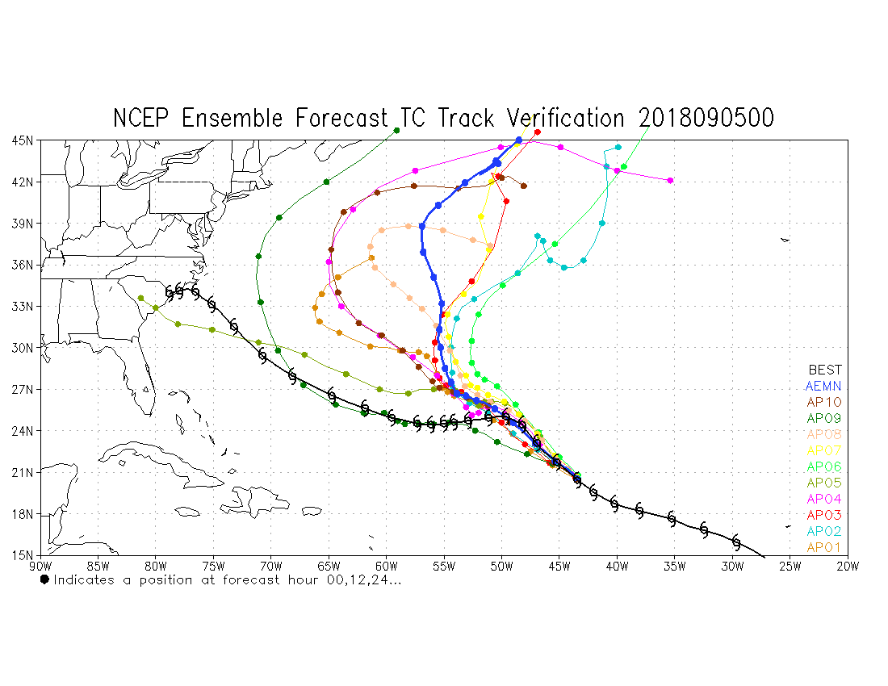
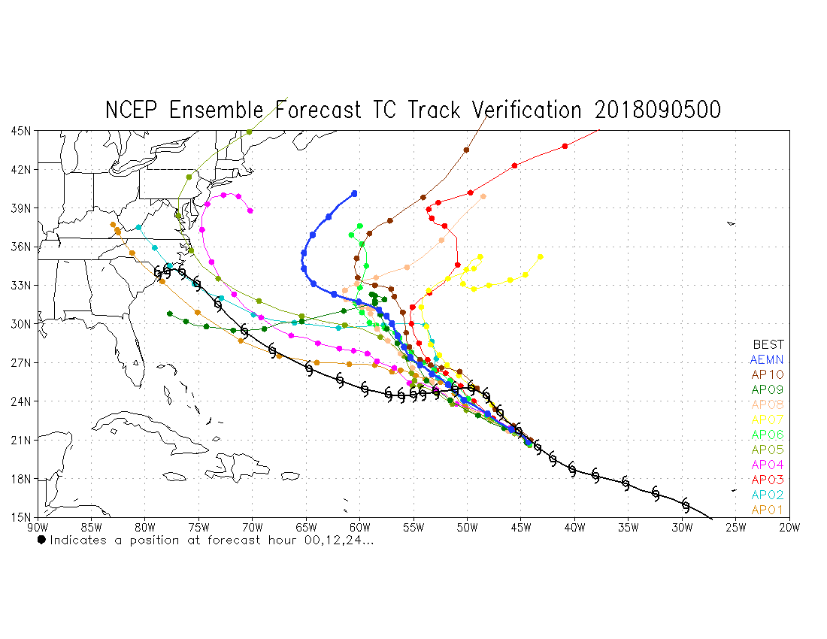
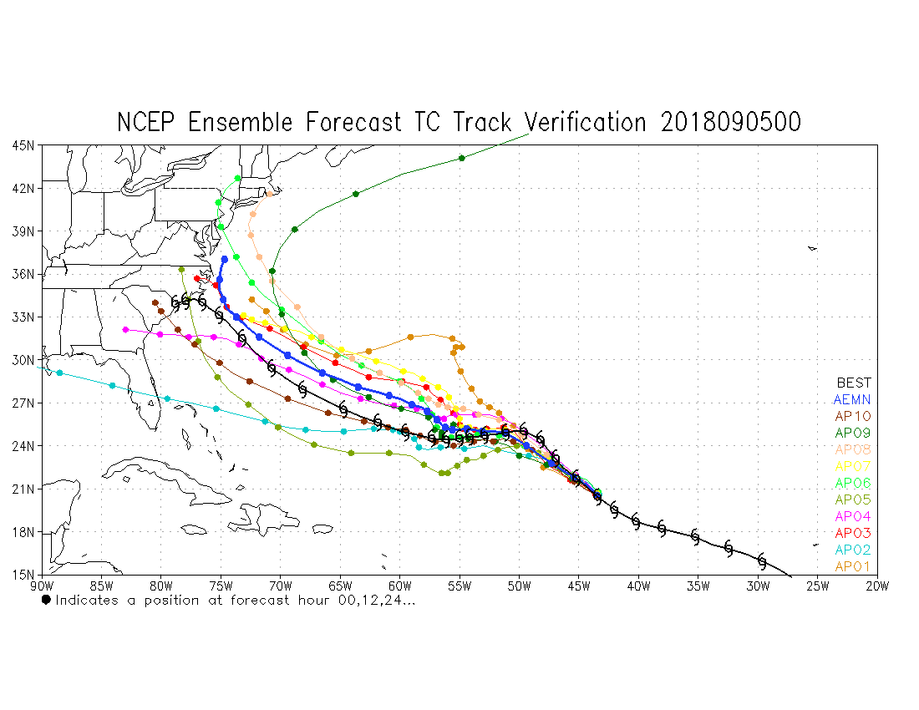
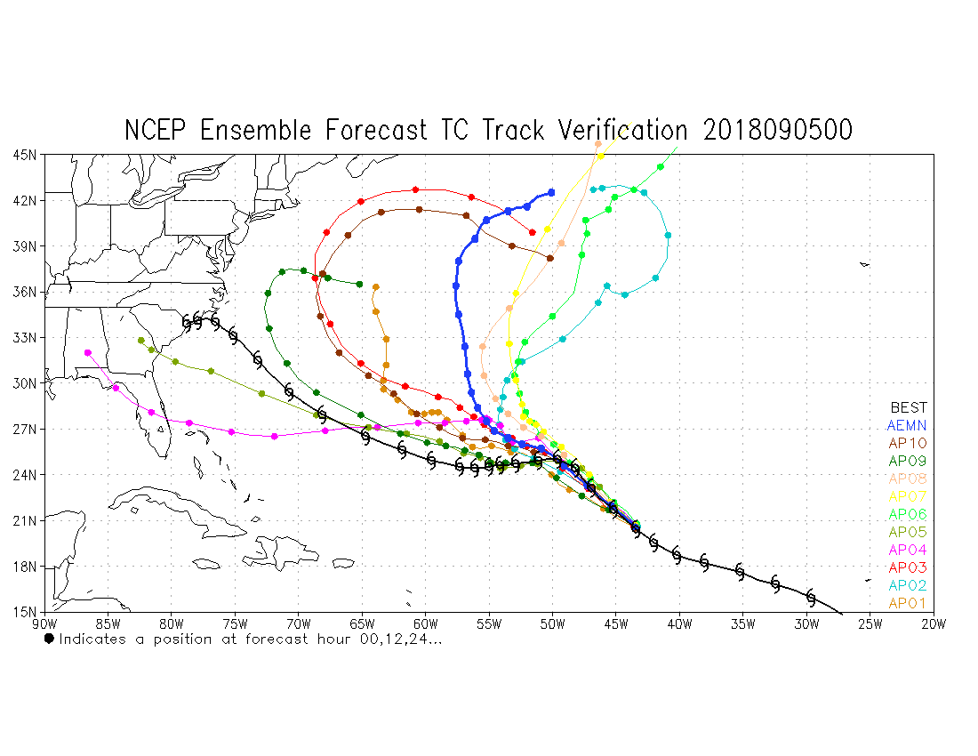
https://ftp.emc.ncep.noaa.gov/gc_wmb/jpeng/gefs_couple/EP1EP2/
AL06-2018
EP1
Reforecast
EP2
EP3

Slide 12
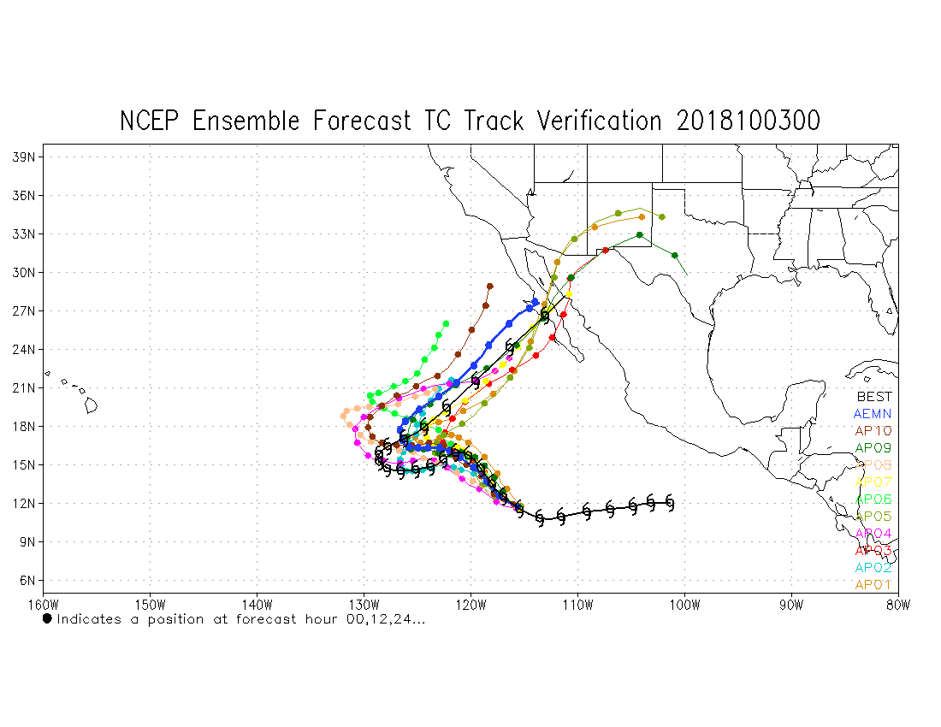
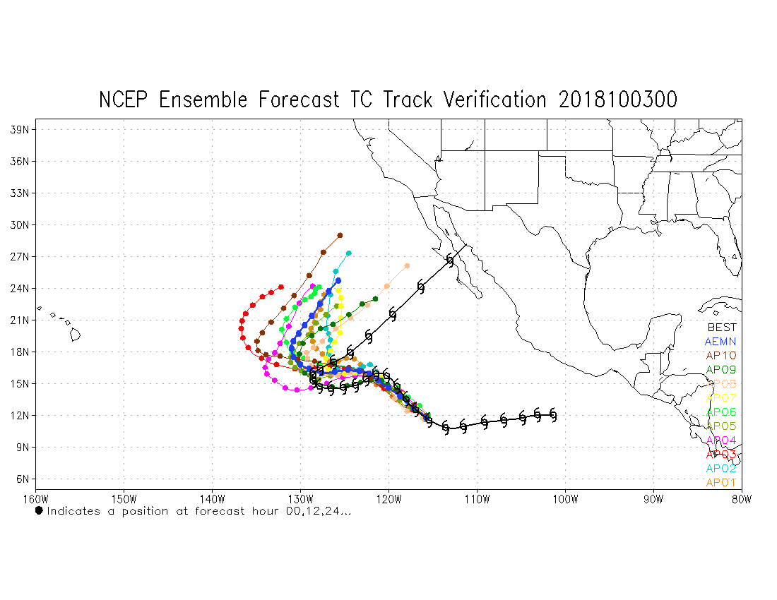
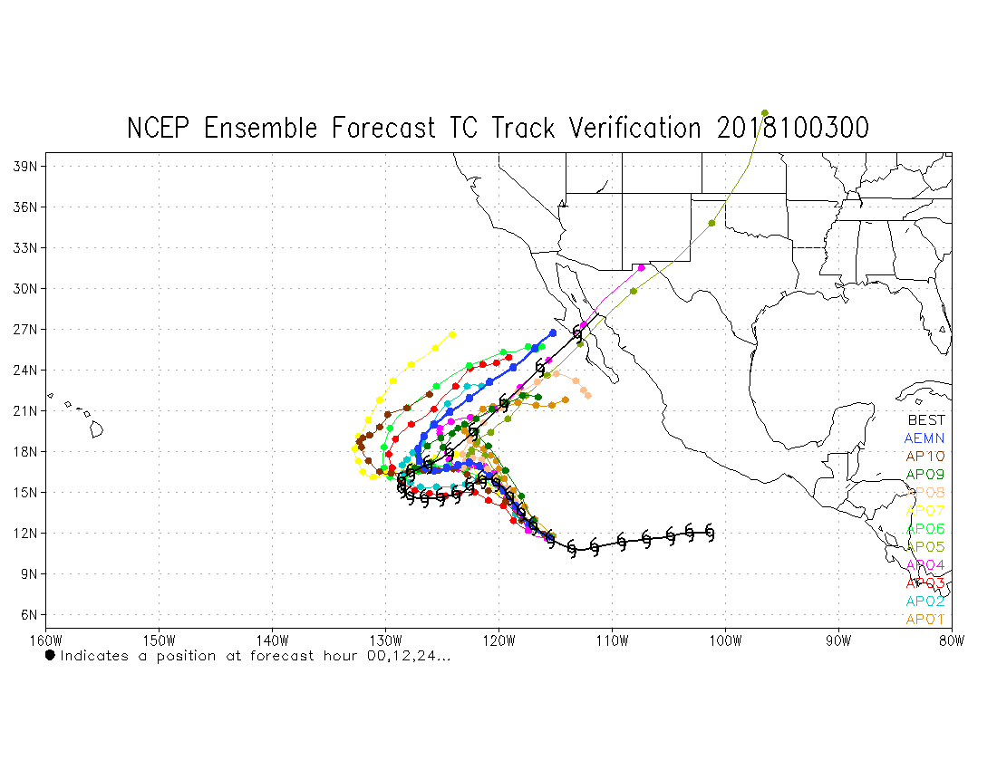
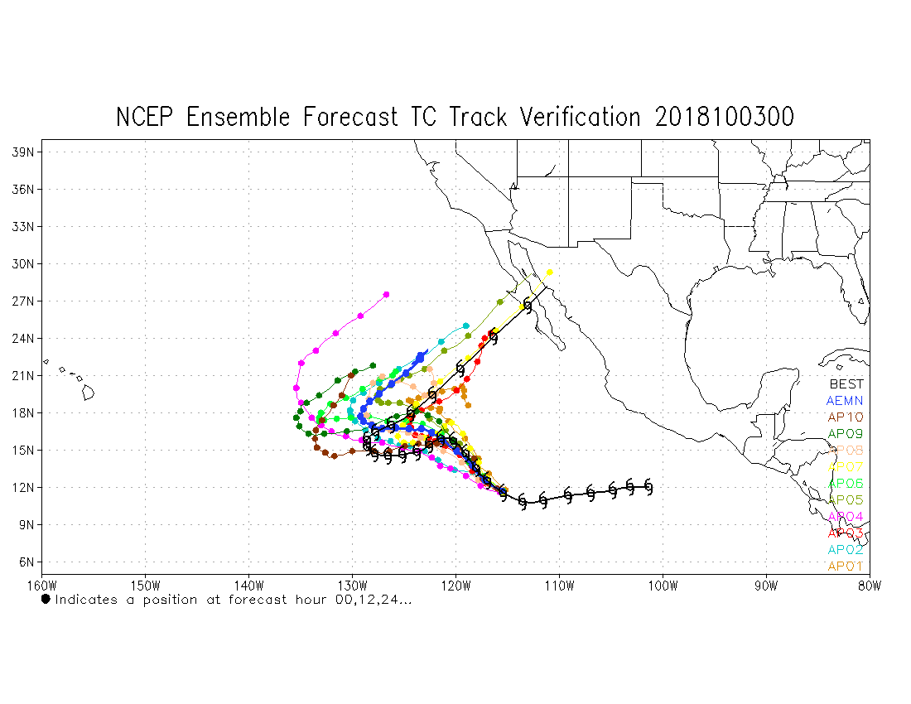
https://ftp.emc.ncep.noaa.gov/gc_wmb/jpeng/gefs_couple/EP1EP2/
EP21-2018
EP1
Reforecast
EP2
EP3

Slide 13
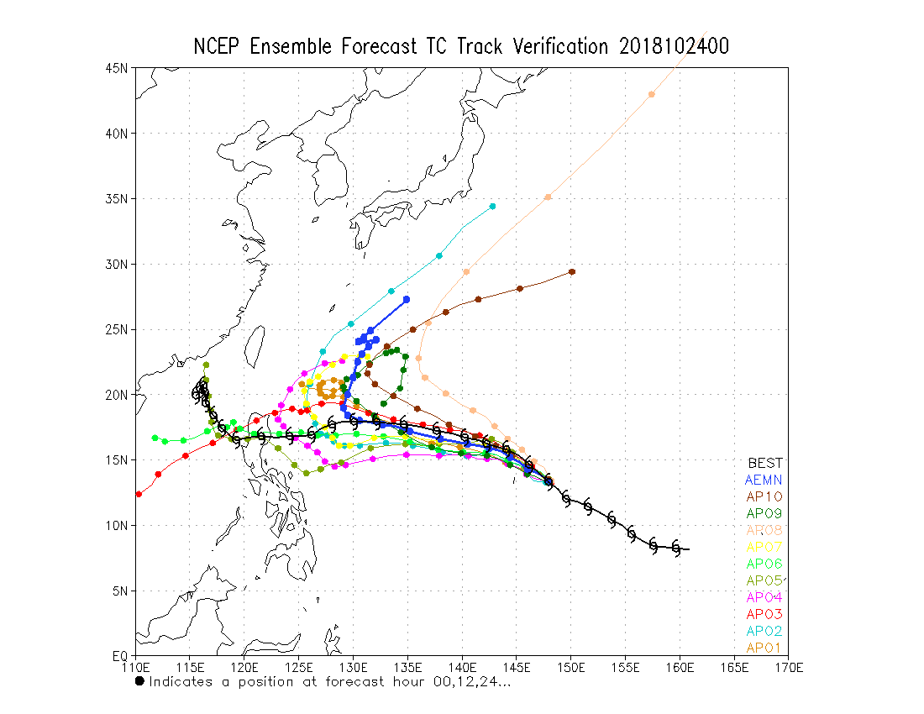
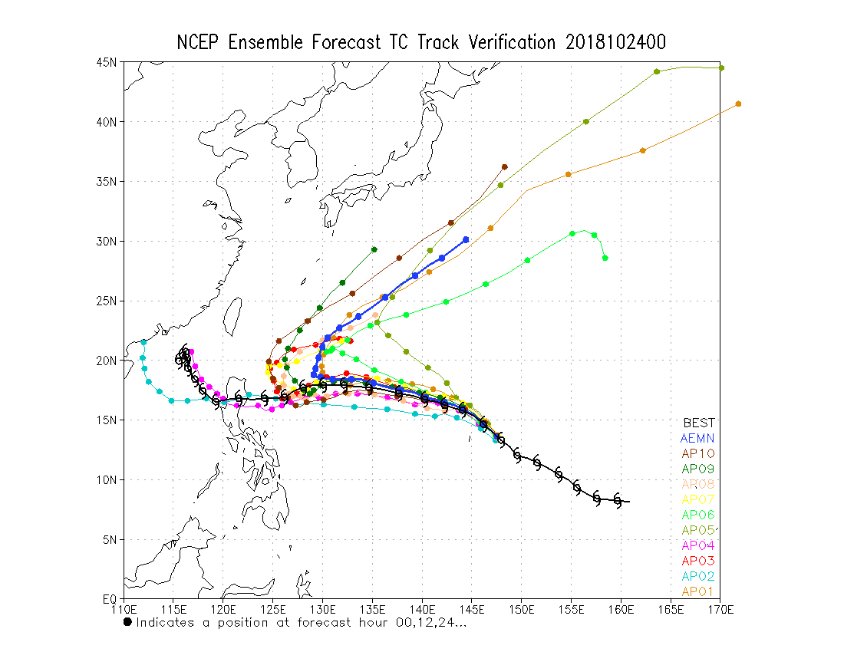
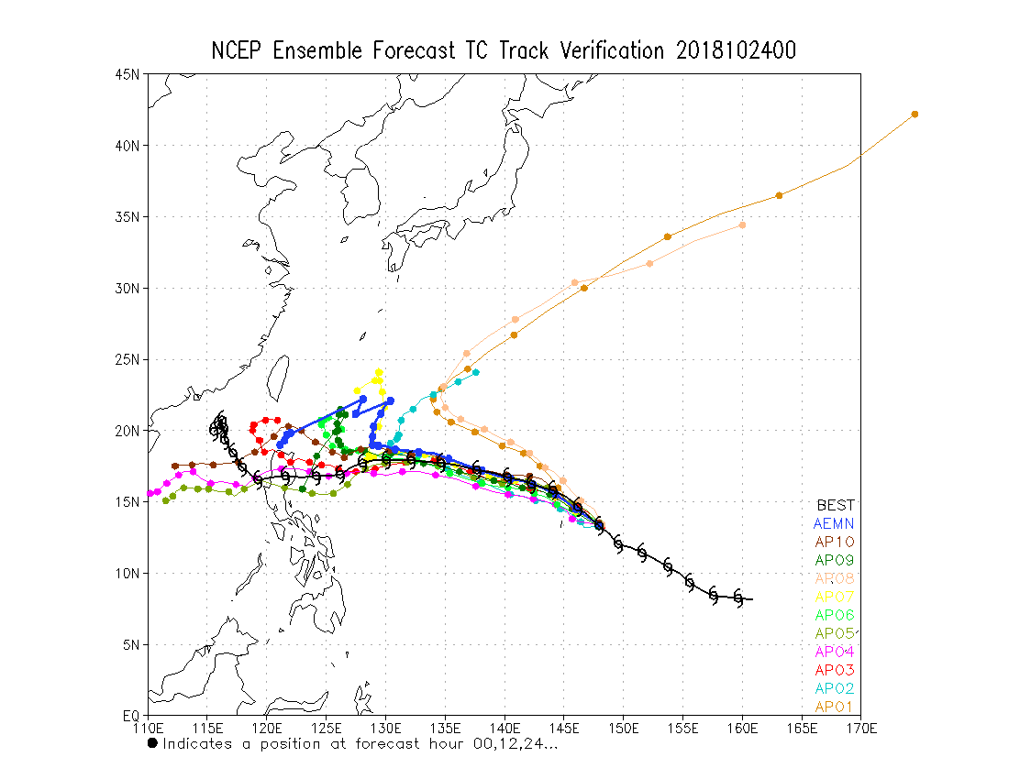
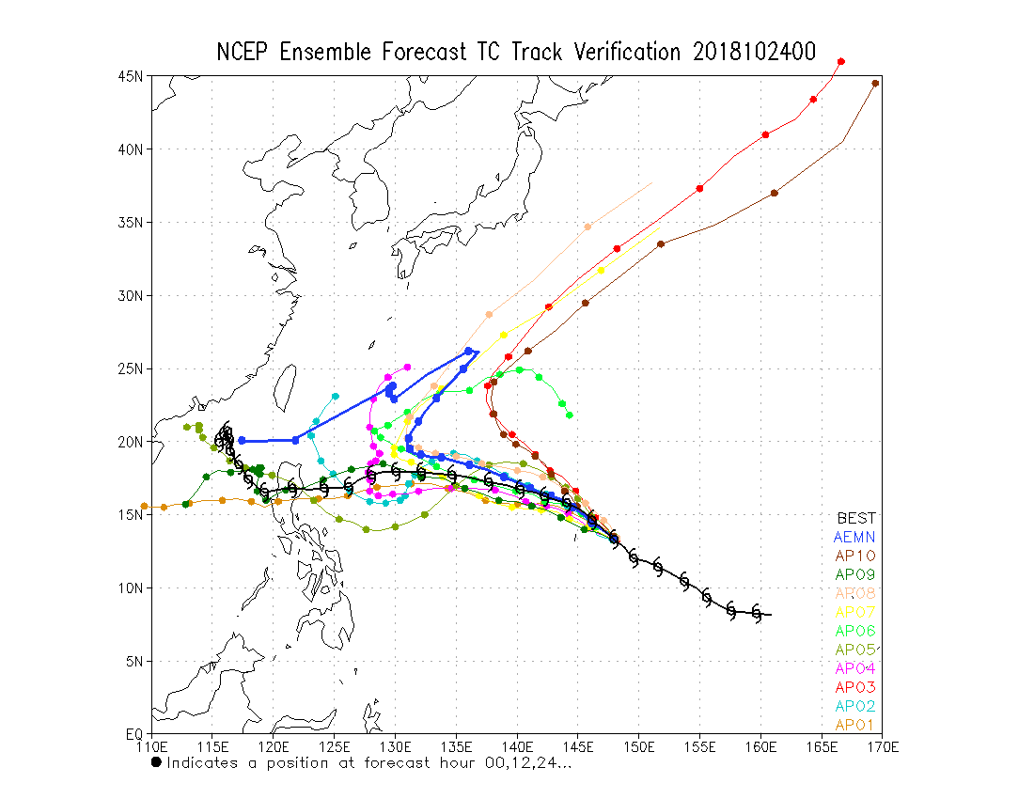
https://ftp.emc.ncep.noaa.gov/gc_wmb/jpeng/gefs_couple/EP1EP2/
WP31-2018
EP1
Reforecast
EP2
EP3

