Slide 1
FV3GFS Version 0 Code Release to the Community
Configuration: NEMS + FV3_CAP + FV3_Dycore + IPDv4 + GFS_Physics
Same model used for Phase-2 dycore comparison with upgrade of physics to Q3FY17 GFS configuration.
Resolution: C96 (~100km), C384 (25km), C768 (~13km), no nesting/stretching
Build the model: On WCOSS, THEIA and Jet, with pre-installed libraries and utilities.
Data: Initial conditions for selected cases, and fixed fields for running the model
Release Date: May 15, 2017
Method of Release: VLab GIT; EMC Subversion
Running the model: simple shell script and configuration files to run forecast-only experiments for selected cases.
Post Processing: Fregrid and Remap tools to convert 6-tile model output to global lat-lon grid with user defined resolution in netCDF format.

Slide 2
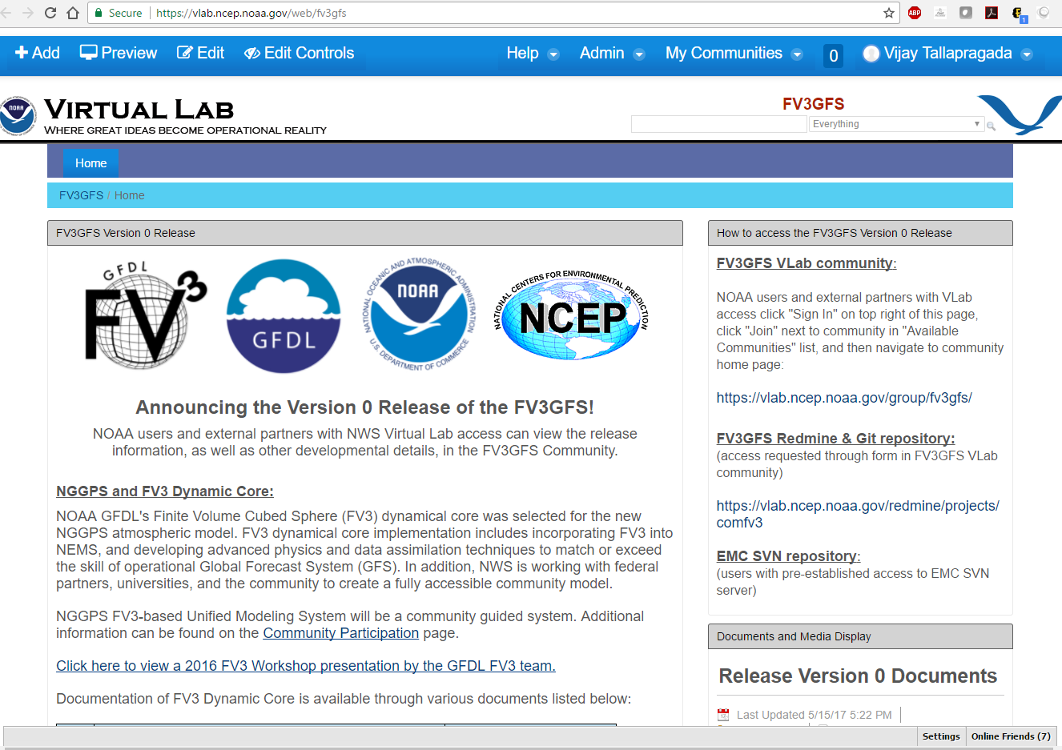
NOAA Virtual Lab (VLab) to host FV3GFS Code Release
Access FV3GFS Project on VLab
https://vlab.ncep.noaa.gov/web/fv3gfs
Code repositories set up on
VLab GIT & EMC Subversion
Community Wiki page, Forums and Developers Pages on VLab
Case Studies:
Sept. 29, 2016 Hurricane Matthew Jan. 18, 2016 East Coast Blizzard Aug. 12, 2016 Louisiana Flooding
Model Resolutions:
C96 (~100km), C382 (~25km) or C768 (~13km)

