Slide 1
Testing of bias correction with the FV3/CMAQ offline coupling system
Jianping Huang, Jeff McQueen,
Perry Shafran, and Ho-Chun Huang
03/14/2019

Slide 2
A summary of cases presented
Set up near real-time of CMAQ driven by FV3GFS in offline mode
- Started from July 2018 to now
FV3GFS/CMAQ performance in August 2018
- O₃ and PM_{2.5}
- Observations, NMMB-CMAQ, and FV3GFS-CMAQ
- Raw forecast vs. Bias corrected
FV3GFS/CMAQ performance in January 2019
- O₃ and PM_{2.5}
- Observations, NMMB-CMAQ, and FV3GFS-CMAQ
- Raw forecast vs. Bias corrected

Slide 3
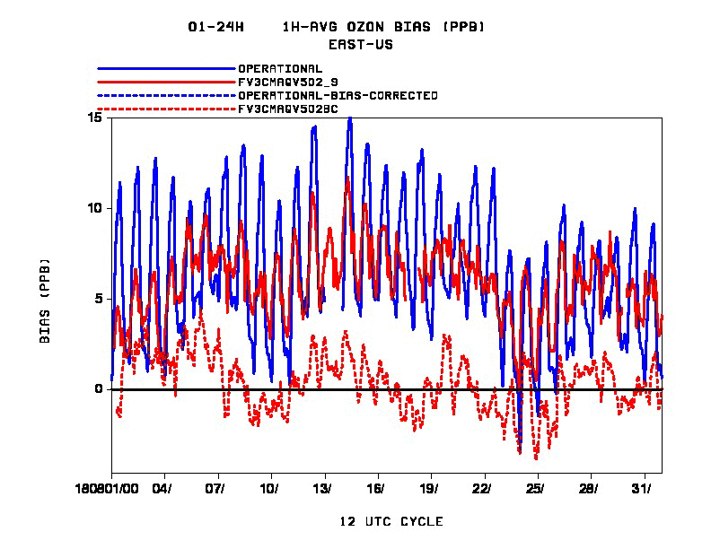
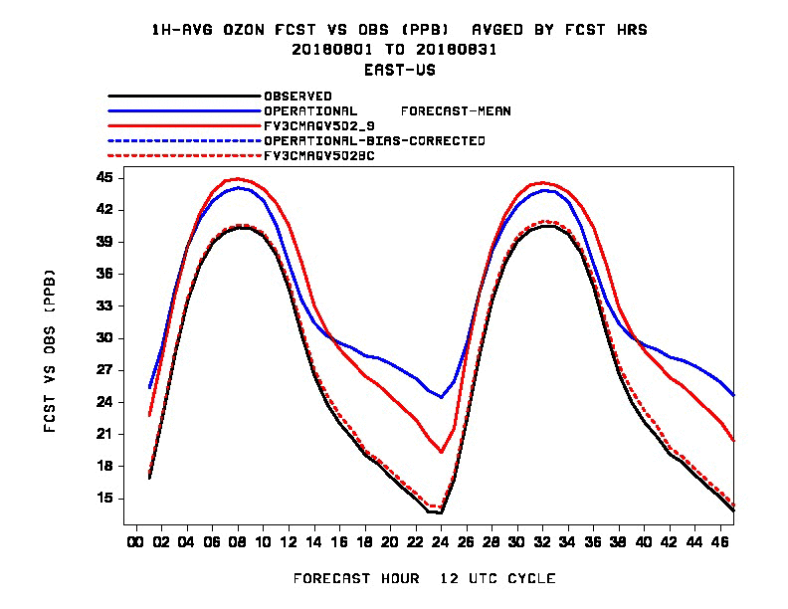
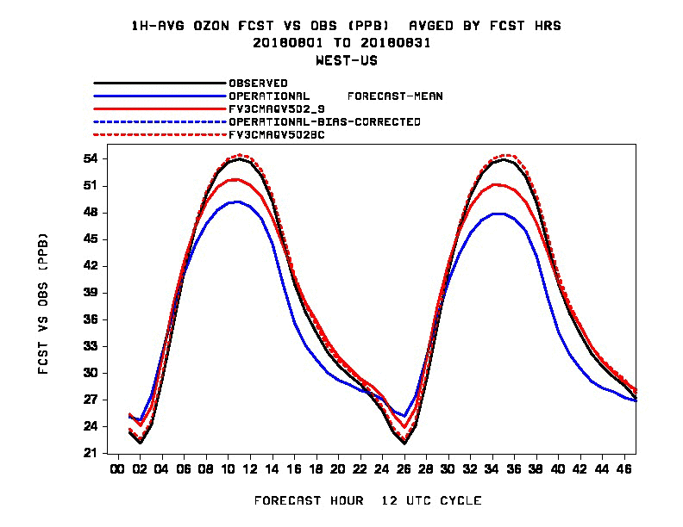
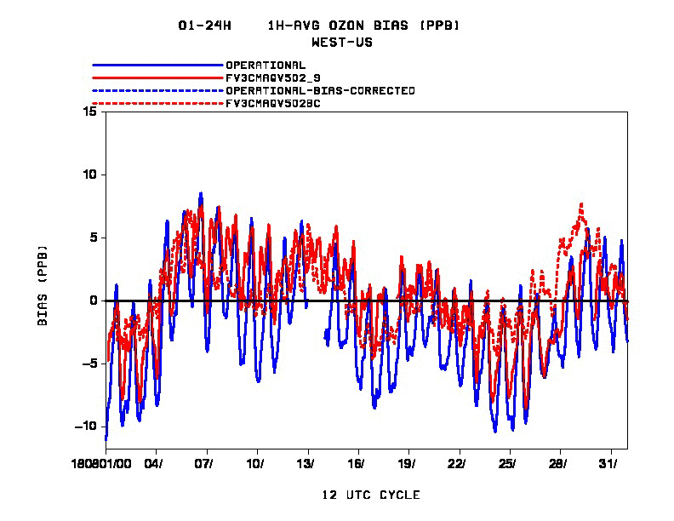
Statistical evaluation of FV3CMAQ O3 performance August 2018
EAST
EAST
WEST
WEST

Slide 4
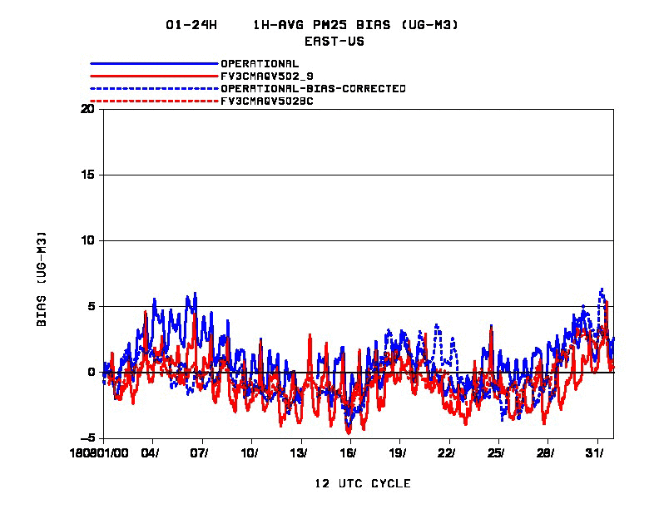
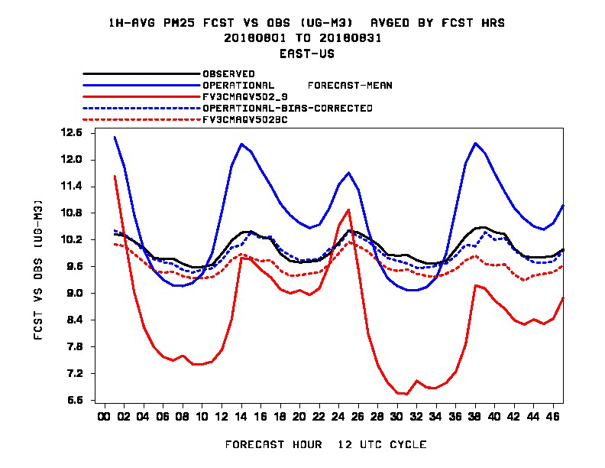
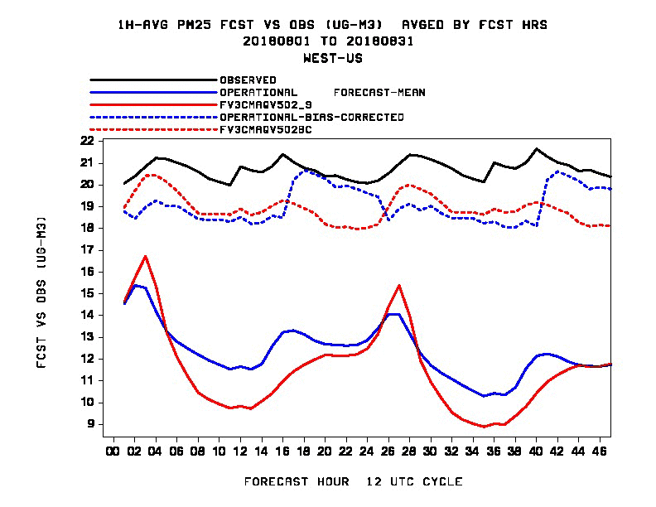
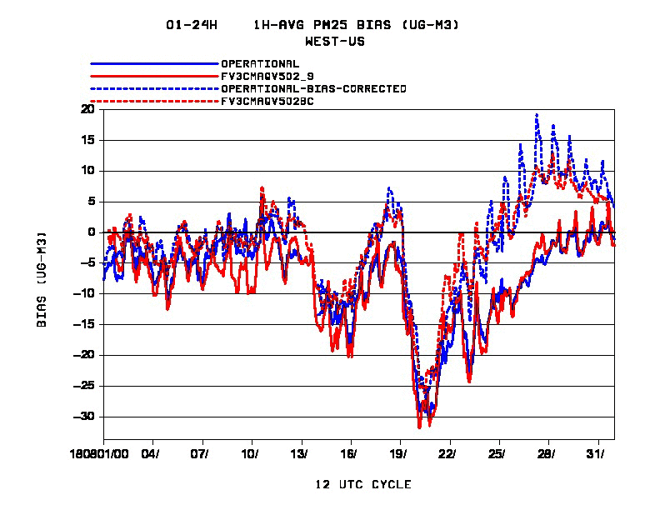
Statistical evaluation of FV3CMAQ PM_{2.5} performance August 2018
EAST
EAST
WEST
WEST

Slide 5
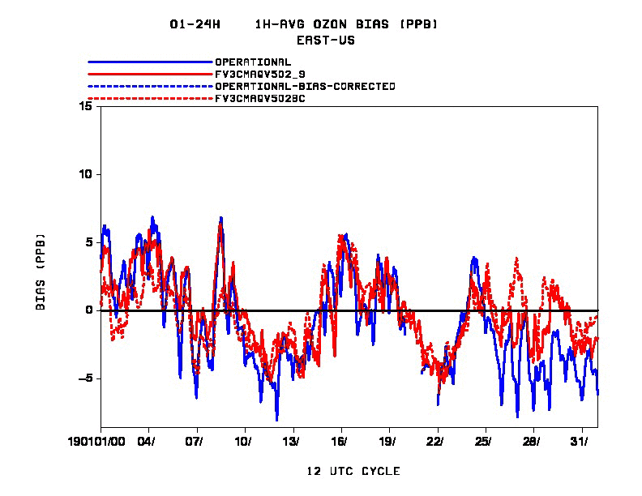
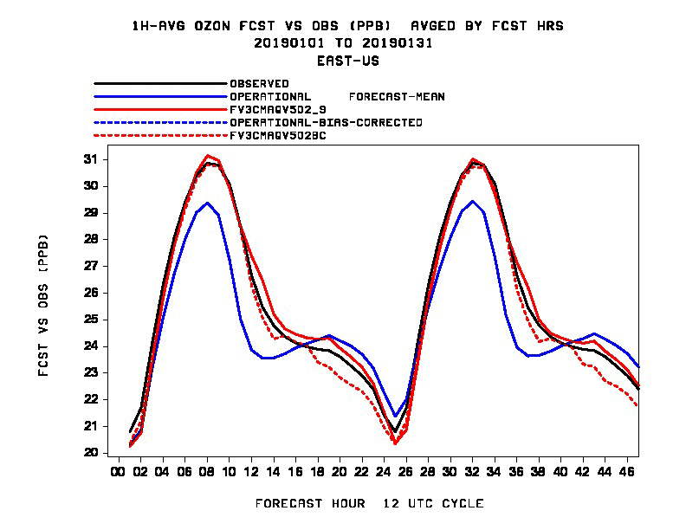
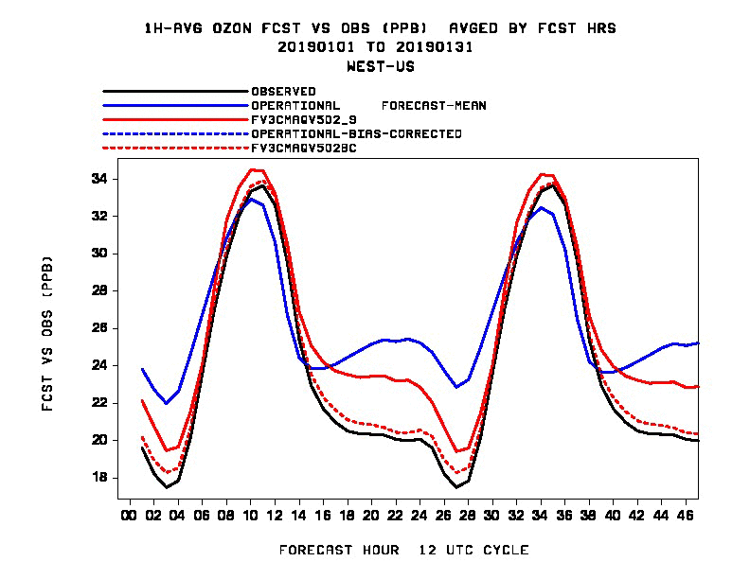
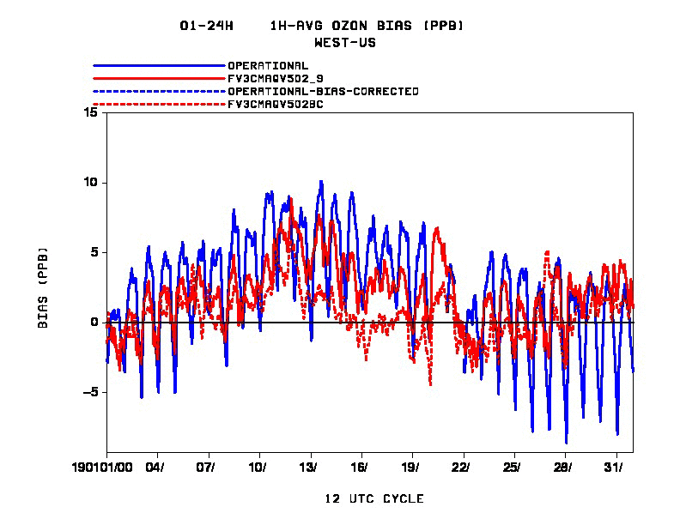
Statistical evaluation of FV3CMAQ O3 performance January 2019

Slide 6
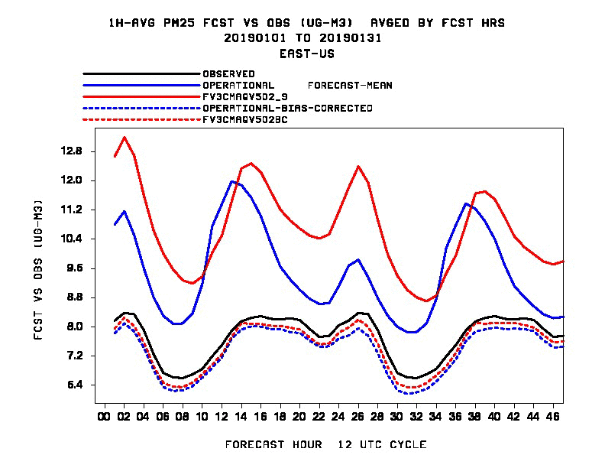
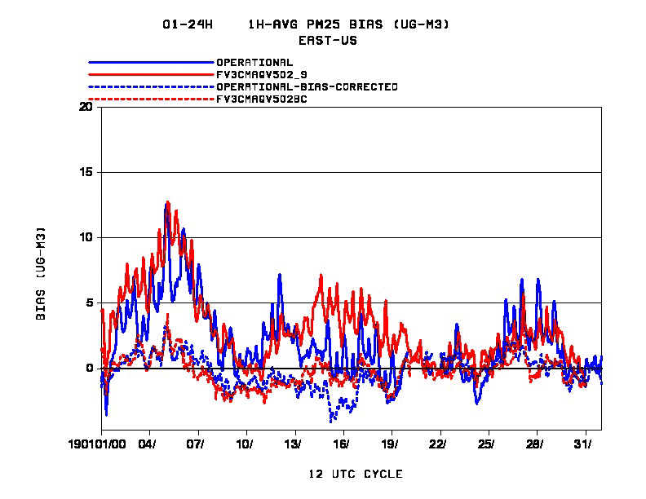
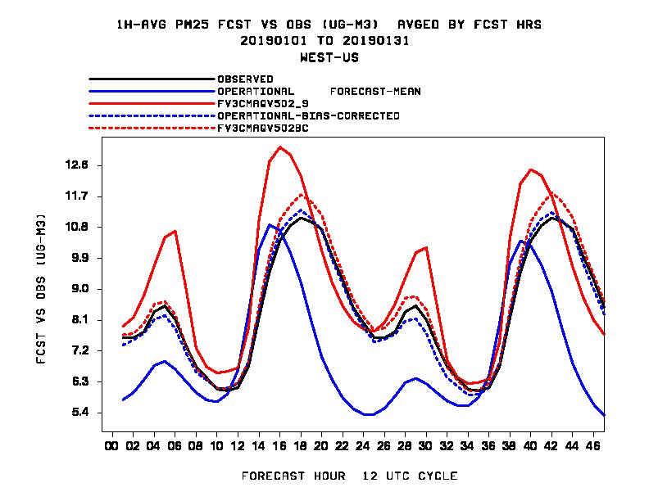
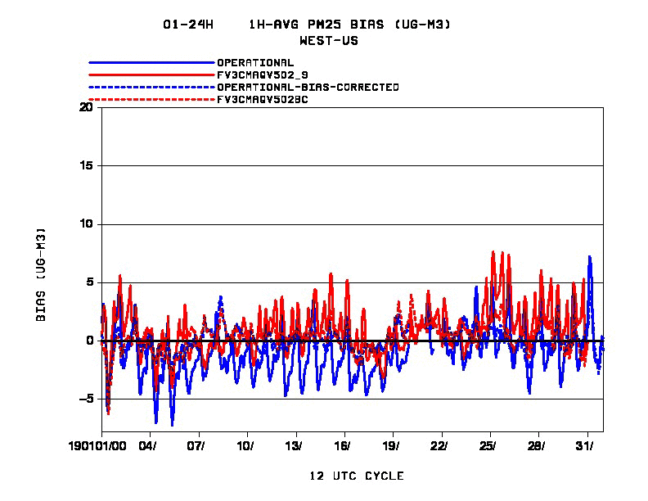
Statistical evaluation of FV3CMAQ PM_{2.5} performance January 2019

Slide 7
A quick summary of performance of CMAQ driven by FV3GFS
Performance in August 2018
- O₃: FV3CMAQ did better especially over the WUS
- PM_{2.5}: under-predicted over the EUS
- Bias correction: performs similarly for both
In January 2019
- O₃: FV3CMAQ did better
- PM_{2.5}: over-predicted, due to cold bias of FV3GFS?

