Slide 1
A prototype of the next generation regional air-quality forecast system (Online-CMAQ)
Jianping Huang, Ivanka Stajner, Fanglin Yang, Raffaele Montuoro, Jeff McQueen, Ho-Chun Huang, Kai Wang, Hsin-Mu Lin, Chan-Hoo Jeon, Perry Shafran, etc.
A joint effort among NWS/EMC, OAR/ARL, CSL, GSD, USRA, UMBC, GMU, U. of Colorado, NDSU, and NESDIS/STAR
05/19/2022

Slide 2
Outline
Motivation and objectives
UFS-based Online-CMAQ prototype
Preliminary testing and evaluations
Summary and an implementation plan
2

Slide 3
Motivation and objectives
Status
The GFS-driven CMAQ offline system provides 72-hr O₃ and PM_{2.5} forecast for CONUS, AK, and HI twice a day at 06z and 12z cycles.
Motivation
Wildfires, a major contributor to poor air quality have been increasing in the U.S. over the past several decades.
Current operational model suffers from large uncertainties in wildfire emissions with respect to emissions intensity, speciation, duration, and diurnal evolution as well as smoke plume rise determination
No any weather-air quality online coupling system has been tested from operational perspective at NOAA.
Objectives
To build up the next-generation online regional air quality forecast system for the UFS AQ application
To replace the operational air quality forecast system (GFS-CMAQ offline system) (to be implemented operationally in Q2 2023)
To better represent the impact of chemistry on weather predictions as a member of the RRFS
3

Slide 4
A flowchart of the Online-CMAQ system
Anthrop.
Emission
Wild Fire
Emission
(RAVE)
GEFS/Aero
+ GEOS/Chem
LBCs
NEXUS
CMAQ
(ML for Chem)
Chem. Data Assimilation
Satellite &
Surface obs.
GFS
(ICs/BCs)
UFS
(Atmos)
Verification
(METPlus)
Web
Display
POST
Bias Correction
Machine Learning
Products

Slide 5
Online-CMAQ within the UFS framework
NOAA Air Quality Model (AQM)
UFS-model
NUOPC Layer
AQM Infrastructure Layer
Read emissions (RAVE+ NEI)
Vertical Transport
IMPORT (includes grid)
Convection
Column Chemistry
(CMAQ)
Advection
Cloud and Radiation
Chemistry
Aerosols
EXPORT
CMAQ: Community Multiscale Air Quality; NUOPC: National Unified Operational Prediction Capability
RAVE: Regional ABI and VIIRS fire Emissions; NEI: National Emission Inventory

Slide 6
Features of the Online-CMAQ
Link the AQM with the UFS model dynamically
Using the same grids and physical schemes for meteorol. and chem. models
Transport (horizontal and vertical) and mixing processes of chemical species are handled by the atmospheric model.
Avoid the inconsistency between met and chem models (e.g., grid-mapping and loss of vertical levels) (model grids → write grids → AQ or CMAQ grids)
Two-way interactions between meteorological and chemical fields
Feed the AQ model at each integration time step in stead of an hourly interval
Provide the feedback to weather predictions (aerosol radiative feedback) (e.g., wildfires)
Heavy computational burden (challenge)
Running time: increased by at least 8 times
Variable number: 206 parameters in dyn files
File size: large (20 GB dyn and 40 GB restart for the NA at a grid-spacing of 13 km)
6

Slide 7
Model configurations for three simulations (or forecasts)
 | Oper (prod) (NAM-AQM) | v150_a (dev) (FV3GFS-AQM) | v161_a (UFS-AQM)
Met+CMAQ | NAM+CMAQv5.1.2 | GFSv15+CMAQv5.2 | UFS_Atmos+CMAQv5.2
Gas mechanism /Aerosol module | CB05 + Aero5 | CB06r3 + Aero6 | CB06r3 + Aero6
Grid_Spacing and vertical levels | 12 km / 35 levels | 13 km / 65 levels | 13 km / 65 levels
Anthropogenic Emi. | NEI 2016 | NEI 2016 (no plume rise) | NEI 2016 (no plume rise)
Fire Emission | HMS + BlueSky | RAVE (hourly, 0.03 deg.) | RAVE (hourly, 0.03 deg.)
Physics or CCPP suites | NAM (NMMB) | GFSv15_P2 | GFSv15_P2
Chem-LBCs | GEOS-Chem + NGACv2 | GEOS-Chem + GEFS/Aero | GEOS-Chem + GEFS/Aero

Slide 8
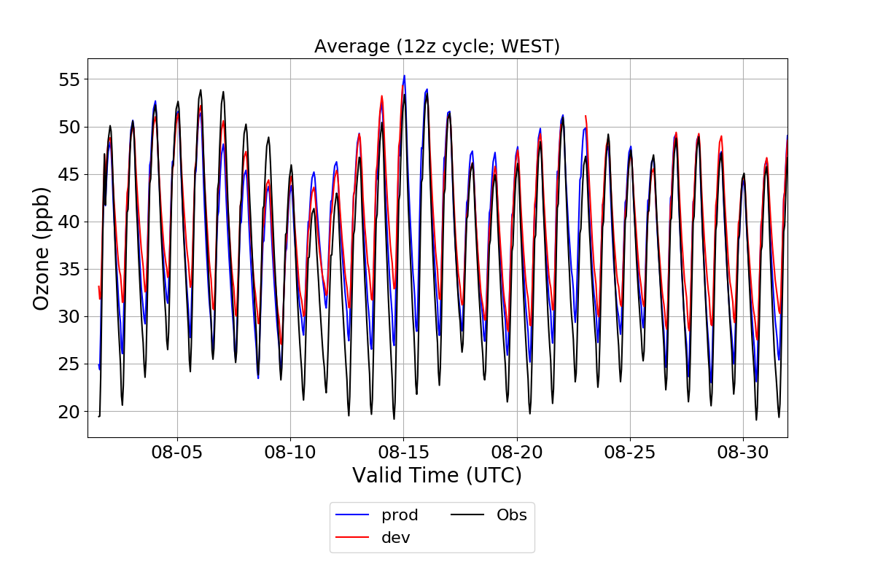
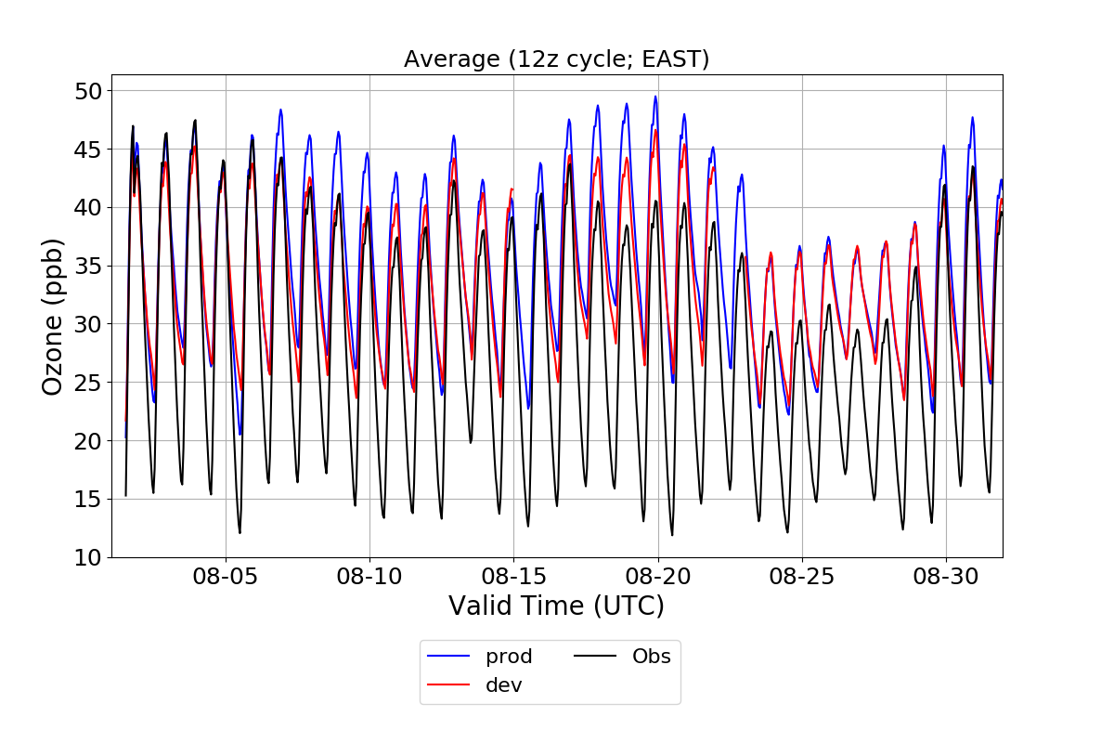
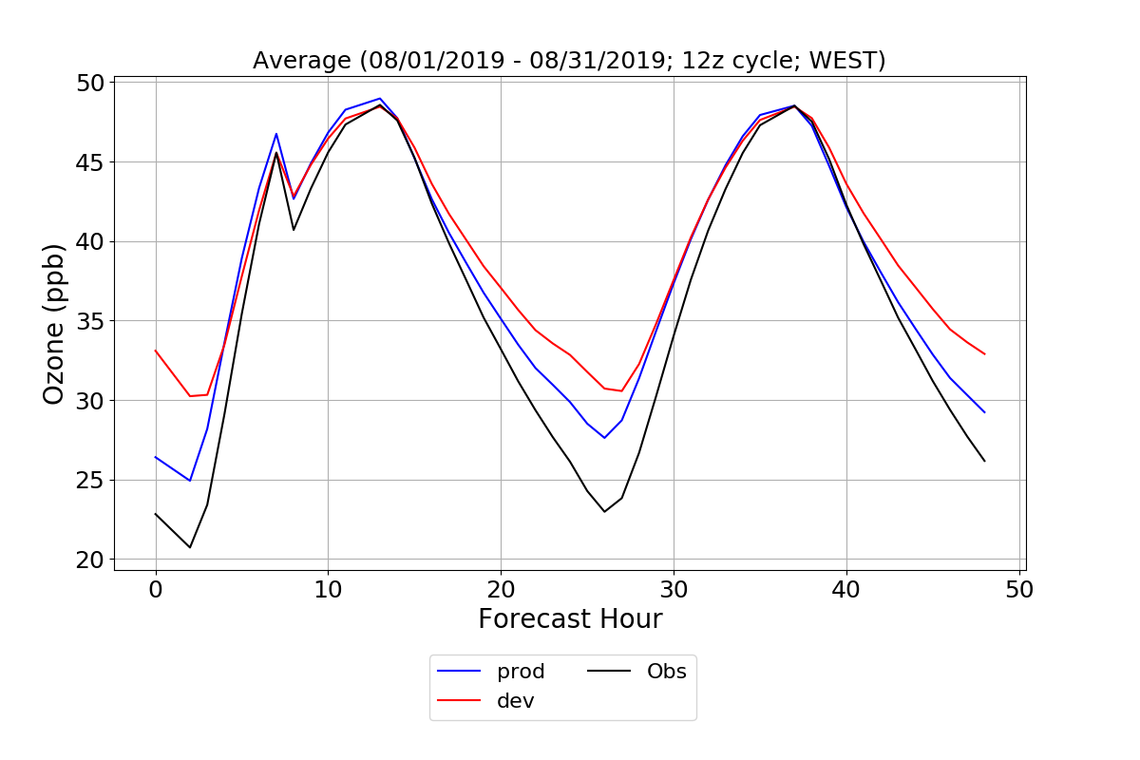
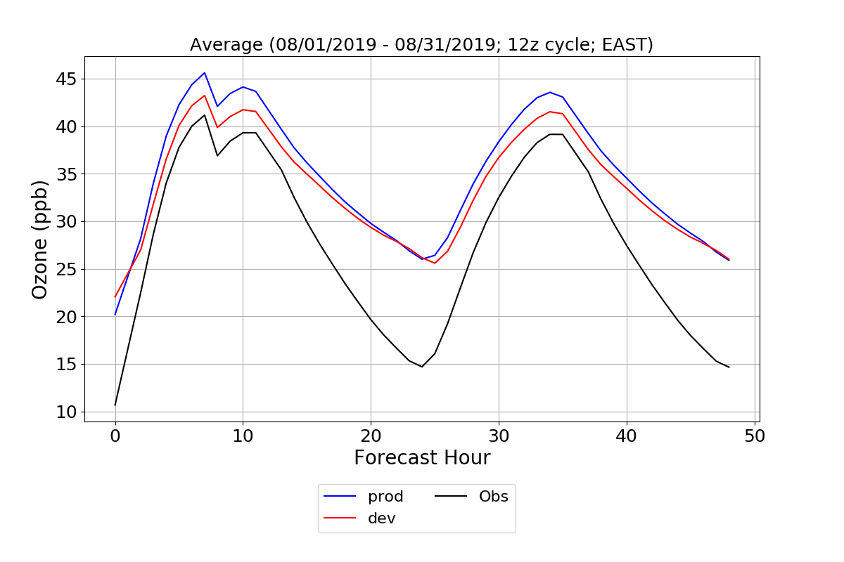
O₃

Slide 9
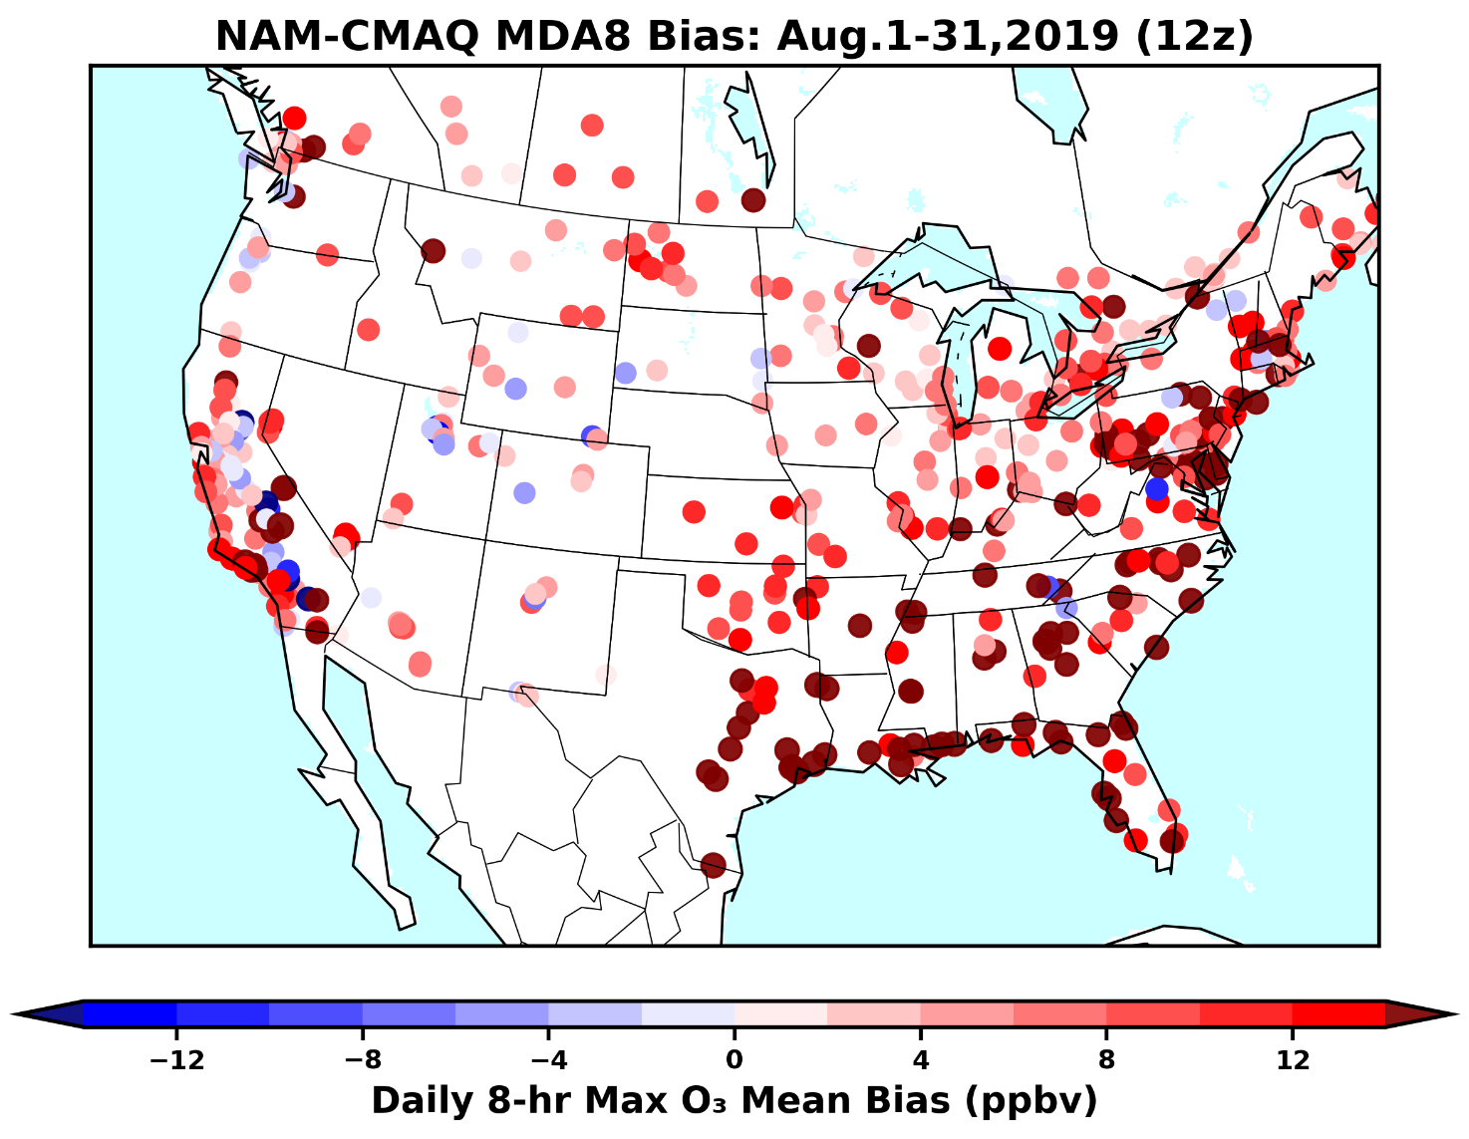
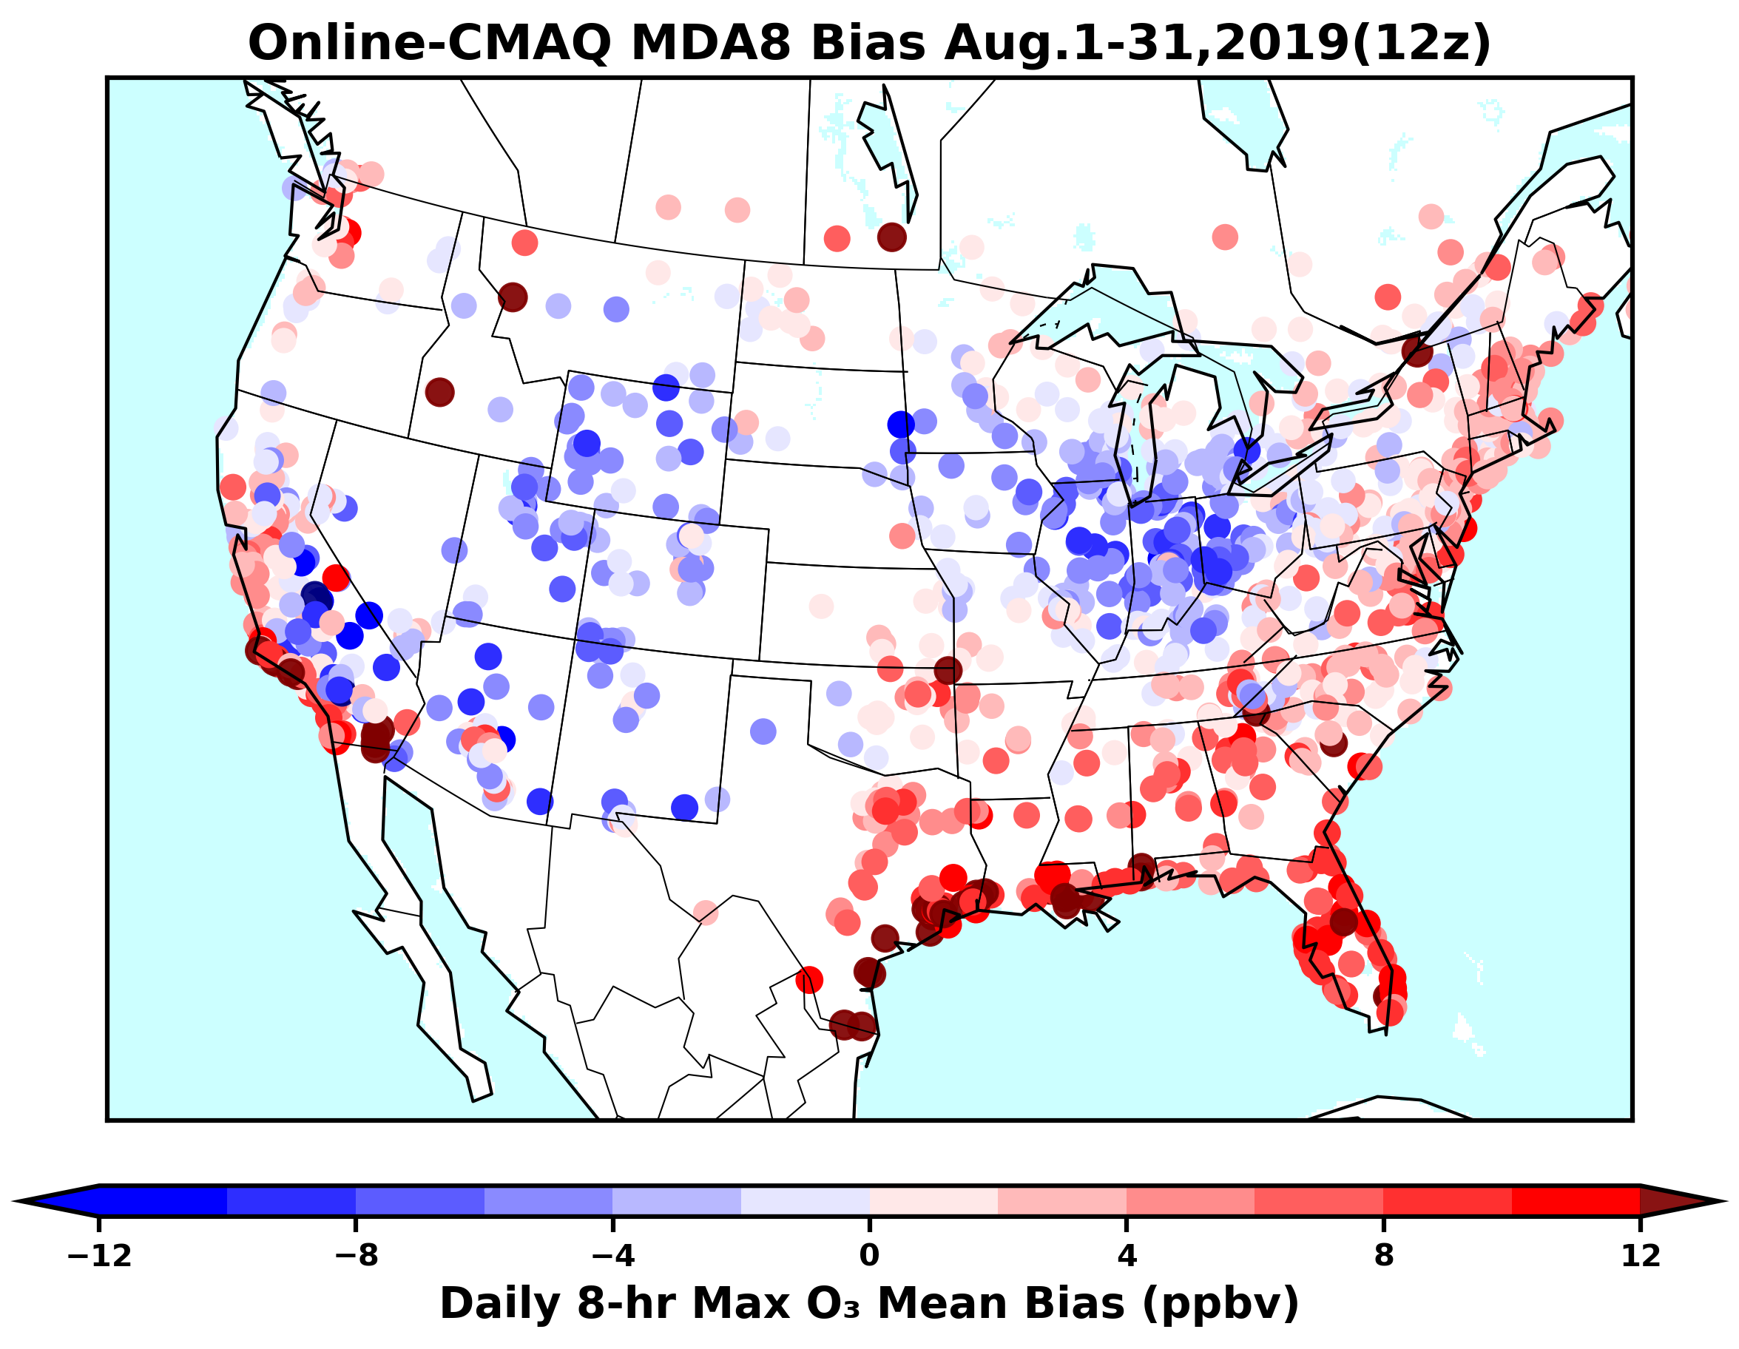
A comparison of monthly mean daily 8-hr maximum surface O₃ (MDA8) forecast bias (forecast – obs.) between the NAM-CMAQ (operational) and the Online-CMAQ forecast in August 2019.

Slide 10
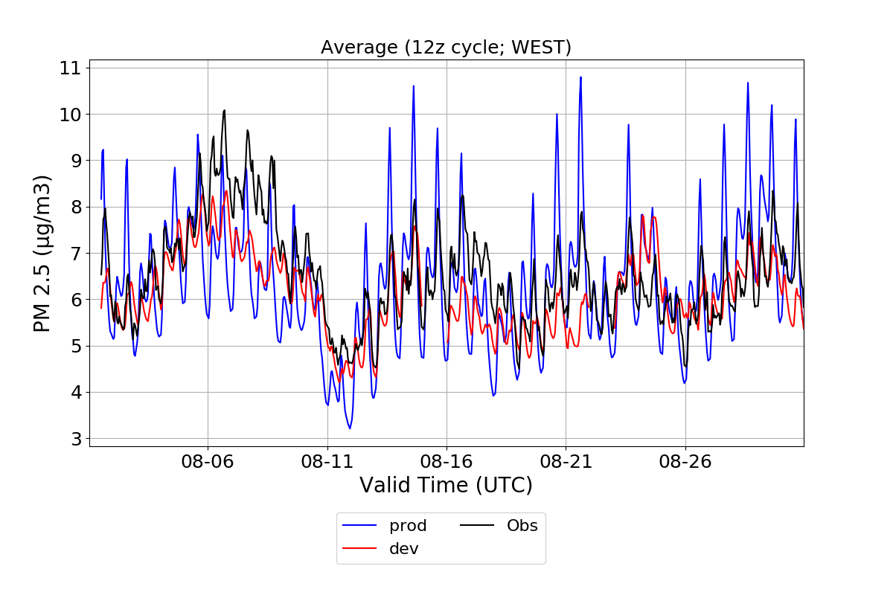
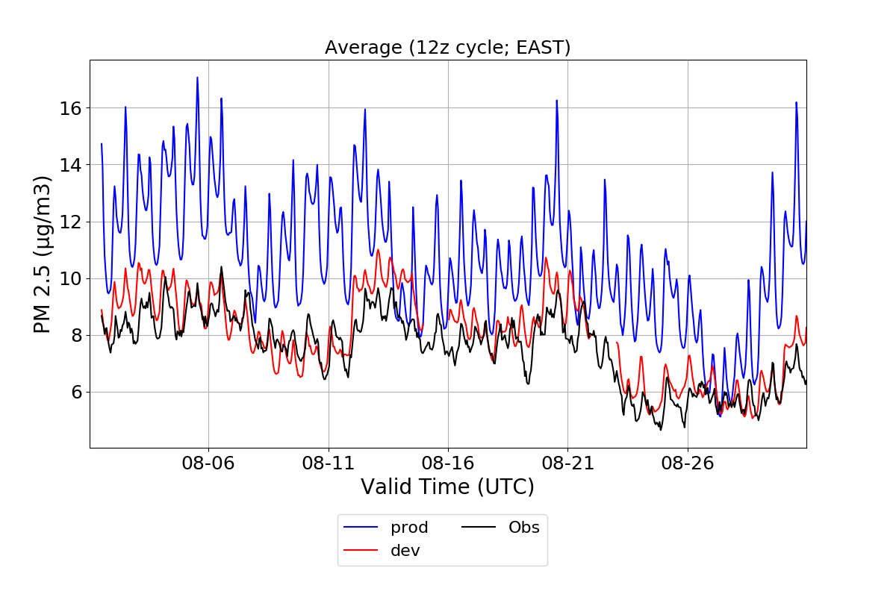
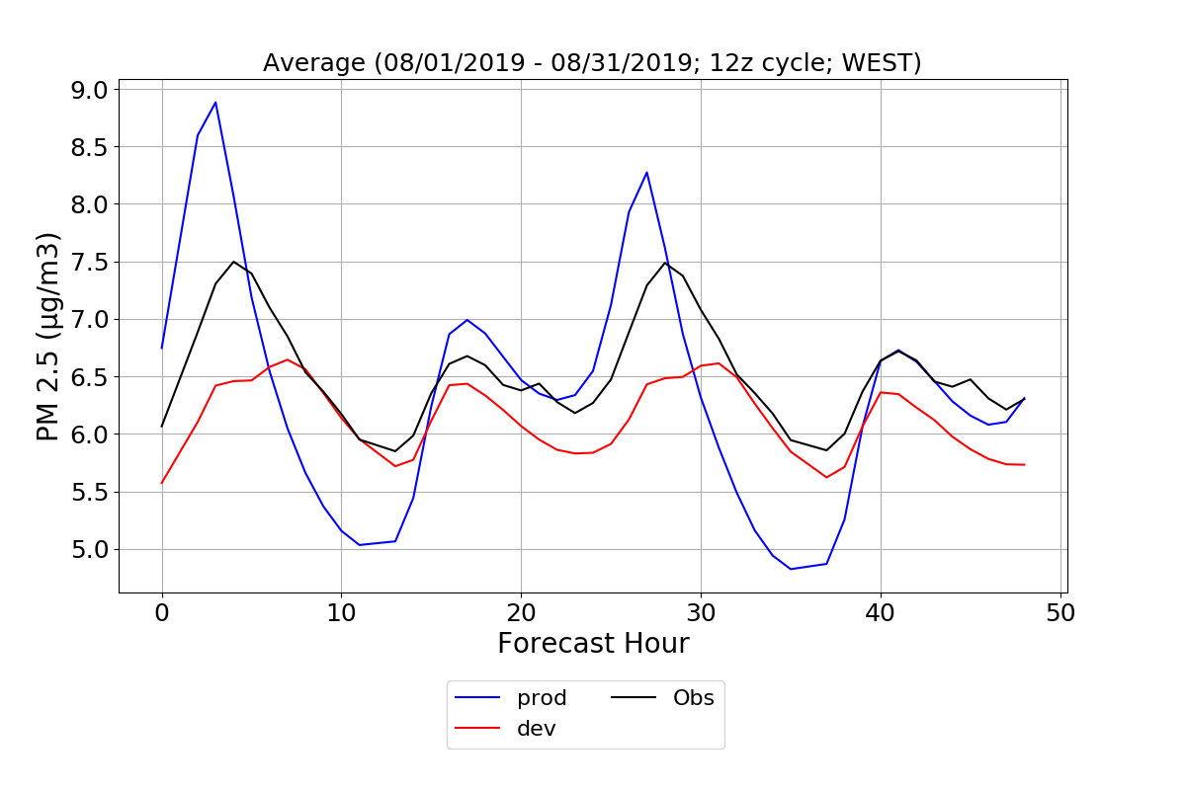
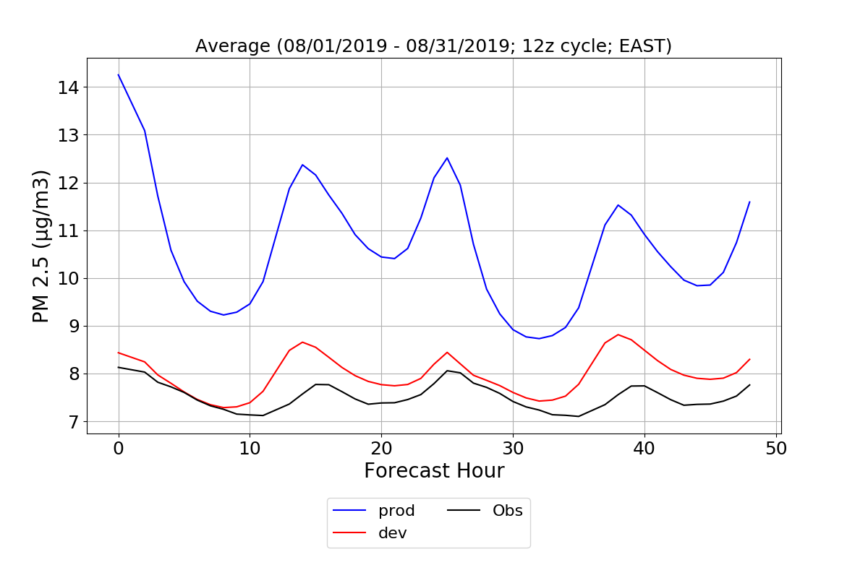

Slide 11
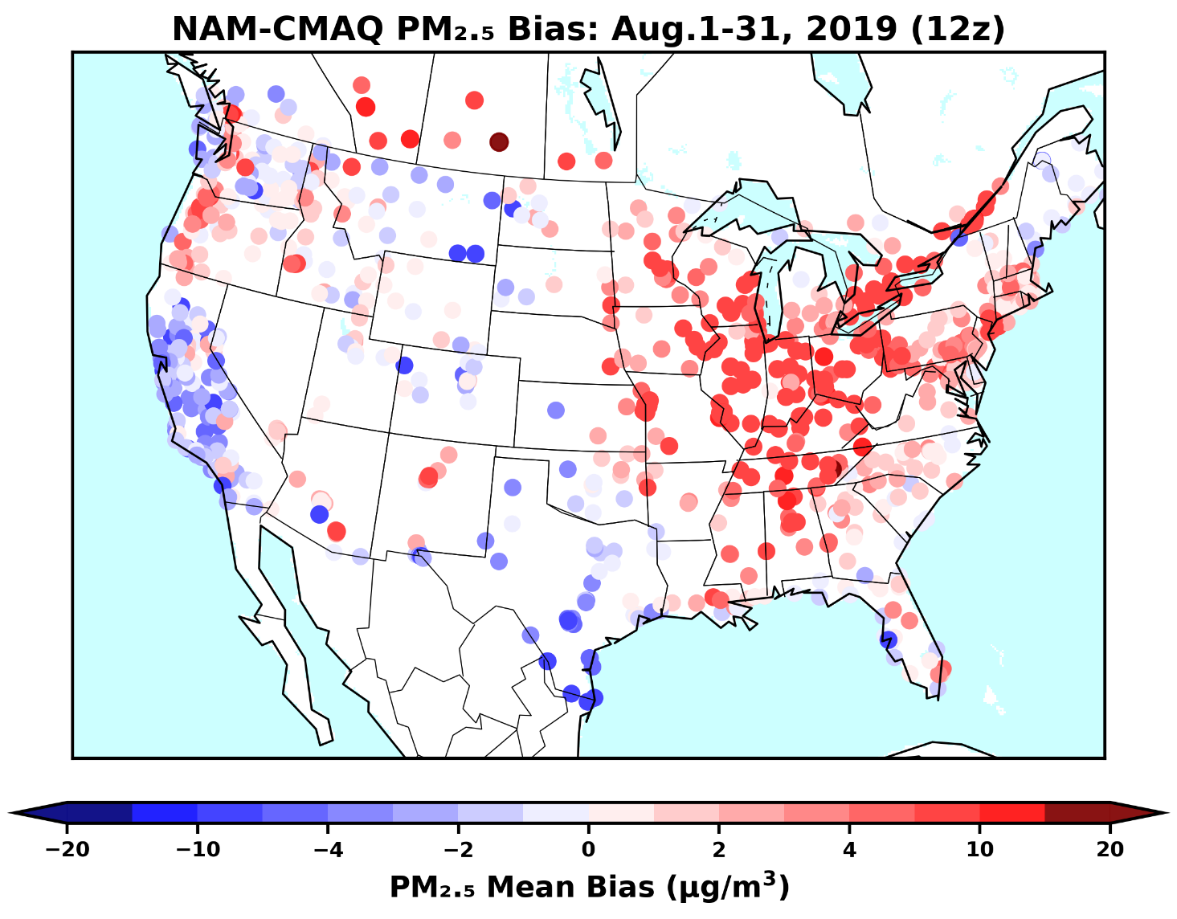
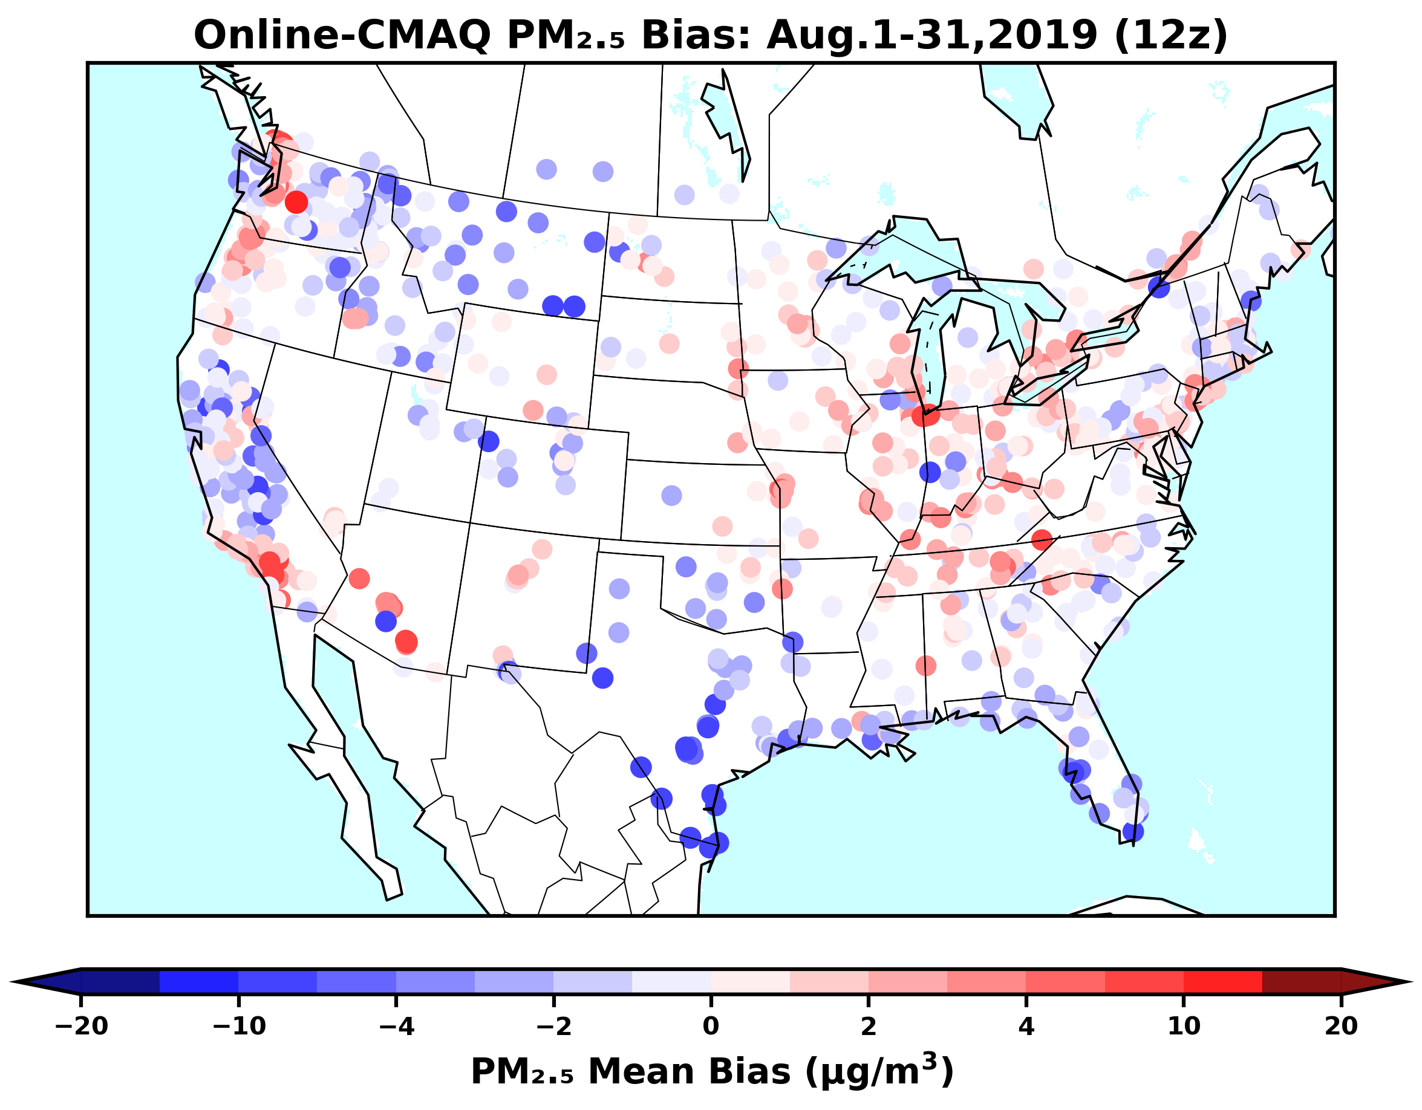
A comparison of monthly mean daily 8-hr maximum surface O₃ (MDA8) forecast bias (forecast – obs.) between the NAM-CMAQ (operational) and the Online-CMAQ forecast in August 2019.

Slide 12
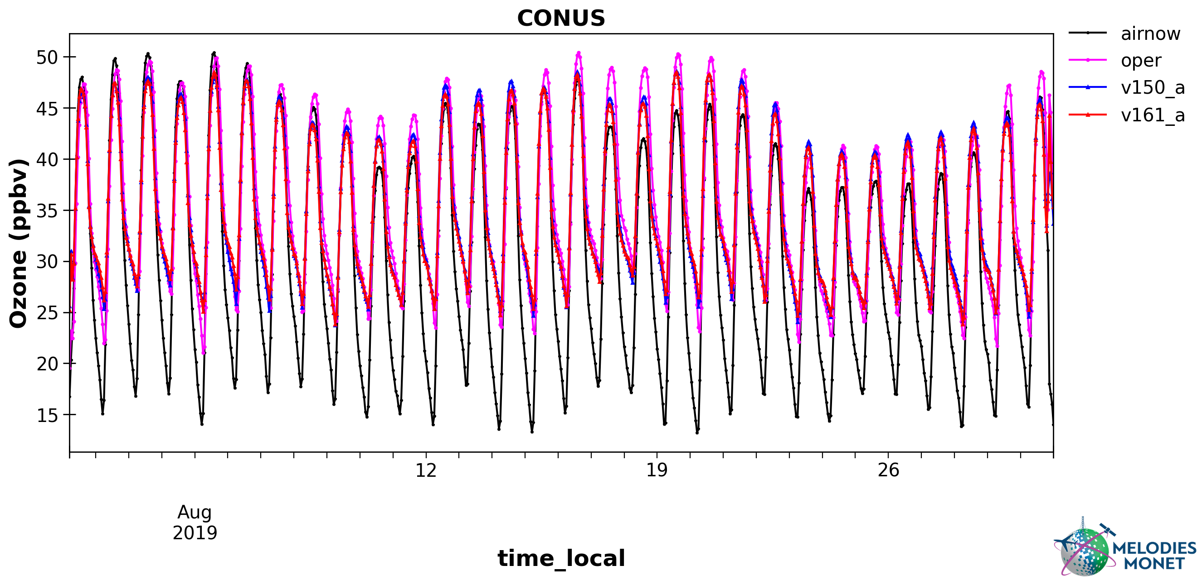
Performance of O₃
12

Slide 13
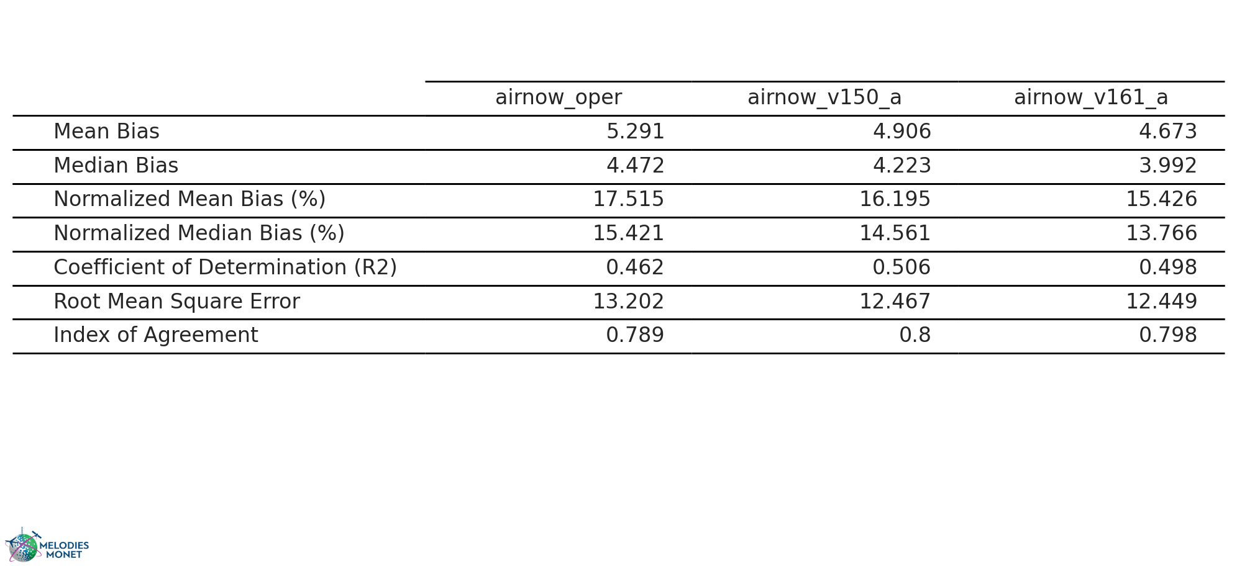
Statistical evaluation of predited O₃ over CONUS in August 2019
13

Slide 14
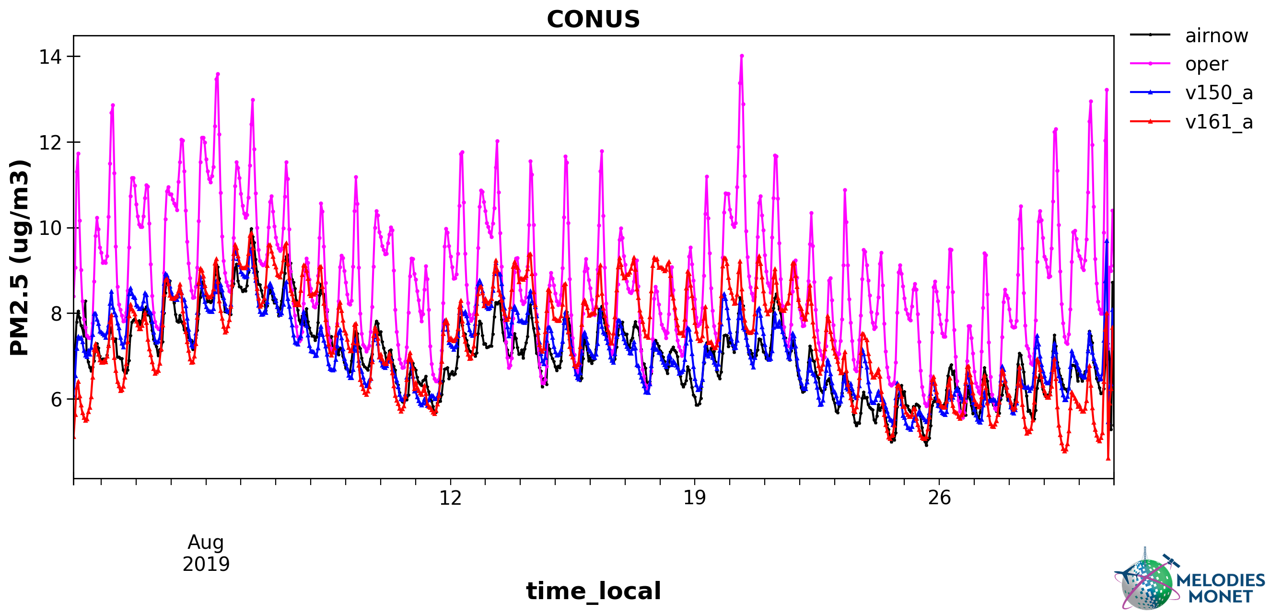
Performance of PM_{2.5}
14

Slide 15
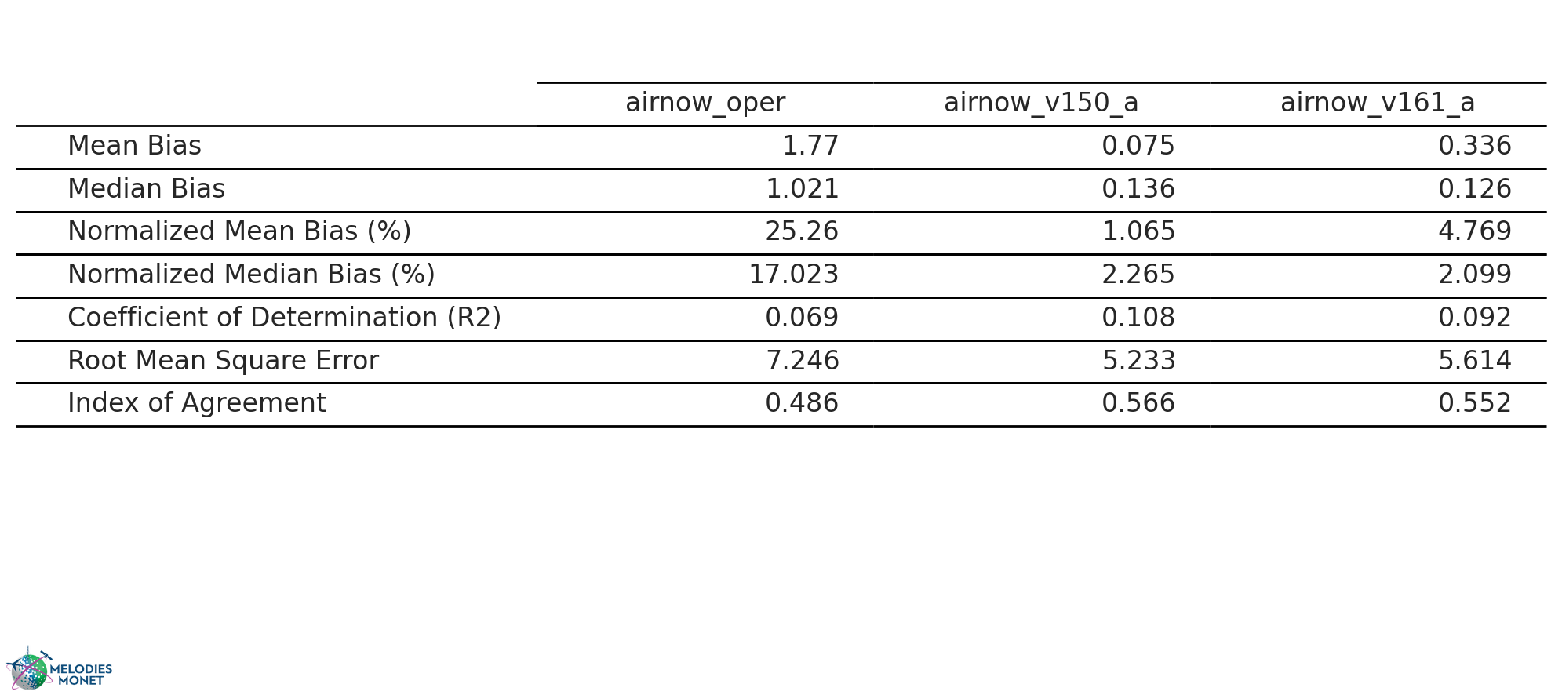
Statistical evaluation of predited CONUS PM_{2.5} over CONUS in August 2019
15

Slide 16
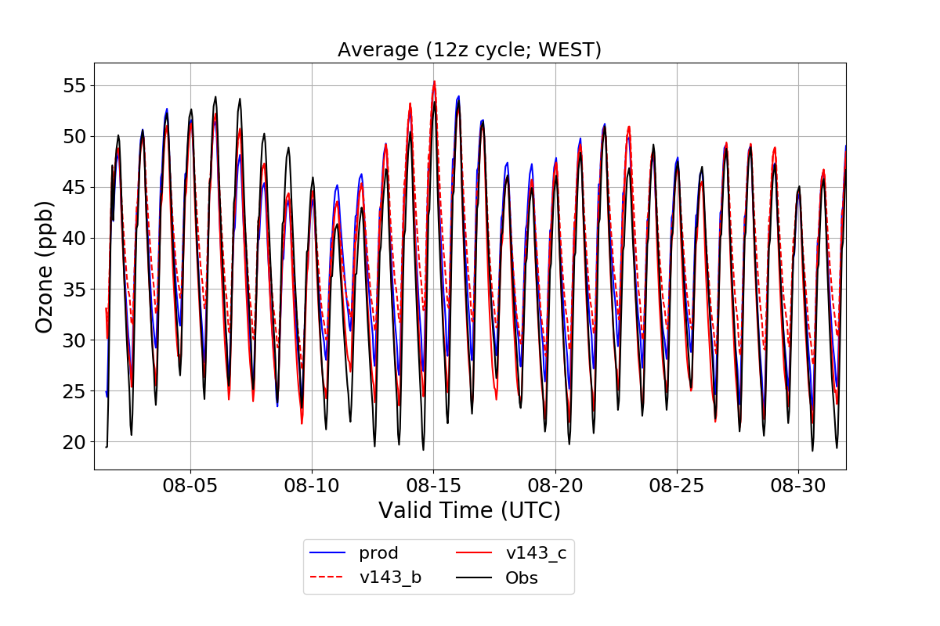
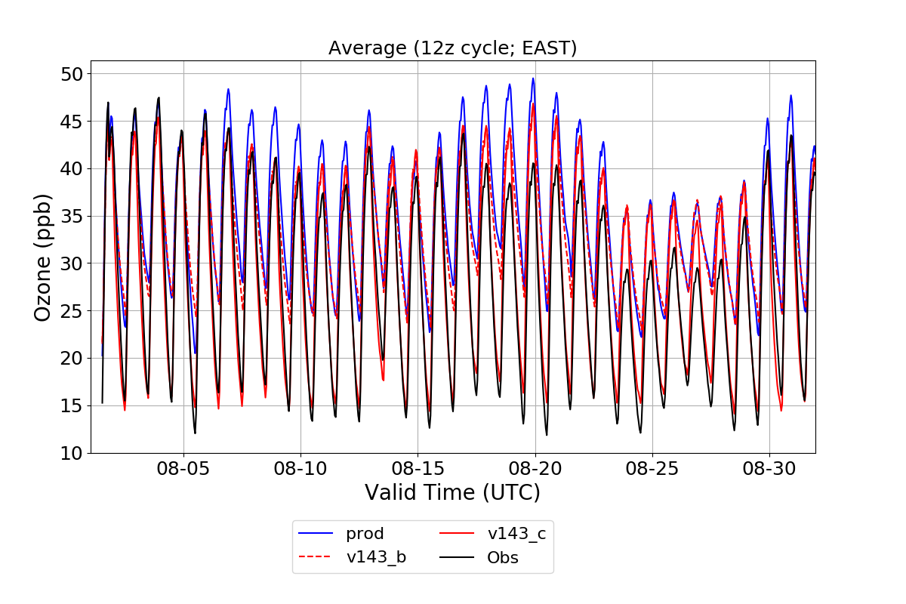
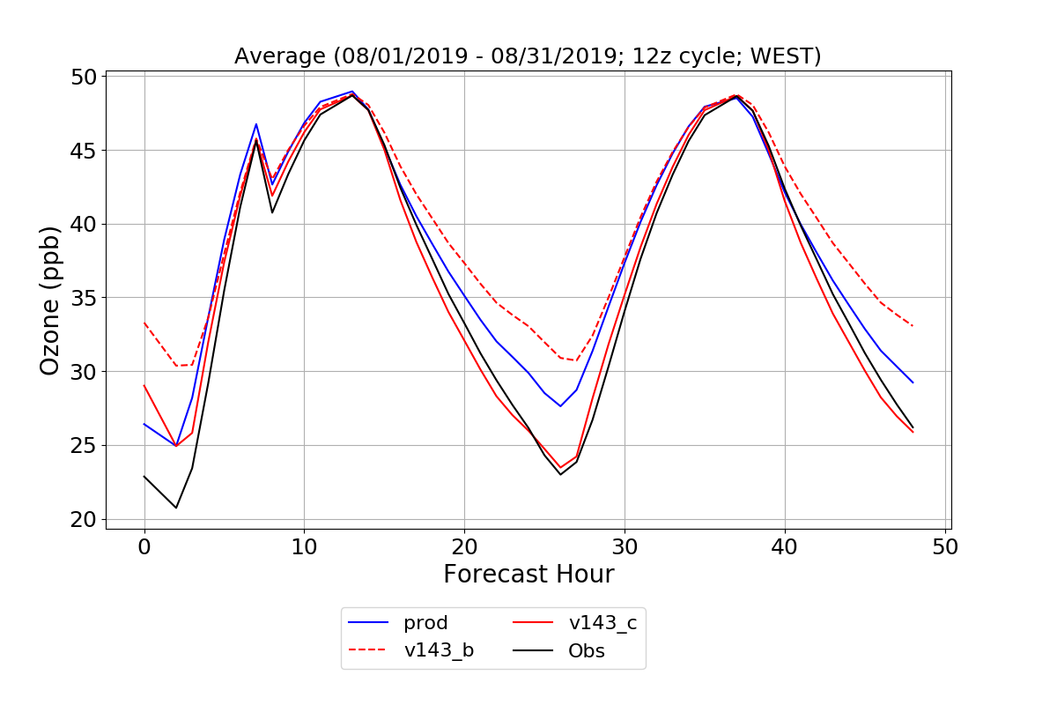
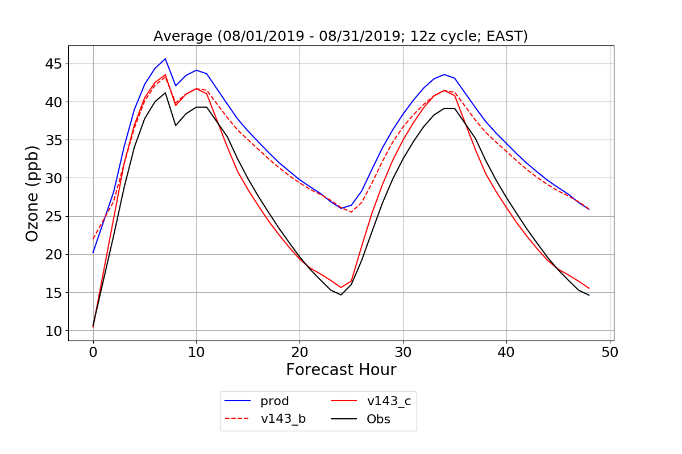
WUS
EUS
Adjustment of eddy diffusivity improves nighttime over-prediction of O₃ significantly. Kc = f(R_{i})Kt , v143_b is same as v150_a

Slide 17
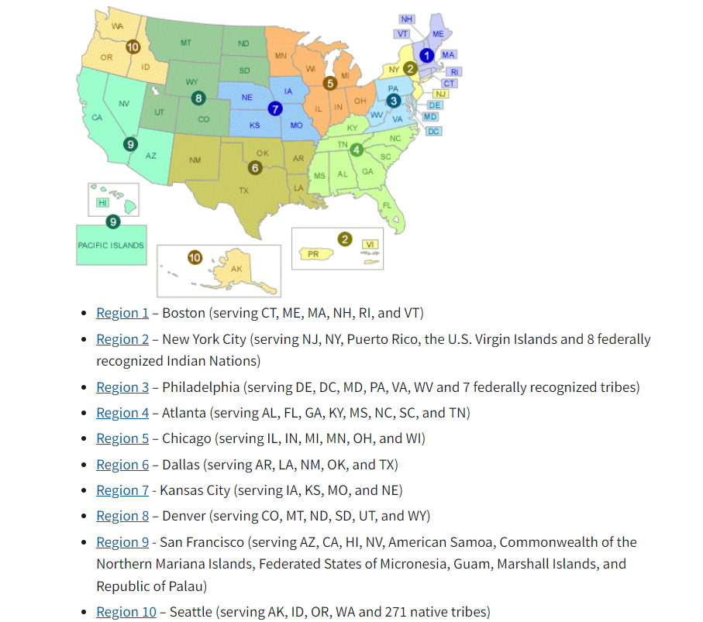
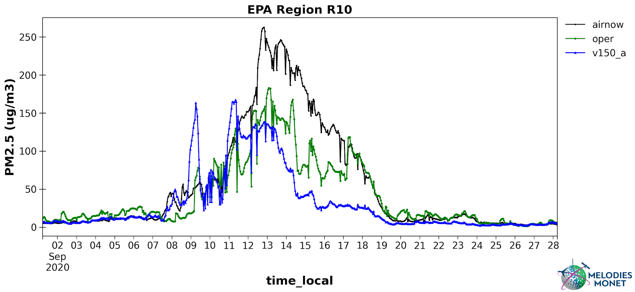
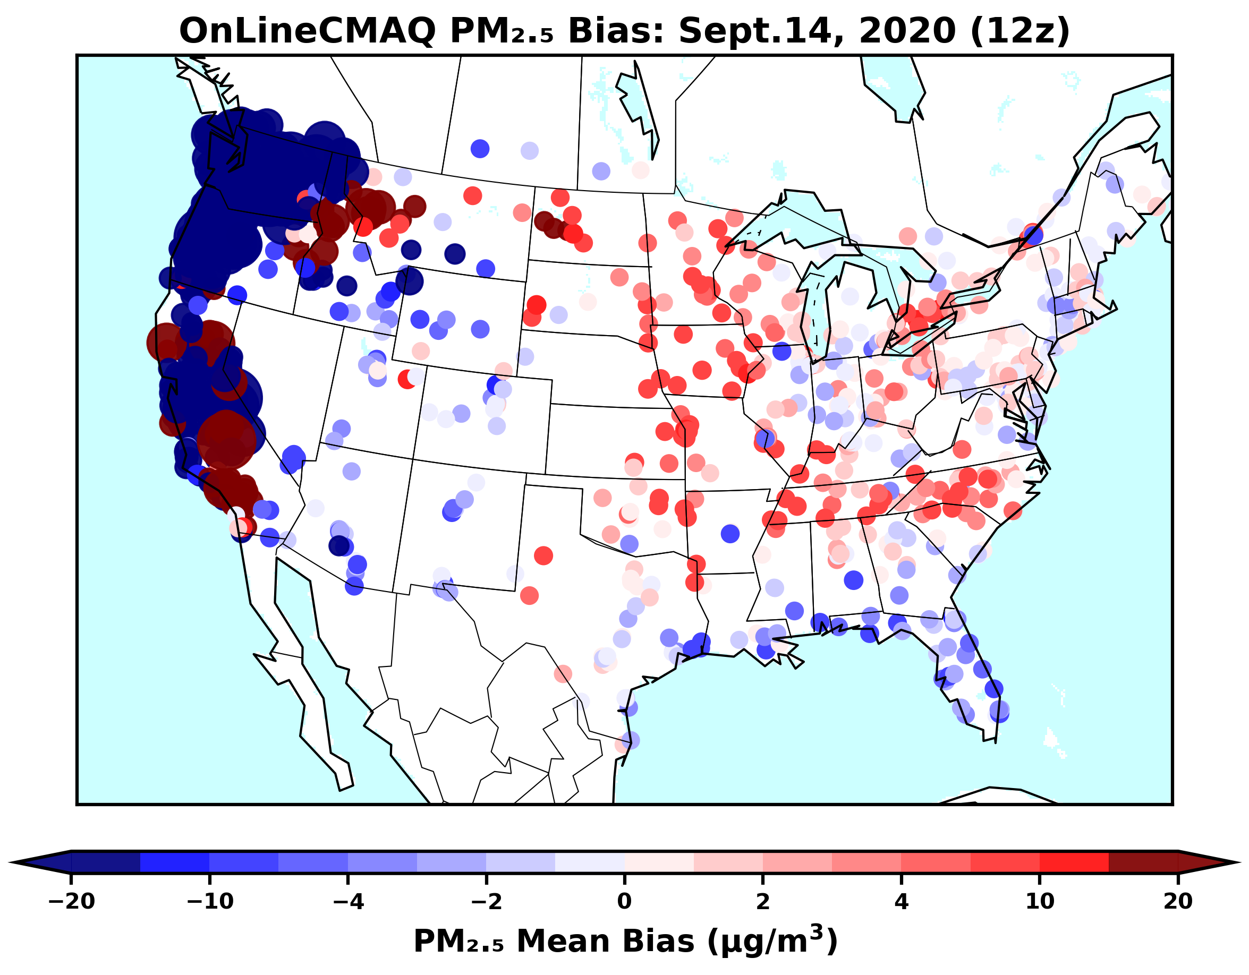
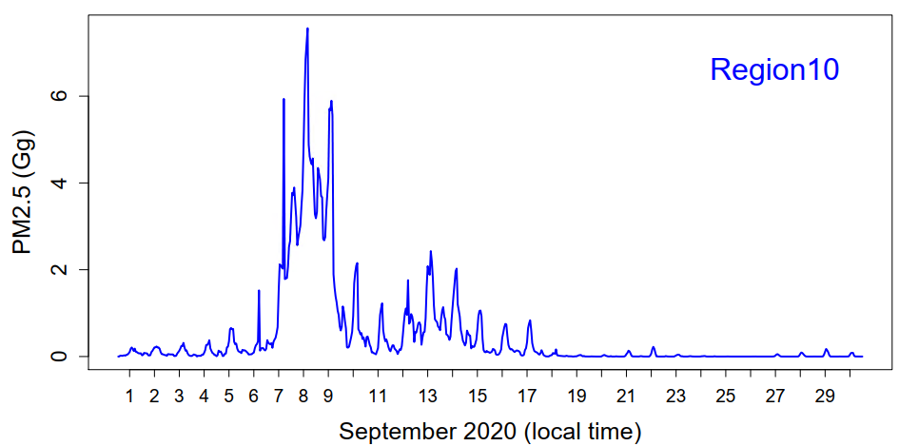
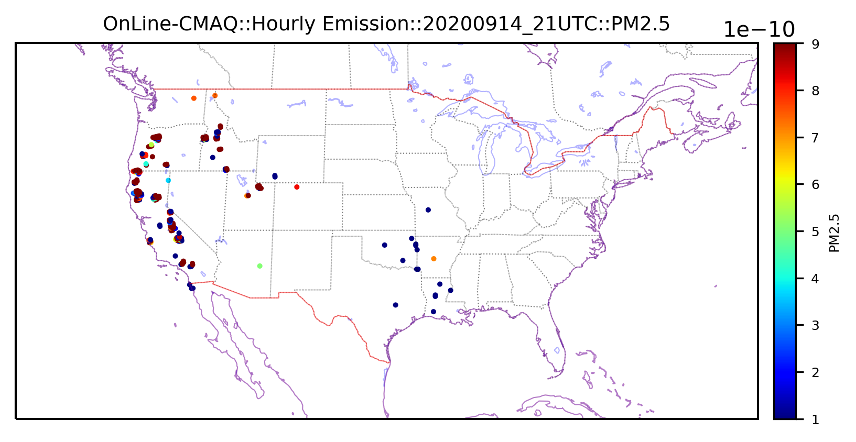
PM_{2.5} FCST Bias
RAVE:
PM_{2.5} fire emis.

Slide 18
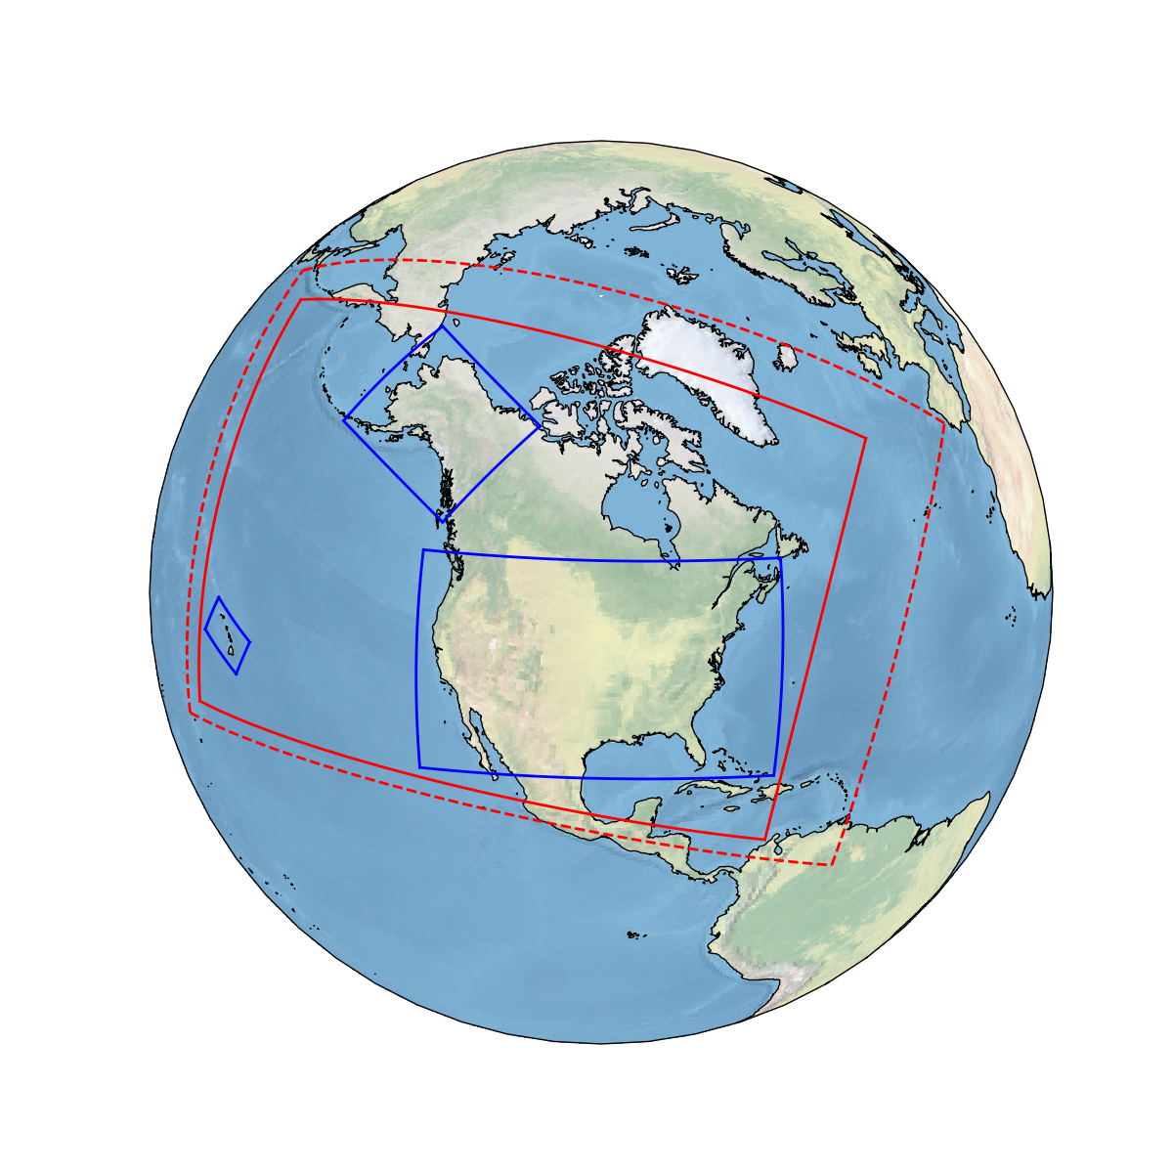
CS: Operational AQM CONUS
AK: Operational Alaska
HI: Operational Hawai
G1: New RRFS domain at 3 km
G2: AQM_NA at 13 km
AK
G1
G2
HI
CS

Slide 19
Summary, on-going work, and an implementation plan
UFS-based Online-CMAQ prototype has been developed and tested over the CONUS domain.
The Online system performs better than the previous operational model (i.e., NAM-driven CMAQ), especially PM_{2.5} predictions.
More capabilities such as Data Assimilation, Bias Correction, and AI emulation for accelerated transport of atmos. tracers are under development and will be integrated into the system.
The system has been testing over an extended domain to cover CONUS, AK, and HI.
The system will be running in real-time from June 1st, code will be frozen on Dec. 1st 2022, be delivered on March 1st, and be implemented in June 2023.

Slide 20
Backup

